Slide 1
Machine Guarding
OSHA 10-hour Outreach Training
General Industry
Notes:
Terminal Objective:
Given current OSHA and industry information regarding general industry worksite illnesses, injuries, and/or fatalities, the student will be able to recognize hazards associated with machinery that has improper or missing guards.
References for Trainer:
Standards that have been established to ensure safe operation of machinery include:
1910 Subpart O, which includes machine guarding; point of operation guarding; guarding required at point of operation for specific machines; barrels, containers, and drums; exposure of blades; and anchoring fixed machinery
1910 Subpart R, which includes machine guarding requirements for special industries such as textiles, bakery equipment, and telecommunications
1910.147 Lockout/tagout
Policies, procedures, and Consensus Standards
National Emphasis Program on Amputations (CPL 03-00-019)
Additional directives
ANSI standards
Source: https://www.osha.gov/SLTC/machineguarding/standards.html

Slide 2
Introduction
Possible machinery-related injuries include:
Crushed fingers or hands
Amputations
Burns
Blindness
A good rule to remember is:
Any machine part, function, or process which may cause injury must be safeguarded.
Notes:
Many accidents result from persons working on, or around, moving machinery. These accidents could have been prevented by the installation and proper maintenance of guarding. The goal of this training is to make the guarding of all equipment as easily understood as possible and re-enforce the safe working procedures that must always be in place around dangerous equipment.
This list of accidents is as long as it is horrifying.
Safeguards are essential for protecting workers from needless and preventable injuries.
Where the operation of a machine can injure the operator or other workers, the hazard must be controlled or eliminated.
National Emphasis Program on Amputations*. CPL 03-00-019, (August 13, 2015). Describes policies and procedures for implementing a National Emphasis Program (NEP) to identify and to reduce workplace machinery and equipment hazards which are causing or likely to cause amputations.

Slide 3
Introduction
Lesson objectives:
Identify the main causes of machinery accidents.
Recognize basic machinery parts that expose workers to hazards.
Recognize workplace situations involving machinery that requires guarding.
Identify the requirements for safeguards.
Identify types of machine guards including types of devices used to safeguard machines.
Notes:
These are the learning objectives for this module. The main focus is hazard recognition and avoidance of the more common machine guard hazards.
Additional information and support on this topic can be found on OSHA’s Machine Guarding Topic page and eTool (www.osha.gov)…
https://www.osha.gov/SLTC/machineguarding/index.html
https://www.osha.gov/SLTC/etools/machineguarding/index.html

Slide 4
Machinery Accidents
Examples of how machine accidents can occur:
Reaching-in to “clear” equipment
Not using Lockout/Tagout
Unauthorized persons doing maintenance or using the machines
Missing or loose machine guards

Slide 5

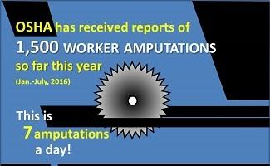
Machinery Accidents
Amputations:
Unguarded/inadequately safeguarded machinery
Materials handling activities
Activities involving
stationary machines
Source: OSHA
Source: OSHA
Notes:
“Amputations are widespread and involve a variety of activities and equipment. Each year, thousands of workers lose fingers, hands, feet, and other body parts–mostly through compression, crushing, or by getting them caught between or struck by objects. Most amputations involve fingertips” (OSHA 2015).
Source: https://www.osha.gov/Publications/amputations-qc.html
Amputations occur most often in the following situations
1. Operating unguarded or inadequately safeguarded machinery
2. Materials handling, including during use of forklifts, compactors, powered and non-powered hand tools
3. During activities involving stationary machines
a. Setting-up
b. Threading
c. Preparing
d. Adjusting
e. Cleaning
f. Lubricating
g. Maintaining
h. Clearing jams

Slide 6
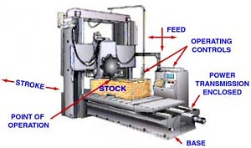
Basic Machinery Parts and Hazards
Three fundamental machine areas:
Point of operation
Power transmission device
Operating controls – mechanical or electric
power control
Source: OSHA
Notes:
OSHA Machine Guarding eTool - https://www.osha.gov/SLTC/etools/machineguarding/intro.html
“All machines consist of three fundamental areas: the point of operation, the power transmission device, and the operating controls. Despite all machines having the same basic components, their safeguarding needs widely differ due to varying physical characteristics and operator involvement” (OSHA 2007).

Slide 7
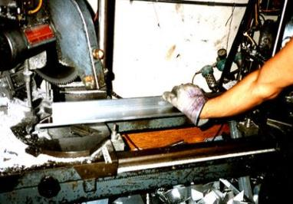
Basic Machinery Parts and Hazards
Point of operation:
Where work is performed on material
Examples
  Cutting
  Shaping
  Boring
  Forming
Source: OSHA DTE
Notes:
OSHA Machine Guarding eTool - https://www.osha.gov/SLTC/etools/machineguarding/intro.html
“The point of operation is where work is performed on the material, such as cutting, shaping, boring, or forming of stock” (OSHA 2007).

Slide 8
Basic Machinery Parts and Hazards
Power transmission device:
Parts that transmit energy to the part of the machine performing work
Examples
  Flywheels
  Pulleys
  Belts
  Connecting rods
  Couplings
  Cams
  Spindles
  Chains
  Cranks
  Gears
Notes:
OSHA Machine Guarding eTool - https://www.osha.gov/SLTC/etools/machineguarding/intro.html
“The power transmission apparatus is all components of the mechanical system which transmit energy to the part of the machine performing the work. These components include flywheels, pulleys, belts, connecting rods, couplings, cams, spindles, chains, cranks, and gears” (OSHA 2007).

Slide 9
Basic Machinery Parts and Hazards
Hazardous motions and actions:
Motions
  How the machine part moves
  Examples: rotating, in-running nip points, reciprocating, and transversing
Actions
  Operation that the machine part performs
  Examples: cutting, punching, shearing, bending
Notes:
OSHA Machine Guarding eTool - https://www.osha.gov/SLTC/etools/machineguarding/motions_actions.html
“A wide variety of mechanical motions and actions may present hazards to the worker. These can include the movement of rotating members, reciprocating arms, moving belts, meshing gears, cutting teeth, and any parts that impact or shear. These different types of hazardous mechanical motions and actions are basic in varying combinations to nearly all machines, and recognizing them is the first step toward protecting workers from the danger they present. The basic types of hazardous mechanical motions and actions are:
Motions [how the machine part is moving]
Rotating
In-running nip points
Reciprocating
Transversing
Actions [operation that the machine part is performing]
Cutting
Punching
Shearing
Bending”
(OSHA 1992)

Slide 10
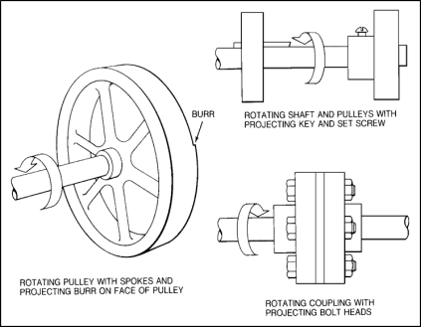

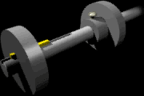
Basic Machinery Parts and Hazards
Rotating parts with hazardous projections
Source of graphics: OSHA
Notes:
OSHA Machine Guarding eTool - https://www.osha.gov/SLTC/etools/machineguarding/motions_actions.html
“Rotating motion can be dangerous; even smooth, slowly rotating shafts can grip hair and clothing, and through minor contact force the hand and arm into a dangerous position. Injuries due to contact with rotating parts can be severe. Collars, couplings, cams, clutches, flywheels, shaft ends, spindles, meshing gears, and horizontal or vertical shafting are some examples of common rotating mechanisms which may be hazardous. The danger increases when projections such as set screws, bolts, nicks, abrasions, and projecting keys or set screws are exposed on rotating parts” (OSHA 2007).

Slide 11

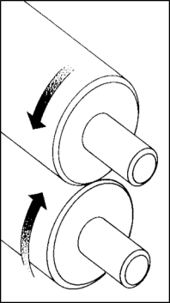


Basic Machinery Parts and Hazards
Common nip points on rotating parts
Source of graphics: OSHA
Notes:
OSHA Machine Guarding eTool - https://www.osha.gov/SLTC/etools/machineguarding/motions_actions.html
“In-running nip point hazards are caused by the rotating parts on machinery. There are three main types of in-running nips. Parts can rotate in opposite directions while their axes are parallel to each other. These parts may be in contact (producing a nip point) or in close proximity. In the latter case, stock fed between two rolls produces a nip point. As seen here, this danger is common on machines with intermeshing gears, rolling mills, and calenders.” (OSHA 2007).

Slide 12
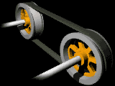
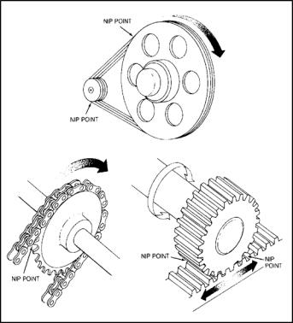
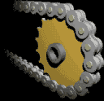
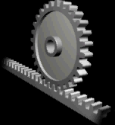
Basic Machinery Parts and Hazards
Nip points between rotating elements and parts with longitudinal motions
Source of graphics: OSHA
Notes:
OSHA Machine Guarding eTool - https://www.osha.gov/SLTC/etools/machineguarding/motions_actions.html
“Nip points are also created between rotating and tangentially moving parts. Some examples would be: the point of contact between a power transmission belt and its pulley, a chain and a sprocket, and a rack and pinion.” (OSHA 2007).

Slide 13


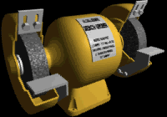
Basic Machinery Parts and Hazards
Nip points between rotating machine components
Source of graphics: OSHA
Notes:
OSHA Machine Guarding eTool - https://www.osha.gov/SLTC/etools/machineguarding/motions_actions.html
“Nip points can occur between rotating and fixed parts which create a shearing, crushing, or abrading action. Examples are: spoked handwheels or flywheels, screw conveyors, or the periphery of an abrasive wheel and an incorrectly adjusted work rest and tongue.” (OSHA 2007).

Slide 14

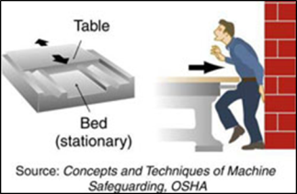
Basic Machinery Parts and Hazards
Reciprocating motions:
  Back-and-forth
  Up-and-down
Source: OSHA
Notes:
OSHA Machine Guarding eTool - https://www.osha.gov/SLTC/etools/machineguarding/motions_actions.html
“Reciprocating motions may be hazardous because, during the back-and-forth or up-and-down motion, a worker may be struck by or caught between a moving and a stationary part.” (OSHA 2007).

Slide 15
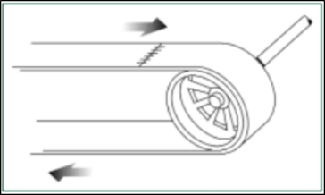
Basic Machinery Parts and Hazards
Transverse motion – movement in straight, continuous line
Source of graphics: OSHA
Notes:
OSHA Machine Guarding eTool - https://www.osha.gov/SLTC/etools/machineguarding/motions_actions.html
“Transverse motion (movement in a straight, continuous line) creates a hazard because a worker may be struck or caught in a pinch or shear point by the moving part.” (OSHA 2007).

Slide 16

Basic Machinery Parts and Hazards
Cutting action – may involve rotating, reciprocating, or transverse motion
Source: OSHA
Notes:
OSHA Machine Guarding eTool - https://www.osha.gov/SLTC/etools/machineguarding/motions_actions.html
“Cutting action may involve rotating, reciprocating, or transverse motion. The danger of cutting action exists at the point of operation where finger, arm and body injuries can occur and where flying chips or scrap material can strike the head, particularly in the area of the eyes or face. Such hazards are present at the point of operation in cutting wood, metal, and other materials. Examples of mechanisms involving cutting hazards include bandsaws, circular saws, boring and drilling machines, turning machines (lathes), or milling machines.” (OSHA 2007).

Slide 17
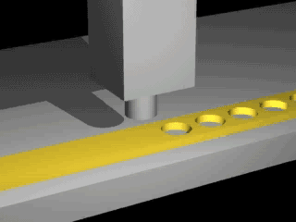
Basic Machinery Parts and Hazards
Punching action – power applied to a slide (ram) for purpose of blanking, drawing, or stamping metal or other materials
Source: OSHA
Notes:
OSHA Machine Guarding eTool - https://www.osha.gov/SLTC/etools/machineguarding/motions_actions.html
“Punching action results when power is applied to a slide (ram) for the purpose of blanking, drawing, or stamping metal or other materials. The danger of this type of action occurs at the point of operation where stock is inserted, held, and withdrawn by hand. Typical machines used for punching operations are power presses and iron workers.” (OSHA 2007).

Slide 18

Basic Machinery Parts and Hazards
Shearing action – applying power to a slide or knife in order to trim or shear metal or other materials.
Source: OSHA
Notes:
OSHA Machine Guarding eTool - https://www.osha.gov/SLTC/etools/machineguarding/motions_actions.html
“Shearing action involves applying power to a slide or knife in order to trim or shear metal or other materials. A hazard occurs at the point of operation where stock is actually inserted, held, and withdrawn. Examples of machines used for shearing operations are mechanically, hydraulically, or pneumatically powered shears.” (OSHA 2007).

Slide 19
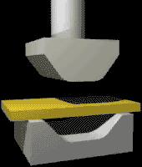
Basic Machinery Parts and Hazards
Bending action – applying power to draw or stamp metal or other materials
Source: OSHA
Notes:
OSHA Machine Guarding eTool - https://www.osha.gov/SLTC/etools/machineguarding/motions_actions.html
“Bending action results when power is applied to a slide in order to draw or stamp metal or other materials. A hazard occurs at the point of operation where stock is inserted, held, and withdrawn. Equipment that uses bending action includes power presses, press brakes, and tubing benders.” (OSHA 2007).

Slide 20
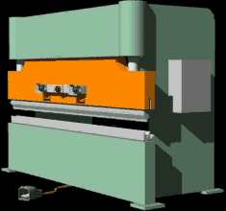
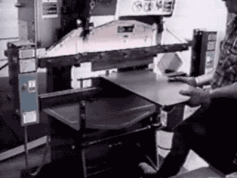
Machinery That Requires Guarding
Machines that require point of operation guarding:
Guillotine cutters
Shears
Alligator shears
Power presses
Milling machines
Power saws
Jointers
Portable power tools
Forming rolls and calenders
Source of graphics: OSHA
Notes:
1910.212(a)(3)
Point of operation guarding.
1910.212(a)(3)(i)
Point of operation is the area on a machine where work is actually performed upon the material being processed.
1910.212(a)(3)(ii)
The point of operation of machines whose operation exposes an employee to injury, shall be guarded. The guarding device shall be in conformity with any appropriate standards therefor, or, in the absence of applicable specific standards, shall be so designed and constructed as to prevent the operator from having any part of his body in the danger zone during the operating cycle.
1910.212(a)(3)(iii)
Special handtools for placing and removing material shall be such as to permit easy handling of material without the operator placing a hand in the danger zone. Such tools shall not be in lieu of other guarding required by this section, but can only be used to supplement protection provided

Slide 21

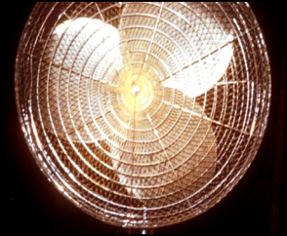
Machinery That Requires Guarding
Exposure of fan blades:
  Guard when periphery of blades is less than 7’ above the floor or working level
  Guards with openings no larger than ½”
Source of graphics: OSHA
Notes:
OSHA Machine Guarding eTool – https://www.osha.gov/SLTC/etools/machineguarding/generalrequirements.html#Exposure_of_Blades
“When the periphery of the blades of a fan is less than seven (7) feet above the floor or working level, the blades must be guarded. The guard must not have openings larger than one-half (½) inch. [29 CFR 1910.212(a)(5)]” (OSHA 2007)

Slide 22
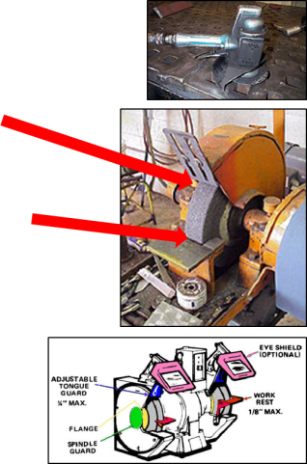
Machinery That Requires Guarding
Abrasive wheel machinery:
  Adjustable tongue guard to
  within ¼” of wheel
  Work rest with maximum
  opening of 1/8”
  Cover spindle end, nut, flange projections
Source of graphics: OSHA
Notes:
1910.215(b)(9)
Exposure adjustment. Safety guards of the types described in Subparagraphs (3) and (4) of this paragraph, where the operator stands in front of the opening, shall be constructed so that the peripheral protecting member can be adjusted to the constantly decreasing diameter of the wheel. The maximum angular exposure above the horizontal plane of the wheel spindle as specified in paragraphs (b)(3) and (4) of this section shall never be exceeded, and the distance between the wheel periphery and the adjustable tongue or the end of the peripheral member at the top shall never exceed one-fourth inch.
1910.215(a)(4)
Work rests. On offhand grinding machines, work rests shall be used to support the work. They shall be of rigid construction and designed to be adjustable to compensate for wheel wear. Work rests shall be kept adjusted closely to the wheel with a maximum opening of one-eighth inch to prevent the work from being jammed between the wheel and the rest, which may cause wheel breakage. The work rest shall be securely clamped after each adjustment. The adjustment shall not be made with the wheel in motion.
1910.215(a)(2)
Guard design. The safety guard shall cover the spindle end, nut, and flange projections. The safety guard shall be mounted so as to maintain proper alignment with the wheel, and the strength of the fastenings shall exceed the strength of the guard [exceptions].

Slide 23
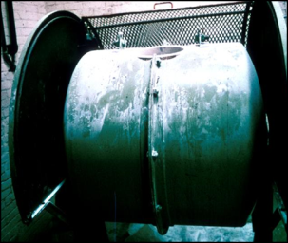
Machinery That Requires Guarding
Revolving barrels, containers, and drums:
Guard by an enclosure which is interlocked with drive mechanism
Guards with openings no larger than ½”
Source: OSHA
Notes:
OSHA Machine Guarding eTool – https://www.osha.gov/SLTC/etools/machineguarding/generalrequirements.html#Exposure_of_Blades
“Revolving barrels, containers, and drums must be guarded by an enclosure interlocked with the drive mechanism, so the barrel, gun, or container cannot revolve unless the guard enclosure is in place. [29 CFR 1910.212(a)(4)]” (OSHA 2007)

Slide 24
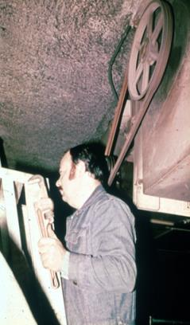
Machinery That Requires Guarding
Power-transmission apparatus:
Shafting, flywheels, pulleys, belts, chain drives, etc.
Less than 7 feet from the floor or working platform must be guarded
Unguarded belt and pulley
Source: OSHA
Notes:
1910.219(b)(1)
Flywheels. Flywheels located so that any part is seven (7) feet or less above floor or platform shall be guarded in accordance with the requirements of this subparagraph:1910.219(b)(1)(i)With an enclosure of sheet, perforated, or expanded metal, or woven wire;1910.219(b)(1)(ii)With guard rails placed not less than fifteen (15) inches nor more than twenty (20) inches from rim. When flywheel extends into pit or is within 12 inches of floor, a standard toeboard shall also be provided;1910.219(b)(1)(iii)When the upper rim of flywheel protrudes through a working floor, it shall be entirely enclosed or surrounded by a guardrail and toeboard...1910.219(b)(1)(iv)
1910.219(b)(1)(iv) For flywheels with smooth rims five (5) feet or less in diameter, where the preceding methods cannot be applied, the following may be used: A disk attached to the flywheel in such manner as to cover the spokes of the wheel on the exposed side and present a smooth surface and edge, at the same time providing means for periodic inspection. An open space, not exceeding four (4) inches in width, may be left between the outside edge of the disk and the rim of the wheel if desired, to facilitate turning the wheel over. Where a disk is used, the keys or other dangerous projections not covered by disk shall be cut off or covered. This subdivision does not apply to flywheels with solid web centers.

Slide 25
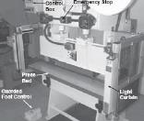
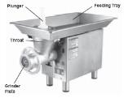
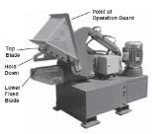
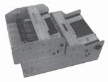
Machinery That Requires Guarding
Machinery associated with amputations – examples:
Mechanical power presses
Power press breaks
Powered and non-powered conveyors
Printing presses
Roll-forming and roll-bending machines
Shearing machines
Food slicers
Meat grinders
Meat-cutting
band saws
Drill presses
Milling machines
Grinding machines
Slitters
Source of graphics: OSHA
Notes:
Many machines are associated with amputation hazards.
The machinery most frequently involved in amputations, ranked from those with the most amputations to those with fewer injuries for all industries, are listed here:
“Machinery Associated with Amputations
Mechanical Power Presses
Power Press Brakes
Powered and Non-Powered Conveyors
Printing Presses
Roll-Forming and Roll-Bending Machines
Shearing Machines
Food Slicers
Meat Grinders
Meat-Cutting Band Saws
Drill Presses
Milling Machines
Grinding Machines
Slitters”
(OSHA 2007)
Source: https://www.osha.gov/Publications/OSHA3170/3170-02R-2007-English.html

Slide 26
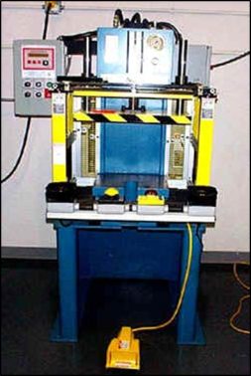
Requirements for Safeguards
Safeguards must meet these minimum general requirements:
Prevent contact
Be secured
Protect from falling objects
Create no new hazards
Create no interference
Allow safe lubrication
Source: OSHA
Notes:
OSHA Machine Guarding eTool – https://www.osha.gov/SLTC/etools/machineguarding/additional_considerations.html
“Safeguards must meet these minimum general requirements:
Prevent contact: The safeguard must prevent hands, arms, and any other part of a worker's body from making contact with dangerous moving parts. A good safeguarding system eliminates the possibility of the operator or another worker placing parts of their bodies near hazardous moving parts.
Secure: Workers should not be able to easily remove or tamper with the safeguard, because a safeguard that can easily be made ineffective is no safeguard at all. Guards and safety devices should be made of durable material that will withstand the conditions of normal use. They must firmly be secured to the machine.
Protect from falling objects: The safeguard should ensure that no objects can fall into moving parts. A small tool which is dropped into a cycling machine could easily become a projectile that could strike and injure someone.
Create no new hazards: A safeguard defeats its own purpose if it creates a hazard of its own such as a shear point, a jagged edge, or an unfinished surface which can cause a laceration. The edges of guards. for instance, should be rolled or bolted in such a way that they eliminate sharp edges.
Create no interference: Any safeguard which impedes a worker from performing the job quickly and comfortably might soon be overridden or disregarded. Proper safeguarding can actually enhance efficiency as it can relieve the worker's apprehensions about injury.
Allow safe lubrication: If possible, one should be able to lubricate the machine without removing the safeguards. Locating oil reservoirs outside the guard, with a line leading to the lubrication point, will reduce the need for the operator or maintenance worker to enter the hazardous area.
” (OSHA 2007)

Slide 27
Types of Machine Safe Guards
Safeguarding machinery:
Primary methods
  Guards
  Devices
Ensure employee protection
  Properly designed, constructed, and installed
  Used and maintained in good operating condition
Notes:
Safeguarding Equipment and Protecting Employees from Amputations (OSHA 3170-02R)
https://www.osha.gov/Publications/OSHA3170/3170-02R-2007-English.html#Controlling1
“Two primary methods are used to safeguard machines: guards and some types of safeguarding devices. Guards provide physical barriers that prevent access to danger areas. Safeguarding devices either prevent or detect operator contact with the point of operation or stop potentially hazardous machine motion if any part of an individual's body is within the hazardous portion of the machine. Both types of safeguards need to be properly designed, constructed, installed, used and maintained in good operating condition to ensure employee protection.”

Slide 28
Types of Machine Safe Guards
Secondary methods
  Probe detection and safety edge devices
  Awareness devices
  Safeguarding methods
    Safe distance
    Safe holding
    Safe opening
  Safe work practices
Safe work procedures
Complementary equipment
Notes:
Safeguarding Equipment and Protecting Employees from Amputations (OSHA 3170-02R)
https://www.osha.gov/Publications/OSHA3170/3170-02R-2007-English.html#Controlling1
“Secondary safeguarding methods are acceptable only when guards or safeguarding devices (that prevent you from being exposed to machine hazards) cannot be installed due to reasons of infeasibility. Where it is feasible to use primary safeguarding methods, secondary safeguarding methods may supplement these primary control measures; however, these secondary safeguarding methods must not be used in place of primary safeguarding methods.”

Slide 29
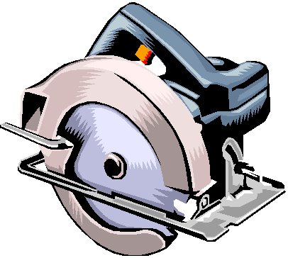
Types of Machine Safe Guards
Guards:
Preferable to other control methods
Provide physical barrier that prevents contact with dangerous machine parts
Four general types
  Fixed
  Interlocked
  Adjustable
  Self-adjusting
Source: OSHA
Notes:
OSHA 3170-02R https://www.osha.gov/Publications/OSHA3170/3170-02R-2007-English.html
“Guards usually are preferable to other control methods because they are physical barriers that enclose dangerous machine parts and prevent employee contact with them. To be effective, guards must be strong and fastened by any secure method that prevents the guard from being inadvertently dislodged or removed. Guards typically are designed with screws, bolts and lock fasteners and usually a tool is necessary to unfasten and remove them. Generally, guards are designed not to obstruct the operator's view or to prevent employees from doing a job.
Guards must not create additional hazards such as pinch points or shear points between guards and other machine parts. Guard openings should be small enough to prevent employees from accessing danger areas” (OSHA 2007)

Slide 30
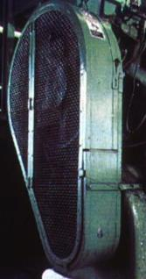
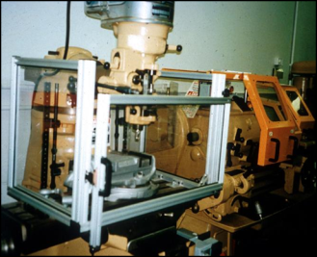
Types of Machine Safe Guards
Fixed guard:
Provides a barrier
Permanent part of the machine, preferable to all other types of guards.
Source of photos: OSHA
Notes:
OSHA Machine Guarding eTool – https://www.osha.gov/SLTC/etools/machineguarding/guards.html#Fixed
“As its name implies, a fixed guard is a permanent part of the machine. It is not dependent upon moving parts to function. It may be constructed of sheet metal, screen, wire cloth, bars, plastic, or any other material that is substantial enough to withstand whatever impact it may receive and to endure prolonged use. This guard is usually preferable to all other types because of its relative simplicity.” (OSHA 2007)
“Safeguarding action
Provides barrier
Advantages
Can be constructed to suit many specific applications
In-plant construction is often possible
Can provide maximum protection
Usually requires minimum maintenance
Can be suitable to high production, repetitive operations
Limitations
May interfere with visibility
Can be limited to specific operations
Machine adjustment and repair often require its removal, thereby necessitating other means of protection for maintenance personnel”
(OSHA 2007)

Slide 31
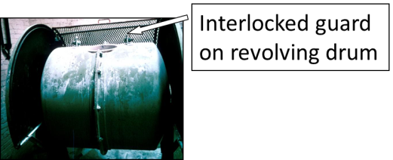
Types of Machine Safe Guards
Interlocked guards:
Shuts off or disengages power, stops moving parts, and prevents starting of machine when guard is open
May use electrical, mechanical, hydraulic, or pneumatic power, or combination
Source: OSHA
Notes:
OSHA Machine Guarding eTool – https://www.osha.gov/SLTC/etools/machineguarding/guards.html#Fixed
“When this type of guard is opened or removed, the tripping mechanism and/or power automatically shuts off or disengages, the moving parts of the machine are stopped, and the machine cannot cycle or be started until the guard is back in place. An interlocked guard may use electrical, mechanical, hydraulic, or pneumatic power or any combination of these. Interlocks should not prevent "inching" by remote control if required. Replacing the guard should not automatically restart the machine. To be effective, all removable guards should be interlocked to prevent occupational hazards.” (OSHA 2007)
“Safeguarding action
Shuts off or disengages power, stops the moving parts and prevents starting of the machine when the guard is open; should require the machine to be stopped before the worker can reach into the danger area
Advantages
Can provide maximum protection
Allows access to the machine for removing jams without time consuming removal of the fixed guards
Limitations
Requires careful adjustment and maintenance
May be easy to disengage”
(OSHA 2007)

Slide 32
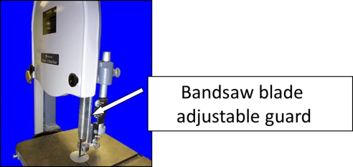
Types of Machine Safe Guards
Adjustable guards:
Shuts off or disengages power
Stops moving parts
Prevents starting of machine when guard is open
Source: OSHA
Notes:
OSHA Machine Guarding eTool – https://www.osha.gov/SLTC/etools/machineguarding/guards.html#Fixed
“Adjustable guards are useful because they allow flexibility in accommodating various sizes of stock.” (OSHA 2007)
“Safeguarding action
Provides a barrier that may be adjusted to facilitate a variety of production operations
Advantages
Can be constructed to suit many specific applications
Can be adjusted to admit varying sizes of stock
Limitations
Hands may enter danger area - protection may not be complete at all times
May require frequent maintenance and/or adjustment
The guard may be made ineffective by the operator
May interfere with visibility ”
(OSHA 2007)

Slide 33
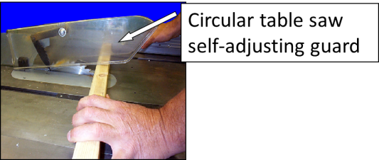
Types of Machine Safe Guards
Self-adjusting guards:
Openings of barriers determined by movement of the stock
Places barrier between danger area and operator
Source: OSHA
Notes:
OSHA Machine Guarding eTool – https://www.osha.gov/SLTC/etools/machineguarding/guards.html#Fixed
“The openings of these barriers are determined by the movement of the stock. As the operator moves the stock into the danger area, the guard is pushed away, providing an opening which is only large enough to admit the stock. After the stock is removed, the guard returns to the rest position. This guard protects the operator by placing a barrier between the danger area and the operator. The guards may be constructed of plastic, metal, or other substantial material. Self-adjusting guards offer different degrees of protection.” (OSHA 2007)
“Safeguarding action
Provides a barrier that moves according to the size of the stock entering the danger area
Advantages
Off-the-shelf guards are often commercially available
Limitations
Does not always provide maximum protection
May interfere with visibility
May require frequent maintenance and adjustment”
(OSHA 2007)

Slide 34
Types of Machine Safe Guards
Devices:
Controls or attachments that prevent inadvertent access by employees to hazardous machine areas
Examples
  Presence sensing
    Photoelectric
    Radiofrequency
    Electromechanical
  Pullback
  Restraint
  Safety trip controls
  Two-hand control
  Two-hand trip
  Gate
Notes:
OSHA 3170-02R https://www.osha.gov/Publications/OSHA3170/3170-02R-2007-English.html
“Safeguarding devices are controls or attachments that, when properly designed, applied and used, usually prevent inadvertent access by employees to hazardous machine areas by:
Preventing hazardous machine component operation if your hand or body part is inadvertently placed in the danger area;
Restraining or withdrawing your hands from the danger area during machine operation;
Requiring the use of both of your hands on machine controls (or the use of one hand if the control is mounted at a safe distance from the danger area) that are mounted at a predetermined safety distance; or
Providing a barrier which is synchronized with the operating cycle in order to prevent entry to the danger area during the hazardous part of the cycle.
These types of engineering controls, which either prevent the start of or stop hazardous motion, may be used in place of guards or as supplemental control measures when guards alone do not adequately enclose the hazard. In order for these safeguarding devices to accomplish this requirement, they must be properly designed and installed at a predetermined safe distance from the machine's danger area. Other safeguarding devices (probe detection and safety edge devices) that merely detect, instead of prevent, inadvertent access to a hazard are not considered primary safeguards. ” (OSHA 2007)

Slide 35
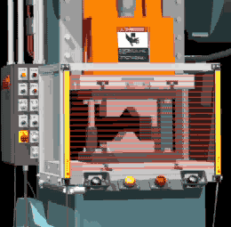
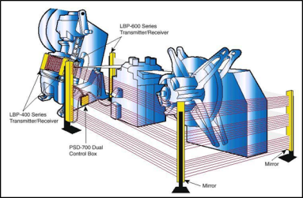
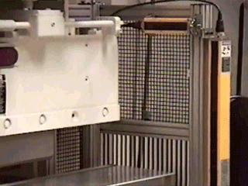
Types of Machine Safe Guards
Presence-sensing devices:
Photoelectric
Radiofrequency
Electromechanical
Source: OSHA
Notes:
OSHA Machine Guarding eTool – https://www.osha.gov/SLTC/etools/machineguarding/devices.html#Photoelectric
PHOTOELECTRIC
“The photoelectric (optical) presence-sensing device uses a system of light sources and controls which can interrupt the machine's operating cycle. If the light field is broken, the machine stops and will not cycle. This device must be used only on machines which can be stopped before the worker can reach the danger area. The design and placement of the guard depends upon the time it takes to stop the mechanism and the speed at which the employee's hand can reach across the distance from the guard to the danger zone.” (OSHA 2007)
“Safeguarding action
Machine will not start cycling when the light field is interrupted
When the light field is broken by any part of the operator's body during the cycling process, immediate machine braking is activated
Advantages
Can allow freer movement for operator
Simplicity of use
Used by multiple operators
Provide passerby protection
No adjustment required
Limitations
Does not protect against mechanical failure
Limited to machines that can be stopped”
(OSHA 2007)
RADIOFREQUENCY
“The radiofrequency (capacitance) presence-sending device uses a radio beam that is part of the machine control circuit. When the capacitance field is broken, the machine will stop or will not activate. Like the photoelectric device, this device shall only be used on machines which can be stopped before the worker can reach the danger area. This requires the machine to have a friction clutch or other reliable means for stopping.” (OSHA 2007)
“Safeguarding action
Machine cycling will not start when the capacitance field is interrupted.
When the capacitance field is disturbed by any part of the operator's body during the cycling process, immediate machine breaking is activated
Advantages
Can allow freer movement for operator
Limitations
Does not protect against mechanical failure
Antennae sensitivity must be properly adjusted; this adjustment must be maintained properly
Limited to machines that can be stopped”
(OSHA 2007)
ELECTROMECHANICAL
“The electromechanical sensing device has a probe or contact bar which descends to a predetermined distance when the operator initiates the machine cycle. If there is an obstruction preventing it from descending its full predetermined distance, the control circuit does not actuate the machine cycle.” (OSHA 2007)
“Safeguarding action
Contact bar or probe travels a predetermined distance between the operator and the danger area.
Interruption of this movement prevents the starting of machine cycle.
Advantages
Can allow access at point of operation
Limitations
Contact bar or probe must be properly adjusted for each application; this adjustment must be maintained properly”
(OSHA 2007)

Slide 36
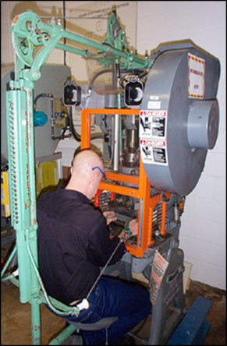
Types of Machine Safe Guards
Pullback devices:
Utilize a series of cables attached to operator
Automatically withdraws hands from point of operation when slide/ram begins to descend
Source: OSHA
Notes:
OSHA Machine Guarding eTool – https://www.osha.gov/SLTC/etools/machineguarding/devices.html#Photoelectric
“Pullback devices utilize a series of cables attached to the operator's hands, wrists, and/or arms. This type of device is primarily used on machines with stroking action. When the slide/ram is up between cycles, the operator is allowed access to the point of operation. When the slide/ram begins to cycle by starting its descent, a mechanical linkage automatically assures withdrawal of the hands from the point of operation.” (OSHA 2007)
“Safeguarding action
As the machine begins to cycle, the operator's hands are pulled out of the danger area
Advantages
Eliminates the need for auxiliary barriers or other interferences at the danger area
Limitations
Hands may enter danger area - protection may not be complete at all times
May require frequent maintenance and/or adjustment
The guard may be made ineffective by the operator
May interfere with visibility ”
(OSHA 2007)

Slide 37
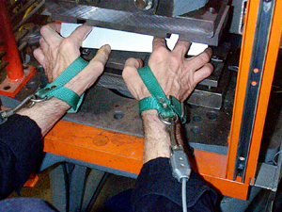
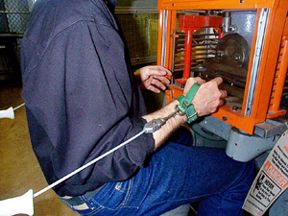
Types of Machine Safe Guards
Source: OSHA
Source: OSHA
Hands in die, feeding
Point of operation exposed
Pullback device attached and properly adjusted
Die closed
Hands withdrawn from point of operation by pullback device
Notes:
OSHA Machine Guarding eTool – https://www.osha.gov/SLTC/etools/machineguarding/presses/pullbacks.html
“Pullback Regulations
Attachments must be connected to and operated only by the press slide or upper die. [29 CFR 1910.217(c)(3)(iv)(a)]
Attachments must be adjusted to prevent the operator from reaching into the point of operation or to withdraw the operator's hand from the point of operation before the dies close. [29 CFR 1910.217(c)(3)(iv)(b)]
A separate pullout device must be provided for each operator if more than one operator is used on the press. [29 CFR 1910.217(c)(3)(iv)(c)]
Each pull-out device in use must be inspected and checked for proper adjustment at the start of each operator shift, following a new die set-up, and when operators are changed. Necessary maintenance or repair on both must be performed and completed before the press is operated. [29 CFR 1910.217(c)(3)(iv)(d)]
Inspection and Maintenance Records. It is the responsibility of the employer to make periodic and regular safety inspections and keep accurate records of them. [29 CFR 1910.217(e)(1)(i)]”
(OSHA 2007)

Slide 38
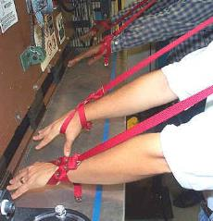
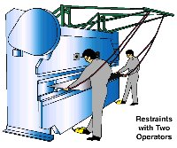
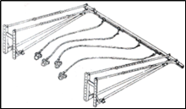
Types of Machine Safe Guards
Restraint devices:
Utilize cables/straps attached to operator’s hands and a fixed point
No extending/retracting action involved
Hand-feeding tools may be necessary
Source of graphics: OSHA
Notes:
OSHA Machine Guarding eTool – https://www.osha.gov/SLTC/etools/machineguarding/devices.html#Restraint
“The restraint (hold-back) device utilizes cables or straps that are attached to the operator's hands and a fixed point. The cables or straps must be adjusted to let the operator's hands travel within a predetermined safe area. There is no extending or retracting action involved. Consequently, hand-feeding tools are often necessary if the operation involves placing material into the danger area.” (OSHA 2007)
“Safeguarding action
Prevents the operator from reaching into the danger area
Advantages
Little risk of mechanical failure
Limitations
Limits movement of operator
May obstruct work space
Adjustments must be made for specific operations and each individual
Requires close supervision of the operator's use of the equipment.”
(OSHA 2007)
Types of restraints include: arm-type, overhead, and sliding restraint devices

Slide 39
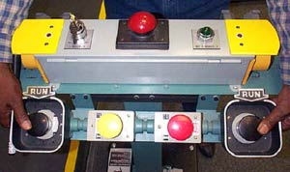
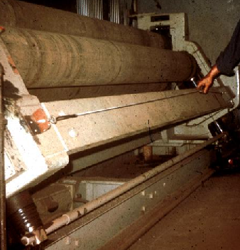
Types of Machine Safe Guards
Safety trip controls:
Deactivates the machine in an emergency situation
Examples
  Pressure-sensitive bar
  Safety tripod
  Safety tripwire
Positioning is critical; must stop machine before body reaches danger area
Source of graphics: OSHA
Notes:
OSHA Machine Guarding eTool – https://www.osha.gov/SLTC/etools/machineguarding/devices.html#Safety Trip Controls
“Safety trip controls provide a quick means for deactivating the machine in an emergency situation. A pressure-sensitive body bar, when depressed, will deactivate the machine. If the operator or anyone trips, loses balance, or is drawn toward the machine, applying pressure to the bar will stop the operation. The positioning of the bar, therefore, is critical. It must stop the machine before a part of the employee's body reaches the danger area.” (OSHA 2007)
“Safeguarding action
Stops machine when tripped
Advantages
Simplicity of use
Limitations
All controls must be manually activated
May be difficult to activate controls because of their location
Only protects the operator
May require special fixtures to hold work
May require a machine brake”
(OSHA 2007)

Slide 40
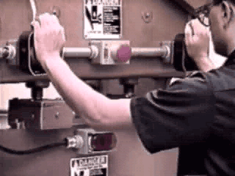
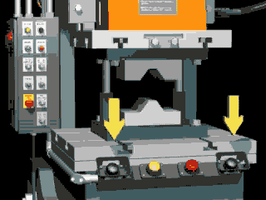
Types of Machine Safe Guards
Two-hand controls:
Deactivates the machine in an emergency situation
Pressure-sensitive
Positioning is critical; must stop machine before body reaches danger area
Source of graphics: OSHA
Notes:
OSHA Machine Guarding eTool – https://www.osha.gov/SLTC/etools/machineguarding/devices.html#Two-Hand Control
“The two-hand control requires constant, concurrent pressure by the operator to activate the machine. This kind of control requires a part-revolution clutch, brake, and a brake monitor if used on a power press. With this type of device, the operator's hands are required to be at a safe location (on control buttons) and at a safe distance from the danger area while the machine completes its closing cycle.” (OSHA 2007)
“Safeguarding action
Concurrent use of both hands is required, preventing the operator from entering the danger area
Advantages
Operator's hands are at a pre-determined location
Operator's hands are free to pick up a new part after first half of the cycle is completed
Limitations
Requires a partial cycle machine with a brake
Some two-hand controls can be rendered unsafe by holding with arm or blocking, thereby permitting one-hand operation
Protects only the operator”
(OSHA 2007)

Slide 41
Types of Machine Safe Guards
Gate devices:
Moveable barrier that protects operator at point of operation before machine cycle can be started
Must be interlocked so machine cannot begin cycle unless gate guard is in place
Must be closed before machine can function
Types
  “A” Gate
  “B” Gate
Notes:
OSHA Machine Guarding eTool – https://www.osha.gov/SLTC/etools/machineguarding/devices.html#Gate
“The gate is a moveable barrier that protects the operator at the point of operation before the machine cycle can be started. Gates are, in many instances, designed to be operated with each machine cycle. To be effective, the gate must be interlocked so that the machine will not begin a cycle unless the gate guard is in place. It must be in the closed position before the machine can function. If the gate is not permitted to descend to the fully closed position, the press will not function.
Another potential application of this type of guard is where the gate is a component of a perimeter safeguarding system. Here the gate may provide protection not only to the operator but to pedestrian traffic as well.” (OSHA 2007)
“Safeguarding action
Provides a barrier between danger area and operator or other personnel
Advantages
Can prevent reaching into or walking into the danger area
Limitations
May require frequent inspection and regular maintenance
May interfere with operator's ability to see the work”
(OSHA 2007)

Slide 42
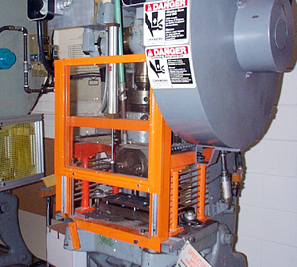
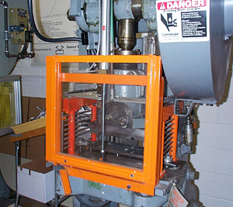
Types of Machine Safe Guards
Gate devices:
Moveable barrier that protects operator at point of operation before machine cycle can be started
Must be interlocked so machine cannot begin cycle unless gate guard is in place
Must be closed before machine can function
Gate Open
Gate Closed
Source of graphics: OSHA
Notes:
OSHA Machine Guarding eTool – https://www.osha.gov/SLTC/etools/machineguarding/devices.html#Gate
“The gate is a moveable barrier that protects the operator at the point of operation before the machine cycle can be started. Gates are, in many instances, designed to be operated with each machine cycle. To be effective, the gate must be interlocked so that the machine will not begin a cycle unless the gate guard is in place. It must be in the closed position before the machine can function. If the gate is not permitted to descend to the fully closed position, the press will not function.
Another potential application of this type of guard is where the gate is a component of a perimeter safeguarding system. Here the gate may provide protection not only to the operator but to pedestrian traffic as well.” (OSHA 2007)
“Safeguarding action
Provides a barrier between danger area and operator or other personnel
Advantages
Can prevent reaching into or walking into the danger area
Limitations
May require frequent inspection and regular maintenance
May interfere with operator's ability to see the work”
(OSHA 2007)

Slide 43
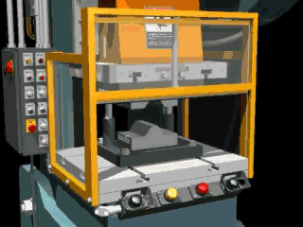

Types of Machine Safe Guards
Type “A” Gate Operation Type “B” Gate Operation
Source of graphics: OSHA
Notes:
OSHA Machine Guarding eTool – https://www.osha.gov/SLTC/etools/machineguarding/presses/typea_bgates.html
“Type "A" and "B" Gates are both recognized methods for power press safeguarding. The "A" gate is used in both full and part revolution clutch presses while the "B" gate is for part revolution presses only.
Type "A" Gates protect the operator during the entire machine stroke. This means the gate will not open until after the crankshaft rotation is complete (360°) and the machine is stopped at top dead center. Although Type "A" Gates can be used on either part or full revolution clutch presses, best safety practice is the "A" gate should be used only on full revolution clutch presses. [29 CFR 1910.217(c)(3)(i)], [(c)(3)(i)(f)], [29 CFR 1910.217(c)(3)(ii)] and [(c)(3)(ii)(a)]
The "A" gate is designed to enclose the point of operation before the press stroke can be started, and it must remain enclosed until all slide motion has stopped. The following is a typical sequence of operation of a complete cycle on a press which uses an "A" gate.
1. Initiate the cycle. As long as there are no obstructions, the gate closes by gravity.
2. The machine makes one complete cycle and returns to "top of stroke" and stops.
3. The gate opens, after the cycle has stopped.
Type "B" Gates protect the operator during the downstroke only. The gate starts to open before the crankshaft rotation is complete (generally after 180° crankshaft rotation). The gates must open on the upstroke of the machine cycle before the crankshaft rotation is complete. [29 CFR 1910.217(c)(3)(i) and (g)] [29 CFR 1910.217(c)(3)(ii) and (c)(3)(ii)(b)]
The "B" gate only protects the operator on the down-stroke of the press slide. The following is a typical sequence of operation of a complete cycle on a press which uses a "B" gate.
1. Initiate the cycle. As long as there are no obstructions, the gate closes by gravity.
2. Once the machine reaches the portion of the stroke where the pinch point has been eliminated and before the stroke has stopped, the "B" gate and the slide go up at the same time.”
(OSHA 2007)

Slide 44
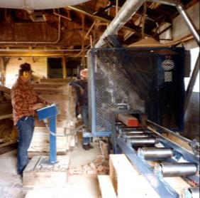
Additional Safeguarding
Location/distance:
The dangerous moving part of a machine must be so positioned that those areas are not accessible or do not present a hazard
Feeding process safeguarded
by maintaining safe distance
to protect worker
Operator’s controls located
safe distance from machine
Source: OSHA
Notes:
Concepts and Techniques of Machine Safeguarding
(OSHA 3067) https://www.osha.gov/Publications/Mach_SafeGuard/chapt2_2.html
“A thorough hazard analysis of each machine and particular situation is absolutely essential before attempting this safeguarding technique.
To consider a part of a machine to be safeguarded by location, the dangerous moving part of a machine must be so positioned that those areas are not accessible or do not present a hazard to a worker during the normal operation of the machine. This may be accomplished by locating a machine so that the hazardous parts of the machine are located away from operator work stations or other areas where employees walk or work. This can be accomplished by positioning a machine with its power transmission apparatus against a wall and leaving all routine operations conducted on the other side of the machine. Additionally, enclosure walls or fences can restrict access to machines. Another possible solution is to have dangerous parts located high enough to be out of the normal reach of any worker.
The feeding process can be safeguarded by location if a safe distance can be maintained to protect the worker's hands. The dimensions of the stock being worked on may provide adequate safety.
For instance, if the stock is several feet long and only one end of the stock is being worked on, the operator may be able to hold the opposite end while the work is being performed. An example would be a single-end punching machine. However, depending upon the machine, protection might still be required for another personnel.
The positioning of the operator's control station provides another potential approach to safeguarding by location. Operator controls may be located at a safe distance from the machine if there is no reason for the operator to tend it.”

Slide 45
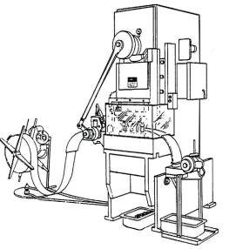

Additional Safeguarding
Transparent
Enclosure
Guard
Feeding and ejection methods:
Automatic/
semi-automatic feed
Automatic/
semi-automatic ejection
Robots
Stock Feed
Roll
Completed Work
Source of graphics: OSHA
Notes:
OSHA Machine Guarding eTool – https://www.osha.gov/SLTC/etools/machineguarding/additional_considerations.html#Feeding and Ejection Methods
“Many feeding and ejection methods do not require the operator to place his or her hands in the danger area. In some cases, no operator involvement is necessary after the machine is set up. In other situations, operators can manually feed the stock with the assistance of a feeding mechanism. Properly designed ejection methods do not require any operator involvement after the machine starts to function.
Using these feeding and ejection methods does not eliminate the need for guards and devices. Guards and devices must be used wherever they are necessary and possible in order to provide protection from exposure to hazards.
Types of feeding and ejection methods:
Automatic Feed
stock is fed from rolls, indexed by machine mechanism, etc.
eliminates the need for operator involvement in the danger area
other guards are required for operator protection, usually fixed barrier guards
requires frequent maintenance
may not be adaptable to stock variation
Semi-automatic Feed
stock is fed by chutes, movable dies, dial feed, plungers, or sliding bolster
Automatic Ejection
work pieces are ejected by air or mechanical means
may create a hazard of blowing chips or debris
size of stock limits the use of this method
air ejection may present a noise hazard
Semi-automatic Ejection
work pieces are ejected by mechanical means which are initiated by the operator
operator does not have to enter danger area to remove finished work
other guards are required for operator protection
may not be adaptable to stock variation
Robots
they perform work usually done by operator
operator does not have to enter danger area
are suitable for operations where high stress factors are present, such as heat and noise
can create hazards themselves
require maximum maintenance
are suitable only to specific operations”
(OSHA 2007)

Slide 46



Additional Safeguarding
Miscellaneous aids:
Awareness barriers
Protective shields
Hand-feeding tools
Source of graphics: OSHA
Notes:
OSHA Machine Guarding eTool – https://www.osha.gov/SLTC/etools/machineguarding/additional_considerations.html#Miscellaneous Aids
“While these aids do not give complete protection from machine hazards, they may provide the operator with an extra margin of safety. Sound judgment is needed in their application and usage. Examples of possible application include the following:
An awareness barrier serves as a reminder to a person that he or she is approaching the danger area. Although the barrier does not physically prevent a person from entering the danger area, it calls attention to it. For an employee to enter the danger area, an overt act must take place, that is, the employee must either reach or step over, under or through the barrier. Generally, awareness barriers are not considered adequate when continual exposure to the hazard exists.
Special hand tools may be used to place or remove stock, particularly from or into the point of operation of a machine. A typical use would be for reaching into the danger area of a press or press brake. A push stick or block may be used when feeding stock into a saw blade. When it becomes necessary for hands to be in close proximity to the blade, the push stick or block may provide a few inches of safety and prevent a severe injury.” (OSHA 2007)

Slide 47

Identify the Hazard
Unguarded lower blade and arbor end of radial saw.

Slide 48

Identify the Hazard
Guard removed from chain rail exposing pins on the spiked chain and sprocket mechanism.

Slide 49
Summary
Safeguards are essential for protecting workers from needless and preventable machinery-related injuries
The point of operation, as well as all parts of the machine that move while the machine is working, must be safeguarded
A good rule to remember is:
Any machine part, function, or process which may cause injury must be safeguarded
Notes:
Even the most elaborate safeguarding system cannot offer effective protection unless the worker knows how to use it and why. Specific and detailed training is therefore a crucial part of any effort to provide safeguarding against machine-related hazards.
This kind of safety training is necessary for new operators and maintenance or setup personnel, when any new or altered safeguards are put in service, or when workers are assigned to a new machine or operation.

Slide 50
Knowledge Check
All machines consist of three fundamental areas, including __.
  Flywheels, connecting rods, and transverse moving parts
  Point of operation, power transmission device, and operating controls
  Reciprocating parts, rotating parts, and on/off switch
  Feed mechanisms, auxiliary machine parts, and nip points
Answer: b. point of operation, power transmission device, and operating controls

Slide 51
Knowledge Check
Rotating, in-running nip points, reciprocating, and transversing are types of hazardous ___.
  motions
  actions
  guards
  devices
Answer: a. motions
Notes:
Motions refer to how the machine parts are moving; rotating, in-running, reciprocating, and transversing refer to motions.

Slide 52
Knowledge Check
Cutting, punching, shearing, and bending are types of hazardous ___.
  motions
  actions
  guards
  devices
Answer: b. actions
Notes:
Actions indicate the operations that machines perform; cutting, punching, shearing, and bending are examples of hazardous actions.

Slide 53
Knowledge Check
Which of the following explains how a guard protects workers?
  Stops the machine when a worker enters the danger area
  Restrains the worker from entering the danger area
  Creates distance to keep the worker from entering the danger area
  Provides a barrier to prevent access to the danger area
Answer: d. Provides a barrier to prevent access to the danger area
Notes:
Explanation:
“Stops the machine when a worker enters the danger area” is an example of how a sensing device works.
“Restrains the worker from entering the danger area” is an example of how a restraining device works.
“Creates distance to keep the worker from entering the danger area” is how a location/distancing works.

Slide 54
Knowledge Check
Which of the following is an example of a safeguarding device?
  Protective shield
  Hand-feeding tool
  Safety trip control
  Awareness barrier
Answer: c. Safety trip control

