Slide 1
Introduction to Industrial Hygiene
10-hour General Industry Outreach Training

Slide 2

Introduction
Health hazards on the job site
Protect yourself; protect your family
Source: OSHA
Notes:
Workers can be exposed to a variety of health hazards on a job site, including:
Chemical
Biological
Physical
Ergonomic
If not practicing good hygiene, these hazards can be brought home and expose family members as well. Protect yourself and your family by knowing what health hazards may be present at your jobsite and take appropriate actions for exposure control.

Slide 3
Introduction
Lesson objectives:
Identify types of health hazards in the workplace.
Describe strategies to control chemical hazards.
Describe strategies to control biological hazards.
Describe strategies to control physical hazards.
Describe strategies to control ergonomic hazards.
Notes:
Identify types of health hazards in the workplace.
Describe strategies to control chemical hazards.
Describe strategies to control biological hazards.
Describe strategies to control physical hazards.
Describe strategies to control ergonomic hazards.

Slide 4

Introduction
Industrial Hygiene – the science of protecting the health and safety of workers through:
Anticipation,
Recognition,
Evaluation, and
Control
  …of workplace conditions that may cause workers’ injury or illness.
Source: OSHA
Notes:
https://www.osha.gov/Publications/OSHA3143/OSHA3143.htm
What is Industrial Hygiene?
Industrial hygiene is the science of anticipating, recognizing, evaluating, and controlling workplace conditions that may cause workers' injury or illness. Industrial hygienists use environmental monitoring and analytical methods to detect the extent of worker exposure and employ engineering, work practice controls, and other methods to control potential health hazards.
How Are OSHA and Industrial Hygiene Related?
Under the Act, OSHA develops and sets mandatory occupational safety and health requirements applicable to the more than 6 million workplaces in the U.S. OSHA relies on, among many others, industrial hygienists to evaluate jobs for potential health hazards.. Industrial hygienists also play a major role in developing and issuing OSHA standards to protect workers from health hazards associated with toxic chemicals, biological hazards, and harmful physical agents.. Industrial hygienists analyze, identify, and measure workplace hazards or stressors that can cause sickness, impaired health, or significant discomfort in workers through chemical, physical, ergonomic, or biological exposures.

Slide 5
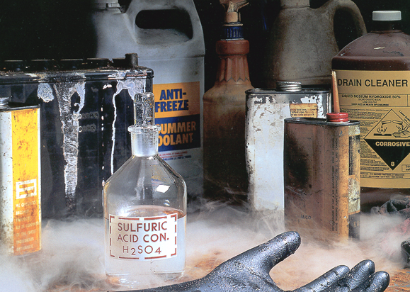
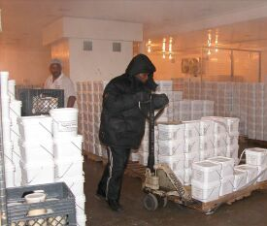
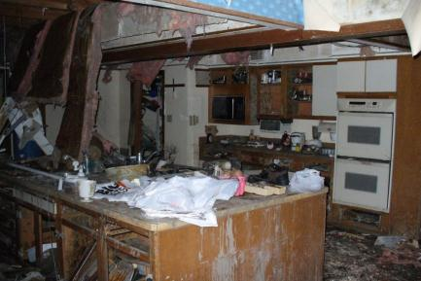

Types of Health Hazards
Common workplace health hazards:
Chemical
Physical
Biological
Ergonomic
Source of photos: OSHA
Notes:
What Are Some Examples of Job Hazards?
To be effective in recognizing and evaluating on-the-job hazards and recommending controls, industrial hygienists must be familiar with the hazards' characteristics. Major job risks can include air contaminants, and chemical, biological, physical, and ergonomic hazards.
Workers can be exposed to a variety of health hazards on a job site, including the following:
Chemical hazards such as solids, liquids, gases and vapors, and aerosols;
Biological hazards such as insects, animals, soil, plants, water, and blood;
Physical hazards such as noise, temperature extremes, and radiation; and
Ergonomic hazards such as lifting, holding, pushing, walking, and reaching.

Slide 6
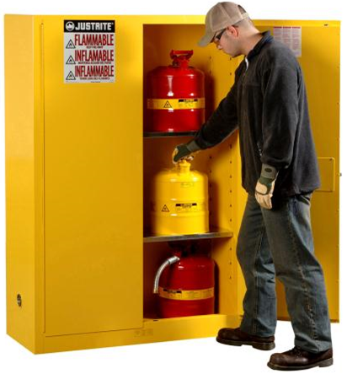
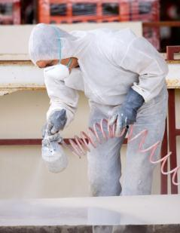

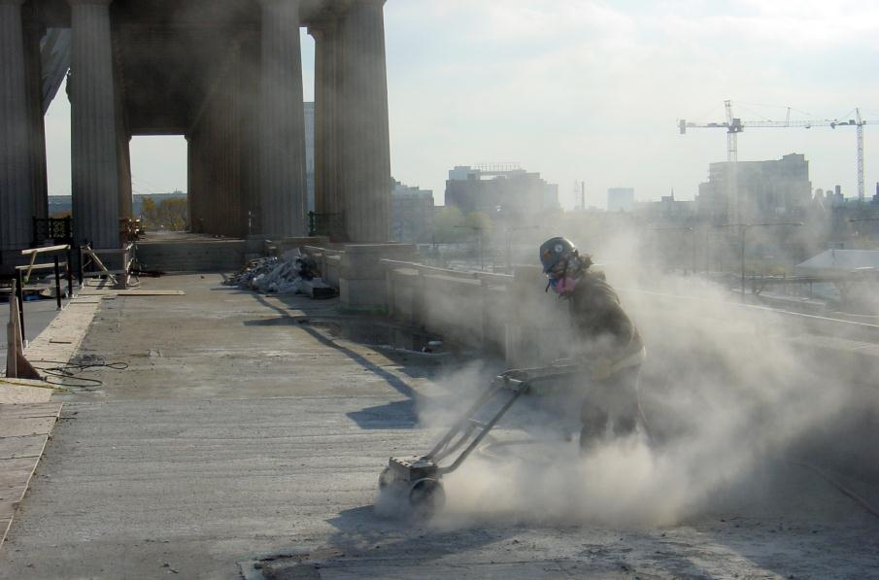
Chemical Hazards and Controls
Multiple chemical hazards
Forms
Solids
Liquids
Gases and vapors
Aerosols - dust, mist, fumes
Spraying mist
Welding fumes
Dust particulates
Source of photos: OSHA
Notes:
https://www.osha.gov/Publications/OSHA3143/OSHA3143.htm
Chemical Hazards
Harmful chemical compounds in the form of solids, liquids, gases, mists, dusts, fumes, and vapors exert toxic effects by inhalation (breathing), absorption (through direct contact with the skin), or ingestion (eating or drinking). Airborne chemical hazards exist as concentrations of mists, vapors, gases, fumes, or solids. Some are toxic through inhalation and some of them irritate the skin on contact; some can be toxic by absorption through the skin or through ingestion, and some are corrosive to living tissue.
The degree of worker risk from exposure to any given substance depends on the nature and potency of the toxic effects and the magnitude and duration of exposure.
Information on the risk to workers from chemical hazards can be obtained from the Safety Data Sheet (SDS) that OSHA'S Hazard Communication Standard requires be supplied by the manufacturer or importer to the purchaser of all hazardous materials. The SDS is a summary of the important health, safety, and toxicological information on the chemical or the mixture's ingredients. Other provisions of the Hazard Communication Standard require that all containers of hazardous substances in the workplace have appropriate warning and identification labels.
SDS(s) are not required for asbestos, silica, lead, or and other non-manufactured chemicals, but they are recommended
Some unintended by-products of production may be hazardous, but may not be included in a SDS. Ex. CO as a byproduct of combustion. You may have an SDS on a gas being used, but not on the CO that is emitted.
Depiction notes:
Welding generates fumes, which is an example of an aerosol
Grinding/Cutting/etc. generates dusts. Silica is an example of a suspended dust particle
Spraying paints is an example of generating mists
Chemical storage units may contain any/all states of chemical hazards

Slide 7
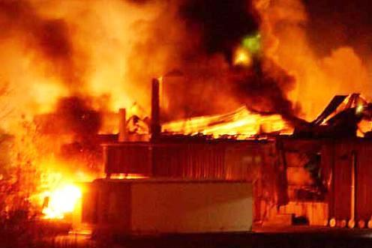
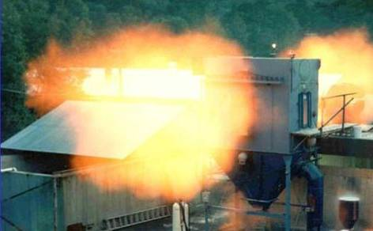
Chemical Hazards and Controls
Effects of chemical exposures:
Health Risks
Heart Ailments | Lung Damage | Sterility
CNS Damage | Kidney Damage | Burns
Cancer | Liver Damage | Rashes
Safety Risks
Fire | Explosion | Corrosion
Source of photos: OSHA
Notes:
Effects of chemical exposures
May pose risk of fire and explosion hazards, as well as corrosive hazards
May put workers at risk of developing health problems such as heart ailments, central nervous system damage, kidney damage, lung damage, sterility, cancer, burns, or rashes
190,000 illnesses caused by chemical exposure annually in the US
50,000 deaths caused by chemical exposure annually in the US
Burns and rashes are examples of local impacts of chemical exposure. (May be reversible or irreversible)
The rest of the health problems in the chart are examples of systemic impacts of chemical exposure. (Likely irreversible)

Slide 8

Chemical Hazards and Controls
Exposure entry routes:
Inhalation: | Breathed in (most common route)
Ingestion: | Swallowing via eating or drinking
Absorption: | Drawn through skin or eye surface
Source of graphics: OSHA
*Injection: | Penetration through the skin
Notes:
Common ways workers encounter chemical hazards
Inhalation
Grinding/Cutting/Sawing/Sanding/etc.
Painting/Spraying
Cleaning
Processing/Manufacturing/Reacting
Laboratory
Welding fumes
Nearby construction (Lead/Asbestos/Silica)
Ingestion
Cross Contamination (food/water/cigarettes)
Mucus Contamination (particulates)
Absorption (Skin/Eye)
Unprotected for all potential airborne exposure
Laboratory (Acids/Bases/Toxics)
Cleaning/Solvents
Product Handling
Injection
Pressurized chemicals (Hydraulics)
Industrial Hole Punching/Injection Processing
Sharps (Needles)

Slide 9
Chemical Hazards and Controls
Warning Signs of Potential Chemical Exposure:
Dust, mist, smoke in the air
Accumulation of particulates (dust) on surfaces
Unusual tastes and/or smells
Eye, nose, throat, upper respiratory, and/or skin irritation

Slide 10
Chemical Hazards and Controls
Examples of chemical exposure symptoms:
Eye, nose, throat, upper respiratory, skin irritation
Flu-like symptoms
Difficulty breathing
Fatigue
Loss of coordination
Memory difficulties
Sleeplessness
Mental confusion
Notes:
Examples of chemical exposure symptoms
Eye, nose, throat, upper respiratory tract, and skin irritation
Flu-like symptoms
Difficulty breathing
Fatigue
Loss of coordination
Memory difficulties
Sleeplessness
Mental confusion
Chronic effects – depend on extent and duration of exposure
---- Many chemicals don’t create an obvious sign or symptom of exposure, and that is why air monitoring is necessary.

Slide 11
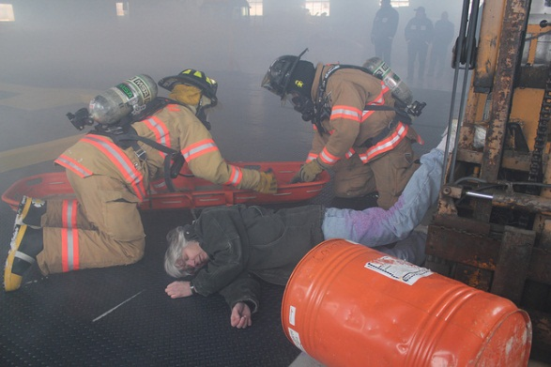
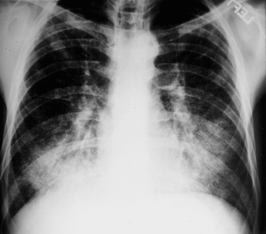
Chemical Hazards and Controls
Types of health effects:
Exposure Condition |  | Exposure | Example
ACUTE | Immediate | Short-term, high concentration | H₂S exposure within a confined space
CHRONIC | Delayed; generally for years | Continuous; for long periods of time | Asbestosis
Acute
Chronic
Source: U.S. Army Corps of Engineers
Source: OSHA
Notes:
For some chemical hazards our primary concern is from acute exposures (Ex. Carbon Monoxide leading to CO poisoning), while some have primarily chronic exposure concerns (Ex. Years of silica exposure leading to silicosis). Some chemical exposures can have both acute and chronic exposure concerns, like Benzene – which can cause narcosis from short term exposure, and cancer from chronic exposure.

Slide 12



Chemical Hazards and Controls
What is toxicology?
The science that studies the poisonous or toxic properties of substances
Source of graphics: OSHA Hazard Communication Pictograms
Notes:
Almost anything - even water - can cause illness if taken in a large enough quantity. On the other hand, most hazardous chemicals can be used safely if the exposure is limited to a small enough exposure.
Hazard Communications Standard – pictograms
Skull and Crossbones: Acute Toxicity (fatal or toxic),
Health Hazard (carcinogen, mutagenicity, reproductive toxicity, respiratory sensitizer, target organ toxicity and aspiration toxicity),
Exclamation Mark (irritant (skin and eye), skin sensitizer, acute toxicity, narcotic effects, respiratory tract irritant.
https://www.osha.gov/dsg/hazcom/pictograms/

Slide 13
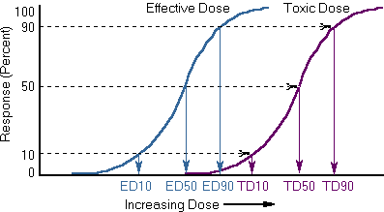
Chemical Hazards and Controls
Toxic effects:
Dose
  Concentration – amount
  Duration of Exposure – time
Source: OSHA
Notes:
Concentration – the amount of a given substance in a stated unit of measure. When conducting air monitoring we are determining the amount of toxin per a unit of time.
Time – OSHA Time Weighted Average (TWA) Permissible Exposure Limits (PEL) are based on 8-hour time limit.
Time – OSHA Ceiling limit PELs are instantaneous.

Slide 14
Chemical Hazards and Controls
Toxic chemicals disrupt the normal functions of the body. Effects can be:
  Local - at the site of exposure
  Systemic
    Affects the entire body
    Target organs - organs or systems where symptoms of exposure appear
Notes:
A toxic chemical may cause local effects, systemic effects, or both. For example, if ammonia gas is inhaled, it quickly irritates the lining of the respiratory tract (nose, throat, and lungs). Almost no ammonia passes from the lungs into the blood. Since damage is caused only at the point of initial contact, ammonia is said to exert a local effect. An epoxy resin is an example of a substance with local effects on the skin. On the other hand, if liquid phenol contacts the skin, it irritates the skin at the point of contact (a local effect) and can also be absorbed through the skin, and may damage the liver and kidneys (systemic effects).
Target Organ - Most chemicals that produce toxicity do not cause a similar degree of toxicity in all organs but usually produce the major toxicity to one or two organs, they are the target organs.

Slide 15
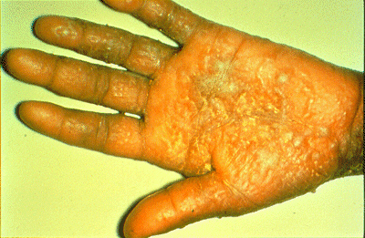
Chemical Hazards and Controls
Local (direct) effects:
Irritation (dryness, redness, cracking) - fiberglass
Corrosion (chemical burn) - acid
Upper Respiratory Track Infection – inhaling particles
Source: Occupational Dermatoses (CDC)
Notes:
“Local Effects” are sometimes referred to as “Direct Effects”

Slide 16
Chemical Hazards and Controls
Systemic effects:
Hepatotoxins
  Cause liver damage
  Carbon tetrachloride, nitrosamines
Nephrotoxins
  Cause kidney damage
  Uranium, halogenated hydrocarbons
Neurotoxins
  Cause nerve damage
  Mercury, lead, carbon disulfide
Notes:
Substances may have systemic effects when they are absorbed into the bloodstream and are then carried to other parts of the body, where they cause their effect. These types of substances usually cause their effect in one or two target body organs. Whether or not these effects occur depends on the concentration of the chemical in the target organ. The concentration in the organ is dependent on the absorption, distribution, biotransformation, and excretion of the substance.

Slide 17
Chemical Hazards and Controls
Hematotoxins
  Cause blood system damage
  Carbon monoxide, cyanides
Anesthetics
  Depress nervous system
  Hydrocarbons, propane, isopropyl ethers

Slide 18
Chemical Hazards and Controls
Factors affecting exposures:
form and innate chemical activity
dosage, especially dose-time relationship
exposure route
age
sex
ability of chemical to be absorbed
metabolism
distribution within the body
excretion
presence of other chemicals
Notes:
Exposure route Some chemicals may be highly toxic by one route but not by others. Two major reasons are differences in absorption and distribution within the body. For example: ingested chemicals, when absorbed from the intestine, distribute first to the liver and may be immediately detoxified. Inhaled toxicants immediately enter the general blood circulation and can distribute throughout the body prior to being detoxified by the liver. Frequently there are different target organs for different routes of exposure.
Age may be important in determining the response to toxicants. Some chemicals are more toxic to infants or the elderly than to young adults. Example: Children more readily absorb lead than adults.
Race is another important factor in chemical response.
Example: Asian men experience much weaker effects of codeine for same exposure than Caucasian men.
The ability to be absorbed is essential for systemic toxicity to occur. Some chemicals are easily absorbed and others poorly absorbed. For example, nearly all alcohols are easily absorbed when ingested, whereas there is virtually no absorption for most polymers. For example: ethanol is readily absorbed from the gastrointestinal tract but poorly absorbed through the skin organic mercury is readily absorbed from the gastrointestinal tract; inorganic lead sulfate is not.
Metabolism, also known as biotransformation, is the changing from one configuration to another, which is a major factor in determining toxicity. There are two types of metabolism - detoxification and bioactivation. Detoxification is the process by which a chemical is converted to a less toxic form. Bioactivation is the process by which a chemical may be converted to more reactive or toxic forms.
The distribution of chemicals and their subparts throughout the body determines the sites where toxicity occurs. A major factor of whether or not a chemical will damage cells is its lipid solubility (lipids can not be dissolved in water). If a chemical is lipid-soluble it readily penetrates cells. Many chemicals are stored in the body. Fat tissue, liver, kidney, and bone are the most common storage depots. Blood serves as the main avenue for distribution. Lymph also distributes some materials.
The site and rate of excretion is another major factor affecting the toxicity of a chemical. The kidney is the primary excretory organ, followed by the gastrointestinal tract, and the lungs (for gases). Some chemicals may also be excreted in sweat, tears, and milk.
A large volume of blood is filtered through the kidney. Lipid-soluble toxicants are reabsorbed and concentrated in kidney cells. Impaired kidney function causes slower elimination of toxicants and increases their toxic potential.
Example: Lead takes months to years to excrete where excess water can excrete in hours

Slide 19
Chemical Hazards and Controls
Interactions with multiple chemicals:
Additive effects 2 + 2 = 4
Synergistic effects 2 + 3 > 5
Potentiation effects 2 + 0 > 2
Antagonistic effects 4 + 6 < 10
Notes:
Additive Effect - This action occurs when the combined effect of two or more chemicals is equal to the sum of the effect of each agents given alone.
Example = coal dust + silica dust = dust laden lungs
Synergistic – This is the situation where the combined effect of two chemicals is much greater than the sum of the effects of each agent given alone.
Example = Asbestos + Cigarette = greater chance of lung cancer
Potentiation - This effect results when one substance that does not normally have a toxic effect is added to another chemical, it makes the second chemical much more toxic.
Example = Isopropyl alcohol (no effect in the liver) + carbon tetrachloride = greatly increase the toxicity of carbon tetrachloride
Antagonistic – Antagonism is the opposite of synergism. It is the situation where the combined effect of two or more compounds is less toxic than the individual effects.
Example = Methanol + Ethanol = ethanol is antidote for methanol poisoning

Slide 20
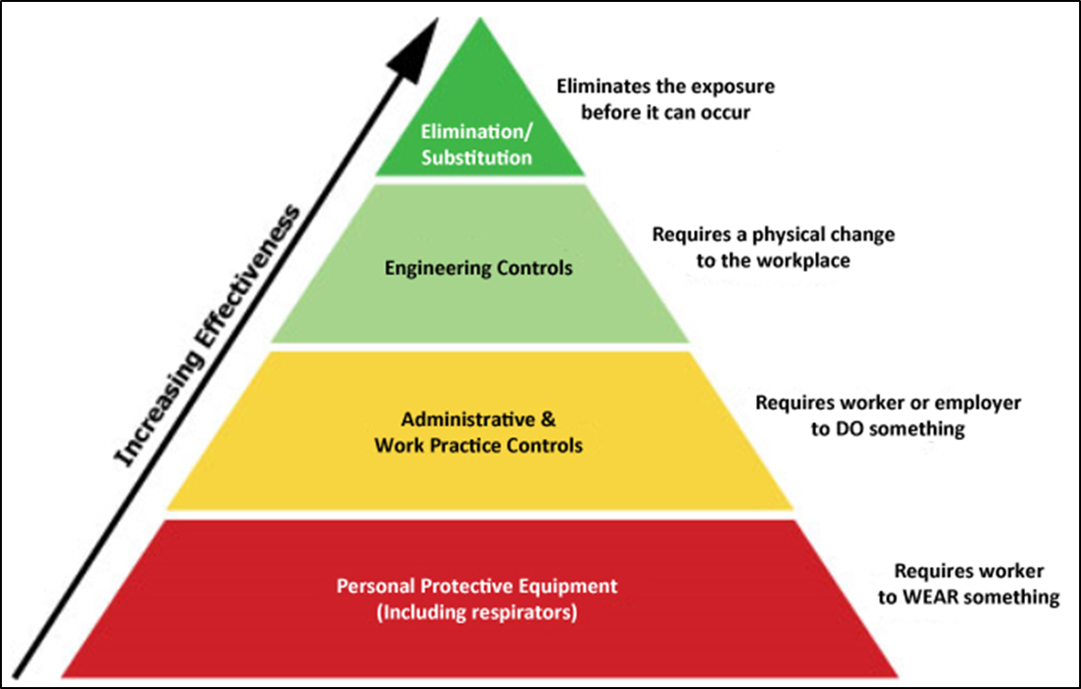
Chemical Hazards and Controls
Hierarchy of control:
Source: OSHA
Notes:
1.) Eliminate the hazard (if possible)
2.) Substitute hazard with safer alternative (if possible)
3.) Engineer controls: ventilation/wetting/guarding/etc.
4.) Administrative: Giving breaks/cycling work to minimize exposures/training
5.) PPE: Respirators/hearing protections/face shields/gloves/boots/etc.

Slide 21

Chemical Hazards and Controls
Elimination and substitution
Source: OSHA
Notes:
https://www.osha.gov/dsg/safer_chemicals/index.html
“Establishing a chemical management system that goes beyond simply complying with OSHA standards and strives to reduce or eliminate chemical hazards at the source through informed substitution best protects workers. Transitioning to safer alternatives can be a complex undertaking, but a variety of existing resources make it easier. OSHA has developed this step-by-step toolkit to provide employers and workers with information, methods, tools, and guidance on using informed substitution in the workplace.
By using this toolkit, businesses can improve worker well-being through eliminating or reducing hazardous chemicals, while creating other benefits, including:
Cost Savings — Reduce expenses and future risks.
Efficiency — Improve performance.
Industry Leadership — Invest in innovation to stay competitive.
Corporate Stewardship — Advance socially responsible practices.”

Slide 22
Chemical Hazards and Controls
Engineering controls
  Ventilation – local (hood) / general (dilution)
  Process and equipment modification
  Isolation/automation
Example: Replacing transfer belts with screw augers on sand movers used in hydraulic fracturing will help contain sand and reduce dust release (lowering exposure to silica).
Source: NIOSH
Notes:
Engineering controls include eliminating toxic chemicals and replacing harmful toxic materials with less hazardous ones, enclosing work processes or confining work operations, and installing general and local ventilation systems.

Slide 23
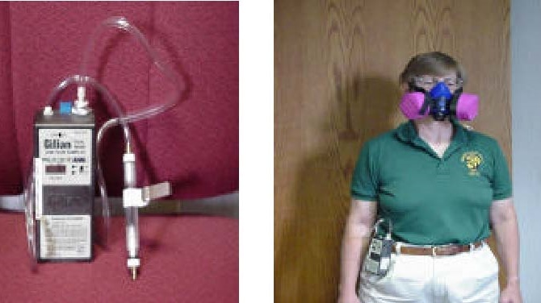
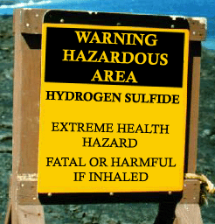
Chemical Hazards and Controls
Administrative controls
  Establish written
  programs & policies
  Training
  Monitor/measure exposure levels
  Inspections and maintenance
  Restricted area signage
  Develop SOPs
Source of photos: OSHA
Notes:
Work practice controls alter the manner in which a task is performed. Some fundamental and easily implemented work practice controls include (1) following proper procedures that minimize exposures while operating production and control equipment; (2) inspecting and maintaining process and control equipment on a regular basis; (3) implementing good house-keeping procedures; (4) providing good supervision and (5) mandating that eating, drinking, smoking, chewing tobacco or gum, and applying cosmetics in regulated areas be prohibited.
Administrative controls include controlling employees' exposure by scheduling production and workers' tasks, or both, in ways that minimize exposure levels. For example, the employer might schedule operations with the highest exposure potential during periods when the fewest employees are present.

Slide 24
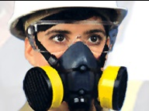
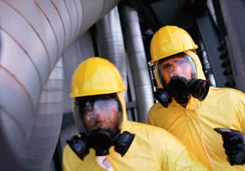
Chemical Hazards and Controls
PPE
  Respirators
  Gloves
  Safety glasses
  Long clothing
Source of photos: OSHA
Notes:
When effective work practices and/or engineering controls are not feasible to achieve the permissible exposure limit, or while such controls are being instituted, and in emergencies, appropriate respiratory equipment must be used. In addition, personal protective equipment such as gloves, safety goggles, helmets, safety shoes, and protective clothing may also be required. To be effective, personal protective equipment must be individually selected, properly fitted and periodically refitted; conscientiously and properly worn; regularly maintained; and replaced as necessary.

Slide 25
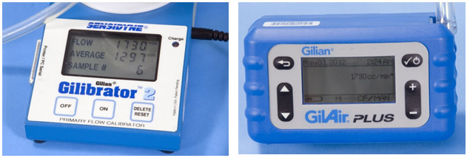
Chemical Hazards and Controls
Worksite analysis – assessing exposures:
Air monitoring – personal and area
Noise monitoring
Observation – PPE use and work practices
Ventilation measurements
Wipe samples – surfaces and personnel
Source: OSHA
Notes:
What is a Worksite Analysis?
A worksite analysis is an essential first step that helps an industrial hygienist determine what jobs and work stations are the sources of potential problems. During the worksite analysis, the industrial hygienist measures and identifies exposures, problem tasks, and risks. The most effective worksite analyses include all jobs, operations, and work activities. The industrial hygienist inspects, researches, or analyzes how the particular chemicals or physical hazards at that worksite affect worker health. If a situation hazardous to health is discovered, the industrial hygienist recommends the appropriate corrective actions.
When toxic chemicals are present in the workplace, your exposure can be estimated by measuring the concentration of a given chemical in the air and the duration of exposure. This measurement is called air or environmental monitoring or sampling and is usually done by industrial hygienists, using various types of instruments. Laboratory analysis may be required. The air is collected from your breathing zone (the air around your nose and mouth) so that the concentrations measured will accurately reflect the concentration you are inhaling. The exposure levels calculated from this monitoring can then be compared to exposure limits for that chemical.

Slide 26
Chemical Hazards and Controls
PELs, or permissible exposure limits:
  OSHA’s regulations that establish the acceptable amount or concentration of a substance in the workplace
  Intended to protect workers from adverse health effects related to hazardous chemical exposure
Notes:
An exposure limit published and enforced by OSHA as a legal standard.
The PELs were adopted exposure limits at the inception of OSHA.
OSHA sets enforceable permissible exposure limits (PEL) to protect workers against the health effects of exposure to hazardous substances. PELs are regulatory limits on the amount or concentration of a substance in the air. They may also contain a skin designation. OSHA PELs are based on an 8-hour time weighted average (TWA) exposure.
Refer to OSHA Chemical Sampling Informaiton
The Chemical Sampling Information pages present, in concise form, data on a large number of chemical substances that may be encountered in industrial hygiene investigations. It is intended as a basic reference for OSHA personnel.
https://www.osha.gov/dts/chemicalsampling/toc/toc_chemsamp.html

Slide 27
Chemical Hazards and Controls
Exposure limits:
TWA = Time - Weighted Average
Levels vary over
the shift duration
These limits protect from chronic diseases
Notes:
Most of OSHA’s PELs are time weighted averages. And most are intended to be the average over an eight hour day. This represents an employee’s real-time exposure to a substance with a PEL of 10ppm . Since the PEL is 10ppm, is this employee overexposed?” No. The TWA would be less than 10ppm.
https://www.osha.gov/pls/oshaweb/owadisp.show_document?p_table=standards&p_id=9992
1910.1000 TABLE Z-1 Limits for Air Contaminants.

Slide 28
Chemical Hazards and Controls
“C” = ceiling limit:
Level never to be exceeded during the work shift
Protect from acute disease or health effects
Notes:
Ceiling limits protect workers from acute or immediate health reactions.
Ceiling limits protect us from death, losing consciousness, inability to think clearly, and other instant reactions.
In this example the Ceiling value has been exceeded.

Slide 29
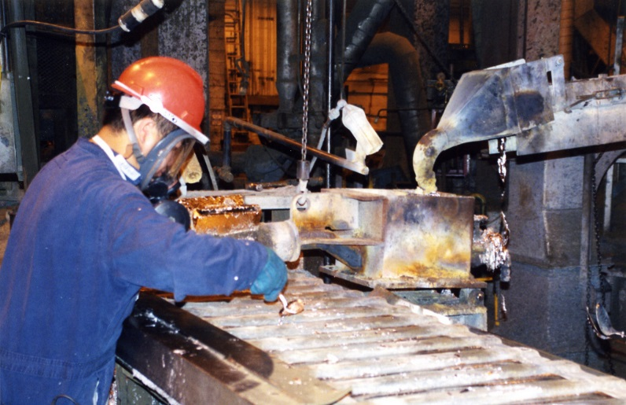
Chemical Hazards and Controls
Substance-specific standards:
Established by OSHA to identify specific requirements
Potentially exposed workers must be monitored and protected
Source: NIOSH
Notes:
While most of OSHA’s PELs are found on the Z Tables, there are substances that are toxic, prevalent, and concerning enough to have earned their own Substance Specific Standards.
OSHA has established substance specific standards for substances (mostly carcinogens) that identify specific requirements. Workers potentially exposed to a substance with a specific standard must be monitored and protected in accordance with that specific standard. A substance-specific standard may require integrated air monitoring or various forms of biological monitoring.

Slide 30
Chemical Hazards and Controls
Components of substance specific standards: (in general)
  Air monitoring
  Control of exposure
    Engineering controls
    Work practices
    Respiratory protection
  Medical surveillance / removal (lead)
  Recordkeeping
  Worker training
Notes:
The components of a substance specific standard are similar for most of the substances. The first component is air monitoring, which quantifies the amount of the contaminant that an employee is exposed to. Then there is controlling that exposure, through engineering controls, work practices, and respiratory protection. Some substances require medical surveillance to track employee health to ensure that they are not being negatively affected by exposure to the substance. The standards also cover the requirements for recordkeeping, and training employees.

Slide 31
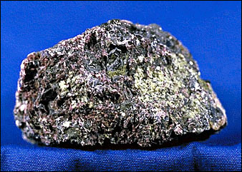
Chemical Hazards and Controls
Hexavalent chromium:
Toxic form of chromium;
Known to cause cancer
Compounds are man-made and widely used
Major source of exposure during “hotwork” on stainless steel and other alloy steels containing Cr(VI)
  Source: OSHA
Notes:
https://www.osha.gov/SLTC/hexavalentchromium/
Hexavalent chromium [Cr(VI)] is one of the valence states (+6) of the element chromium. It is usually produced by an industrial process. Cr(VI) is known to cause cancer. In addition, it targets the respiratory system, kidneys, liver, skin and eyes. Chromium metal is added to alloy steel to increase hardenability and corrosion resistance. A major source of worker exposure to Cr(VI) occurs during "hot work" such as welding on stainless steel and other alloy steels containing chromium metal. Cr(VI) compounds may be used as pigments in dyes, paints, inks, and plastics. It also may be used as an anticorrosive agent added to paints, primers, and other surface coatings. The Cr(VI) compound chromic acid is used to electroplate chromium onto metal parts to provide a decorative or protective coating.
Requirements to protect workers from Cr(VI) exposure are addressed in specific OSHA hexavalent chromium standards covering general industry (1910.1026), shipyards (1915.1026), and construction (1926.1126).

Slide 32
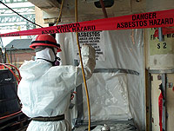
Chemical Hazards and Controls
Asbestos:
Mineral fibers – chrysotile, amosie,
crocidolite, tremolite, anthophylite,
actinolite, and chemically treated/
altered forms
Known carcinogen;
can cause chronic lung disease, as well as
lung and other cancers
Used in numerous building materials and vehicle products
Exposure potential during construction and ship repair; as well as manufacturing of products containing asbestos
  Source: OSHA
Notes:
https://www.osha.gov/SLTC/asbestos/
“What is asbestos?
Asbestos is the name given to a group of naturally occurring minerals that are resistant to heat and corrosion. Asbestos has been used in products, such as insulation for pipes (steam lines for example), floor tiles, building materials, and in vehicle brakes and clutches. Asbestos includes the mineral fibers chrysotile, amosite, crocidolite, tremolite, anthophyllite, actinolite and any of these materials that have been chemically treated or altered. Heavy exposures tend to occur in the construction industry and in ship repair, particularly during the removal of asbestos materials due to renovation, repairs, or demolition. Workers are also likely to be exposed during the manufacture of asbestos products (such as textiles, friction products, insulation, and other building materials) and during automotive brake and clutch repair work.
What are the hazards of asbestos?
Asbestos is well recognized as a health hazard and its use is now highly regulated by both OSHA and EPA. Asbestos fibers associated with these health risks are too small to be seen with the naked eye. Breathing asbestos fibers can cause a buildup of scar-like tissue in the lungs called asbestosis and result in loss of lung function that often progresses to disability and death. Asbestos also causes cancer of the lung and other diseases such as mesothelioma of the pleura which is a fatal malignant tumor of the membrane lining the cavity of the lung or stomach. Epidemiologic evidence has increasingly shown that all asbestos fiber types, including the most commonly used form of asbestos, chrysotile, causes mesothelioma in humans.
What can be done to reduce the hazards of asbestos?
Worker exposure to asbestos hazards are addressed in specific OSHA standards for the construction industry, general industry and shipyard employment sectors. These standards reduce the risk to workers by requiring that employers provide personal exposure monitoring to assess the risk and hazard awareness training for operations where there is any potential exposure to asbestos. Airborne levels of asbestos are never to exceed legal worker exposure limits. There is no "safe" level of asbestos exposure for any type of asbestos fiber. Asbestos exposures as short in duration as a few days have caused mesothelioma in humans. Every occupational exposure to asbestos can cause injury of disease; every occupational exposure to asbestos contributes to the risk of getting an asbestos related disease.8 Where there is exposure, employers are required to further protect workers by establishing regulated areas, controlling certain work practices and instituting engineering controls to reduce the airborne levels. The employer is required to ensure exposure is reduced by using administrative controls and provide for the wearing of personal protective equipment. Medical monitoring of workers is also required when legal limits and exposure times are exceeded.”

Slide 33
Chemical Hazards and Controls
Silica:
Important industrial material found abundantly in the earth’s crust; most common form is quartz
Can cause lung diseases, including silicosis and lung cancer, as well as kidney disease
Exposure to respirable crystalline silica
  Inhalation of small particles
  in air
  Common with operations
  such as cutting, sawing,
  and drilling
Source: NIOSH
Notes:
https://www.osha.gov/dsg/topics/silicacrystalline/
Crystalline silica is an important industrial material found abundantly in the earth’s crust. Quartz, the most common form of silica, is a component of sand, stone, rock, concrete, brick, block, and mortar. Materials containing quartz are found in a wide variety of workplaces.
Silica dust is hazardous when very small (respirable) particles are inhaled. These respirable dust particles can penetrate deep into the lungs and cause disabling and sometimes fatal lung diseases, including silicosis and lung cancer, as well as kidney disease.
Occupational exposure to respirable crystalline silica occurs when cutting, sawing, drilling, and crushing of concrete, brick, ceramic tiles, rock, and stone products. Occupational exposure also occurs in operations that process or use large quantities of sand, such as foundries and the glass, pottery and concrete products industries.
OSHA estimates that more than 2.3 million workers in the United States are potentially exposed to dust containing crystalline silica with nearly 90% of those workers employed in the construction industry. Other industries and operations that may be exposed to crystalline silica include, but are not limited to: glass products, pottery products, concrete products, foundries, dental laboratories, jewelry production, refractory installation and repair, railroad track maintenance, hydraulic fracturing for gas and oil, and abrasive blasting operations.

Slide 34
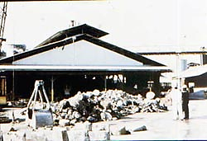
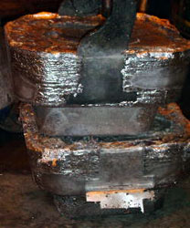
Chemical Hazards and Controls
Lead:
Blue-gray, heavy metal occurring naturally in Earth’s crust
Can harm many of the body’s
organ systems; variety of ailments
Exposure
  Inhalation and/or ingestion of airborne particles containing lead
  Occurs in most industry sectors, including manufacturing, wholesale trade, transportation, construction, remediation, and even recreation
  Source of photos: OSHA
Notes:
https://www.osha.gov/SLTC/lead/
Lead enters the body primarily through inhalation and ingestion. Today, adults are mainly exposed to lead by breathing in lead-containing dust and fumes at work, or from hobbies that involve lead.
Lead passes through the lungs into the blood where it can harm many of the body's organ systems. While inorganic lead does not readily enter the body through the skin, it can enter the body through accidental ingestion (eating, drinking, and smoking) via contaminated hands, clothing, and surfaces. Workers may develop a variety of ailments, such as neurological effects, gastrointestinal effects, anemia, and kidney disease.
OSHA estimates that approximately 804,000 workers in general industry and an additional 838,000 workers in construction are potentially exposed to lead. Workers are exposed to lead as a result of the production, use, maintenance, recycling, and disposal of lead material and products. Lead exposure occurs in most industry sectors including construction, manufacturing, wholesale trade, transportation, remediation and even recreation.
In general industry, workers come in contact with lead in solder, plumbing fixtures, rechargeable batteries, lead bullets, leaded glass, brass, or bronze objects, and radiators. Lead exposure can occur not only in the production of these kinds of objects but also in their use (e.g., firing ranges), repair (e.g., radiator repair), and recycling (e.g., lead-acid battery recycling). Construction workers are exposed to lead during the removal, renovation, or demolition of structures painted with lead pigments. Workers may also be exposed during installation, maintenance, or demolition of lead pipes and fittings, lead linings in tanks and radiation protection, leaded glass, work involving soldering, and other work involving lead metal or lead alloys.
In the general population, lead may be present in small but hazardous concentrations in food, water, and air. Lead poisoning from deteriorating old paint is the primary source of elevated blood lead levels in children. Children under the age of six are at risk of developing cognitive health effects even at very low blood lead levels. Pregnant women or those who might become pregnant must avoid lead exposure because it is toxic to the fetus. Another source of environmental exposure to lead is from workers who take home lead dust on their clothing and shoes.

Slide 35
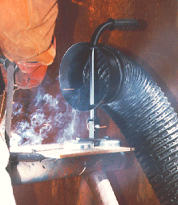
Chemical Hazards and Controls
Welding fumes:
Content depends on components of
base metal, coatings, and/or filler
materials; and welding temperatures
Potential health effects
  Acute exposure: eye, nose, and
  throat irritation; dizziness; nausea
  Prolonged exposure: lung damage; various types of cancer, including lung, larynx, and urinary tract
  Certain fumes and gases can lead to additional health issues
  Source: OSHA
Notes:
https://www.osha.gov/Publications/OSHA_FS-3647_Welding.pdf
Welding joins materials together by melting a metal work piece along with a filler metal to form a strong joint. The welding process produces visible smoke that contains harmful metal fume and gas by-products.
What is in welding fume?
Metals
Aluminum, Antimony, Arsenic, Beryllium, Cadmium, Chromium, Cobalt, Copper, Iron, Lead, Manganese, Molybdenum, Nickel, Silver, Tin, Titanium, Vanadium, Zinc.
Gases
• Shielding—Argon, Helium, Nitrogen, Carbon Dioxide.
• Process—Nitric Oxide, Nitrogen Dioxide, Carbon Monoxide, Ozone, Phosgene, Hydrogen Fluoride, Carbon Dioxide.
Health effects of breathing welding fume
• Acute exposure to welding fume and gases can result in eye, nose and throat irritation, dizziness and nausea. Workers in the area who experience these symptoms should leave the area immediately, seek fresh air and obtain medical attention.
• Prolonged exposure to welding fume may cause lung damage and various types of cancer, including lung, larynx and urinary tract.
• Health effects from certain fumes may include metal fume fever, stomach ulcers, kidney damage and nervous system damage. Prolonged exposure to manganese fume can cause Parkinson’s–like symptoms.
• Gases such as helium, argon, and carbon dioxide displace oxygen in the air and can lead to suffocation, particularly when welding in confined or enclosed spaces. Carbon monoxide gas can form, posing a serious asphyxiation hazard.

Slide 36
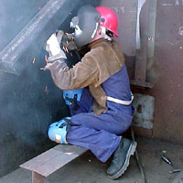
Chemical Hazards and Controls
Exposure to welding fumes affected by:
  Welding process
  Materials used
  Location (outside, enclosed space)
  Work practices
  Air movement
  Use of ventilation
  Source: OSHA
Notes:
https://www.osha.gov/Publications/OSHA_FS-3647_Welding.pdf
Factors that affect worker exposure to welding fume
• Type of welding process
• Base metal and filler metals used
• Welding rod composition
• Location (outside, enclosed space)
• Welder work practices
• Air movement
• Use of ventilation controls

Slide 37
Chemical Hazards and Controls
Toxic atmospheres:
Confined spaces – storage tanks, process vessels, bins, boilers, ventilation or exhaust ducts, sewers, underground utility vaults, tunnels, pipelines, open-top spaces more than 4’ in depth (pits, tubs, vaults)
Hazardous atmospheres
  Oxygen-deficient
  Hydrogen sulfide
  Carbon monoxide
  Source: OSHA
Notes:
https://www.osha.gov/SLTC/confinedspaces/hazards_solutions.html
Confined spaces may be encountered in virtually any occupation; therefore, their recognition is the first step in preventing fatalities. Deaths in confined spaces often occur because the atmosphere is oxygen-deficient, toxic or combustible.
https://www.osha.gov/SLTC/hydrogensulfide/index.html
Hydrogen sulfide (also known as H₂S, sewer gas, swamp gas, stink damp, and sour damp) is a colorless gas known for its pungent "rotten egg" odor at low concentrations. It is extremely flammable and highly toxic.
Hydrogen sulfide is used or produced in a number of industries, such as
Oil and gas refining
Mining
Tanning
Pulp and paper processing
Rayon manufacturing
Hydrogen sulfide also occurs naturally in sewers, manure pits, well water, oil and gas wells, and volcanoes. Because it is heavier than air, hydrogen sulfide can collect in low-lying and enclosed spaces, such as manholes, sewers, and underground telephone vaults. Its presence makes work in confined spaces potentially very dangerous.
The health effects of hydrogen sulfide depend on how much H₂S a worker breathes and for how long. However, many effects are seen even at low concentrations. Effects range from mild, headaches or eye irritation, to very serious, unconsciousness and death.
https://www.osha.gov/OshDoc/data_General_Facts/carbonmonoxide-factsheet.pdf
Carbon monoxide (CO) is a poisonous, colorless, odorless, and tasteless gas. Although it has no detectable odor, CO is often mixed with other gases that do have an odor. So, you can inhale carbon monoxide right along with gases that
you can smell and not even know that CO is present. CO is a common industrial hazard resulting from the incomplete burning of natural gas and any other material containing carbon such as gasoline, kerosene, oil, propane, coal, or wood.
Forges, blast furnaces and coke ovens produce CO, but one of the most common sources of exposure in the workplace is the internal combustion engine.
Carbon monoxide is harmful when breathed because it displaces oxygen in the blood and deprives the heart, brain, and other vital organs of oxygen. Large amounts of CO can overcome you in minutes without warning—causing you to lose consciousness and suffocate.

Slide 38
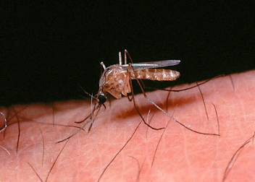





Biological Hazards and Controls
Insects
Animals
Contaminated Soil
Source: OSHA
Source: OSHA
Source: CDC
Poisonous Plants
Water/Sewage
Bloodborne Pathogens
Source: OSHA
Source: OSHA
Source: OSHA
Notes:
Biological Hazards
https://www.osha.gov/Publications/OSHA3143/OSHA3143.htm
Types of biological hazards include:
Contact with contaminated or disease-carrying soil, water, feces, animals (insects, rodents, etc.), or plants
Contact with human blood or bodily fluids, which may contain bloodborne pathogens such as HIV, Hepatitis B, Hepatitis C
Contact with biting or puncturing organisms
Pathogens (bacteria, viruses, protozoa, parasitic worms, mold and other fungi) and other infectious microorganisms can cause diseases and illnesses, including, but not limited to:
Tetanus
H1N1 or Swine flu
Avian flu
West Nile virus
Lime disease
Bloodborne pathogens – HIV, Hepatitis B, Hepatitis C
Exposure to poisonous or harmful plants
Poison ivy, poison oak, poison sumac
Thorn-bearing plants
Exposure to animals and insects
Mosquitoes and other biting insects, ticks, spiders, scorpions
Snakes
Stray or wild animals

Slide 39
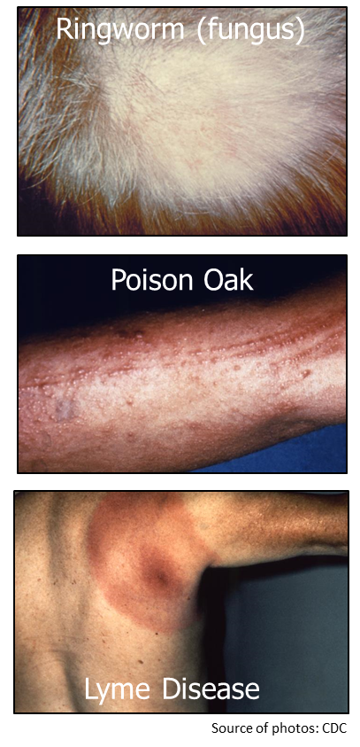
Biological Hazards and Controls
Possible effects of exposure to biological hazards:
Mild, allergic reactions
Serious medical conditions
Death
Most virulent and prevalent biological agents
Notes:
Effects of exposure to biological hazards may range from mild to deadly:
Relatively mild, allergic reactions
Serious medical conditions, even death
Most virulent and prevalent biological agents – anthrax, avian flu, bloodborne pathogens, botulism, foodborne disease, hantavirus, Legionnaires disease, mold, plague, ricin, SARS, smallpox, tularemia, viral hemorrhagic fevers

Slide 40

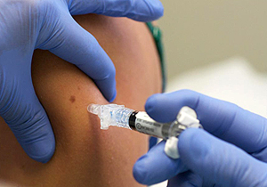
Biological Hazards and Controls
Protection against biological hazards:
Practice universal precaution with:
  Blood
  Bodily fluids
Practice personal hygiene
Provide proper first aid
  Cuts/Scratches
Vaccinations
Wear proper PPE/clothing
  Source of photos: OSHA
Notes:
Methods of protecting workers against exposure to biological hazards
Practice universal precaution with blood and other bodily fluids
Personal hygiene
Proper first aid attention to cuts/scratches, especially on hands and forearms
Keep current on vaccinations

Slide 41


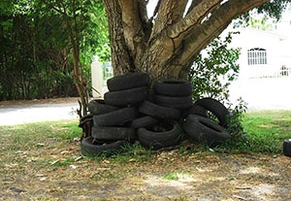
Biological Hazards and Controls
Practice precaution with:
  Animals
  Insects
Use insect repellent
Provide proper ventilation or other appropriate environmental controls
Certain species of fruit bats are thought to be the natural reservoir for Ebola virus. EHF outbreaks are believed to start as a result of contact with infected animals or animal carcasses.
Source: OSHA; photo courtesy of National Park Service, U.S. Dept. of Interior.
The best way to protect yourself from Zika, as well as other mosquito-borne illnesses, is to prevent mosquito bites by using insect repellent, wearing long sleeves and pants, and reducing mosquito breeding grounds, such as standing water. Source: OSHA; photos courtesy of CDC.
  Source: OSHA
Notes:
Methods of protecting workers against exposure to biological hazards
Proper ventilation or other appropriate environmental controls
Proper PPE
Use insect repellent and wear clothing to ward off pathogen-carrying insects
Be alert for animals in hiding under materials or debris piles

Slide 42



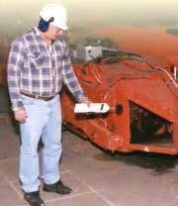
Physical Hazards and Controls
Types of physical hazards:
Temperature
Vibration
Radiation
Noise
Source of photos: OSHA
Notes:
https://www.osha.gov/Publications/OSHA3143/OSHA3143.htm
Types of physical hazards
Noise exposure
Short-term exposure to loud noises; long-term exposure to noise
Examples of noise sources – tools, equipment, and heavy machinery
Permissible Exposure Limit (PEL) is 90 dBA for 8-hour Time Weighted Average (TWA); this is the legal limit set by OSHA
OSHA and NIOSH recommend that worker exposure to noise be controlled below a level of 85 dBA for 8-hour TWA
Extreme temperatures
Exposure occurs in both indoor and outdoor environments due to climate or working conditions
Temperatures affected by humidity level, wind speed, radiant heat, physical contact with hot or cold objects, and strenuous physical activity
Impact or vibrating tools
Hand-held and stationary tools that transmit vibration through a workpiece
Examples – chainsaws, mowers, drillers, air hammers, tractors, excavators, earth-moving equipment, and other large machinery
Radiation exposure – invisible, undetectable energy that travels through space
Extremely Low Frequency Radiation (ELF) – produced by power lines, electrical wiring, and electrical equipment; sources of intense exposure include ELF induction furnaces and high-voltage power lines
Radiofrequency (RF) and Microwave Radiation (MW) – sources include radio emitters and cell phones
Infrared Radiation (IR) – sources include furnaces, heat lamps, and IR lasers
Visible Light Radiation – different visible frequencies of the electromagnetic spectrum; lighting
Ultraviolet Radiation (UV) – sources include the sun, black lights, welding arcs, and UV lasers;
Lasers – emit optical radiations (UV, visible light, IR)

Slide 43
Physical Hazards and Controls
Effects of exposure to physical hazards:
Temperature | Radiation | Vibration | Noise
Rash; Cramps | Burns | Fatigue | Interferences
Exhaustion | Sickness | Strains | Stress
Stroke | Aging | Carpal Tunnel | Tinnitus
Hypothermia | Cancer | HAVS | Headaches
Frostbite | DNA Mutations | Raynaud’s | Hearing Loss
Notes:
1.) Temperature extremes: Exposure occurs both indoor and outdoor. Temperatures affected by humidity, wind speed, radiant heat, physical contact with hot or cold surfaces, and strenuous physical activities. Hypothermia = when body temperature drops to or below 95^{О} F. Frostbite = when air temperature is below 0^{О} F or when cold temperatures are combined with high winds. Trench Foot = Result of prolonged exposure of lower extremities to cold (32^{О} F to 50^{О} F) and moisture
2.) Radiation: ELF produced by power lines and electrical wiring/equipment, RF and microwave radiation (cell phones and radio emitters), IR (IR lasers, furnaces, and heat lamps), UV (welding arcs, UV lasers, and sun) --- UV is the most common in construction!
3.) Vibrating/Impact: Hand-held and stationary tools that transmit vibration through work piece (i.e. chainsaws, mowers, drillers, air hammers, pile drivers, tractors, graders, excavators, earth-moving equipment, and other large machinery)
4.) Noise: Short and long-term exposure to loud noises

Slide 44
Physical Hazards and Controls
Exposure to heat:
Health Effects | Cause | Symptoms
Rash; Cramps | Heavy sweating | Red cluster of bumps/blisters; Muscle pains or spasms
Exhaustion | Loss of body fluids/salts | Dizziness, light-headedness, weakness, heavy sweating, pale skin, sick to stomach
Stroke | Rapid body temperature rise | ≥104F body temperature. Red, hot, dry skin; dizziness; confusion; unconscious
Notes:
https://www.osha.gov/SLTC/heatstress/heat_illnesses.html
Exposure to hot temperatures
Heat rash – most common problem
Caused by sweating
Looks like red cluster of pimples or small blisters; usually appears on neck, upper chest, in the groin, under the breasts, and in elbow creases
Heat cramps
Usually occurs after prolonged exposure to heat; heavy sweating depletes body of salt and moisture
Painful cramps in abdomen and other muscles as result of decreased salt
Signs/symptoms – muscle pains or spasms in abdomen, arms, or legs; sick feeling in the stomach
Heat exhaustion – serious condition
Caused by loss of large amounts of fluids and sometimes excessive loss of salts due to sweating during work/exercise in hot environment
Signs/symptoms – dizziness/light-headedness; weakness; heavy sweating; pale skin color; feeling sick to stomach; vomiting; irritability; fainting; moist, clammy skin
Heat stroke – most serious condition
Serious medical condition that requires immediate attention; occurs when body is unable to control its temperature
Body’s temperature rises rapidly, sweating is diminished or absent, and body is unable to cool down; body temperature could rise to 104 ^{О} F or higher within 10-15 minutes
Warning signs – red, hot, dry skin; rapid, strong pulse; body temperature ˃104 ^{О} F; confusion; throbbing headache; dizziness; feeling sick to stomach; unconscious

Slide 45
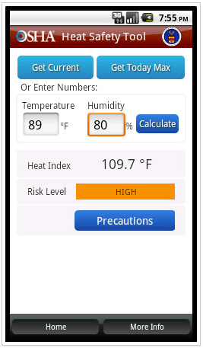
Physical Hazards and Controls
OSHA’s Heat Safety Tool
Heat Index App
Notes:
https://www.osha.gov/SLTC/heatillness/heat_index/heat_app.html
“The App allows workers and supervisors to calculate the heat index for their worksite, and, based on the heat index, displays a risk level to outdoor workers. Then, with a simple "click," you can get reminders about the protective measures that should be taken at that risk level to protect workers from heat-related illness-reminders about drinking enough fluids, scheduling rest breaks, planning for and knowing what to do in an emergency, adjusting work operations, gradually building up the workload for new workers, training on heat illness signs and symptoms, and monitoring each other for signs and symptoms of heat-related illness.”

Slide 46
Physical Hazards and Controls
Protection against heat:
Engineering | Administrative | PPE
Air conditioning Ventilation Cooling fans Local exhaust ventilation Reflective shields Insulation Eliminate steam leaks | Emergency plan Acclimatization Adequate water Work/rest cycles Avoid hottest times; adjust work demands Rotate job functions Buddy system Monitoring | Insulated PPE, in some work places Thermal clothing (cool vests)
Eliminate or substitute hazard, whenever feasible
Notes:
https://www.osha.gov/SLTC/heatstress/prevention.html
Most heat-related health problems can be prevented, or the risk of developing them can be reduced.
Engineering Controls
The best way to prevent heat-related illness is to make the work environment cooler. A variety of engineering controls can reduce workers' exposure to heat:
Air conditioning (such as air-conditioned crane or construction equipment cabs, air conditioning in break rooms).
Increased general ventilation.
Cooling fans.
Local exhaust ventilation at points of high heat production or moisture (such as exhaust hoods in laundry rooms).
Reflective shields to redirect radiant heat.
Insulation of hot surfaces (such as furnace walls).
Elimination of steam leaks.
Work Practices
Employers should have an emergency plan in place that specifies what to do if a worker has signs of heat-related illness, and ensures that medical services are available if needed.
Employers should take steps that help workers become acclimatized (gradually build up exposure to heat), especially workers who are new to working in the heat or have been away from work for a week or more. Gradually increase workloads and allow more frequent breaks during the first week of work.
Workers must have adequate potable (safe for drinking) water close to the work area, and should drink small amounts frequently.
Rather than being exposed to heat for extended periods of time, workers should, wherever possible, be permitted to distribute the workload evenly over the day and incorporate work/rest cycles.
If possible, physical demands should be reduced during hot weather, or heavier work scheduled for cooler times of the day.
Rotating job functions among workers can help minimize overexertion and heat exposure.
Workers should watch out for each other for symptoms of heat-related illness and administer appropriate first aid to anyone who is developing a heat-related illness.
In some situations, employers may need to conduct physiological monitoring of workers
Personal Protective Equipment
Workers should be aware that use of certain personal protective equipment (e.g., certain types of respirators and impermeable clothing) can increase the risk of heat-related illness.
In some situations, special cooling devices can protect workers in hot environments:
In some workplaces, insulated gloves, insulated suits, reflective clothing, or infrared reflecting face shields may be needed.
Thermally conditioned clothing might be used for extremely hot conditions; for example:
A garment with a self-contained air conditioner in a backpack.
A garment with a compressed air source that feeds cool air through a vortex tube.
A plastic jacket whose pockets can be filled with dry ice or containers of ice.

Slide 47
Physical Hazards and Controls
Exposure to cold:
Health Effects | Cause | Symptoms
Hypothermia | Body temperature drops ≤95F | Uncontrolled shivering; slurred speech; memory loss; blue/purple skin
Frostbite | Exposed to ≤0F air | Pale, cold, waxy-white skin; tingling; stinging
Notes:
https://www.osha.gov/SLTC/emergencypreparedness/guides/cold.html
Exposure to cold temperatures
Hypothermia
Body temperature drops to or below 95^{О} F
Impaired muscular and brain functions
Symptoms – uncontrolled shivering, fumbling hands/clumsy movements, slurred speech, memory loss, erratic behavior, cool bluish/purple-colored skin
Frostbite
Freezing body tissue – exposed skin susceptible when air temperature is below 0^{О} F or when cold temperatures are combined with high winds
Leads to tissue damage, scarring, and possible amputation
Symptoms – pale, waxy-white skin color that is cool to touch; tingling, stinging, or aching feeling in exposed area, followed by numbness; ears, fingers, toes, and cheeks are areas primarily affected; freezing of muscles and tendons, causing areas to become numb, painless, and hard to the touch
Trench foot
Result of prolonged exposure of lower extremities to cold (32^{О} F to 50^{О} F) and moisture
Usually develops slowly, over a period of hours to days
Symptoms – initially, reddened skin, which later becomes pale and swollen; numbness, followed by leg cramps; blister formation, followed by ulceration

Slide 48
Physical Hazards and Controls
Protection against cold:
Engineering | Administrative | PPE
Heaters Shield work areas (windbreaks) | Warm liquids Adjust work schedule Buddy system Monitoring Frequent breaks in warm areas Acclimatization | Layered clothing Hat or hood, face cover, gloves Clothing out of fabric that retains insulation even when wet Insulated and waterproof boots
Eliminate or substitute hazard, whenever feasible
Notes:
https://www.osha.gov/SLTC/emergencypreparedness/guides/cold.html
Employers should provide engineering controls. For example, radiant heaters may be used to warm workers in outdoor security stations. If possible, shield work areas from drafts or wind to reduce wind chill.
Employers should use safe work practices. For example, it is easy to become dehydrated in cold weather. Employers therefore, can provide plenty of warm sweetened liquids to workers. Avoid alcoholic drinks. If possible, employers can schedule heavy work during the warmer part of the day. Employers can assign workers to tasks in pairs (buddy system), so that they can monitor each other for signs of cold stress. Workers can be allowed to interrupt their work, if they are extremely uncomfortable. Employers should give workers frequent breaks in warm areas. Acclimatize new workers and those returning after time away from work, by gradually increasing their workload, and allowing more frequent breaks in warm areas, as they build up a tolerance for working in the cold environment. Safety measures, such as these, should be incorporated into the relevant health and safety plan for the workplace.
Dressing properly is extremely important to preventing cold stress. The type of fabric worn also makes a difference. Cotton loses its insulation value when it becomes wet. Wool, silk and most synthetics, on the other hand, retain their insulation even when wet. The following are recommendations for working in cold environments:
Wear at least three layers of loose fitting clothing. Layering provides better insulation. Do not wear tight fitting clothing.
An inner layer of wool, silk or synthetic to keep moisture away from the body.
A middle layer of wool or synthetic to provide insulation even when wet.
An outer wind and rain protection layer that allows some ventilation to prevent overheating.
Wear a hat or hood to help keep your whole body warmer. Hats reduce the amount of body heat that escapes from your head.
Use a knit mask to cover the face and mouth (if needed).
Use insulated gloves to protect the hands (water resistant if necessary).
Wear insulated and waterproof boots (or other footwear).

Slide 49
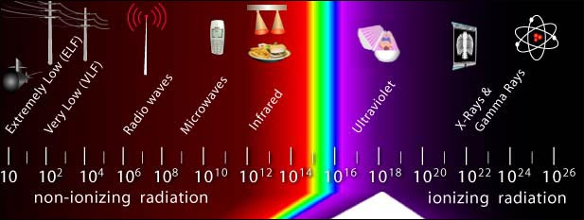
Physical Hazards and Controls
Exposure to radiation:
Source: OSHA
Notes:
https://www.osha.gov/SLTC/radiation/index.html
Exposure to radiation
Radiation may be defined as energy traveling through space. Non-ionizing radiation is essential to life, but excessive exposures will cause tissue damage. All forms of ionizing radiation have sufficient energy to ionize atoms that may destabilize molecules within cells and lead to tissue damage. Radiation sources are found in a wide range of occupational settings. If radiation is not properly controlled it can be potentially hazardous to the health of workers.
NON-IONIZING RADIATION https://www.osha.gov/SLTC/radiation_nonionizing/index.html
“Non-ionizing radiation is described as a series of energy waves composed of oscillating electric and magnetic fields traveling at the speed of light. Non-ionizing radiation includes the spectrum of ultraviolet (UV), visible light, infrared (IR), microwave (MW), radio frequency (RF), and extremely low frequency (ELF). Lasers commonly operate in the UV, visible, and IR frequencies. Non-ionizing radiation is found in a wide range of occupational settings and can pose a considerable health risk to potentially exposed workers if not properly controlled.
Extremely Low Frequency Radiation (ELF) - Extremely Low Frequency (ELF) radiation at 60 HZ is produced by power lines, electrical wiring, and electrical equipment. Common sources of intense exposure include ELF induction furnaces and high-voltage power lines.
Radiofrequency and Microwave Radiation - Microwave radiation (MW) is absorbed near the skin, while Radiofrequency (RF) radiation may be absorbed throughout the body. At high enough intensities both will damage tissue through heating. Sources of RF and MW radiation include radio emitters and cell phones.
Infrared Radiation (IR) - The skin and eyes absorb infrared radiation (IR) as heat. Workers normally notice excessive exposure through heat sensation and pain. Sources of IR radiation include furnaces, heat lamps, and IR lasers.
Visible Light Radiation - The different visible frequencies of the electromagnetic (EM) spectrum are "seen" by our eyes as different colors. Good lighting is conducive to increased production, and may help prevent incidents related to poor lighting conditions. Excessive visible radiation can damage the eyes and skin.
Ultraviolet Radiation (UV) - Ultraviolet radiation (UV) has a high photon energy range and is particularly hazardous because there are usually no immediate symptoms of excessive exposure. Sources of UV radiation include the sun, black lights, welding arcs, and UV lasers.
Laser Hazards - Lasers typically emit optical (UV, visible light, IR) radiations and are primarily an eye and skin hazard. Common lasers include CO₂ IR laser; helium - neon, neodymium YAG, and ruby visible lasers, and the Nitrogen UV laser.
IONIZING RADIATION https://www.osha.gov/SLTC/radiationionizing/index.html
Ionizing radiation sources may be found in a wide range of occupational settings, including health care facilities, research institutions, nuclear reactors and their support facilities, nuclear weapon production facilities, and other various manufacturing settings, just to name a few. These radiation sources can pose a considerable health risk to affected workers if not properly controlled.

Slide 50
Physical Hazards and Controls
Protection against radiation:
Engineering | Administrative | PPE
Enclose/Shield work areas to minimize stray radiation Interlocked doors on devices that can produce acute thermal injuries Remote operation of radiation-producing devices | Clearly mark controlled spaces Minimize exposure times Location/ installation of devices Proper maintenance | RF/MW protective suits, including head and eye protection Safety glasses, goggles, welding helmets, or welding face shields with appropriate filter lenses
Eliminate or substitute hazard, whenever feasible
Notes:
Source: ISBN: 978-1-4606-7601-1 (HTML) https://www.labour.gov.on.ca/english/hs/pubs/radiation/gl_radio_4.php
“Engineering Controls
Sources of RF/MW radiation should be properly shielded to minimize stray radiation.
Devices which can produce acute thermal injuries (e.g., industrial MW ovens) should have interlocked doors.
Devices which produce high levels of stray RF radiation (e.g., induction heaters, vinyl welders and dielectric heaters) should be operated remotely whenever possible.
Administrative controls
Training appropriate to the potential level of RF/MW exposure should be provided to workers.
Controlled spaces should be clearly demarcated.
Exposure of workers to RF/MW radiation should not exceed the recommended occupational exposure limits.
Areas where it is suspected that worker exposure to RF/MW radiation could exceed the recommended limits should be surveyed to determine the exposure levels.
Needless exposure to RF/MW fields should be avoided.
Exposure times should be kept as short as reasonably possible.
Potentially hazardous RF/MW devices should be appropriately labeled, and areas of excessive exposure around them clearly demarcated. Notices with warnings and the necessary precautions should be posted.
Electrically-activated explosive devices should not be placed near sources of RF/MW radiation.
RF/MW devices should not be used in flammable or explosive atmospheres.
Equipment sensitive to RF/MW radiation, such as telephone switchboards or control panels, should not be installed near sources of RF/MW radiation.
Maintenance of devices used to produce RF/MW radiation should be done by qualified personnel following standard safety procedures. The equipment should be turned off whenever possible.
Personal protection
When exposures cannot be reduced by the above methods, RF/MW protective suits, including head and eye protection, can be used. Suits should be tested to determine whether they reduce worker exposure to levels below the recommended occupational exposure limits for controlled spaces, and that they do not pose any additional safety hazards to workers (e.g., from overheating, shocks or fire).
Controlling RF shocks and burns
Metallic structures producing contact shocks should be electrically grounded and/or insulated.
Insulating platforms or shoes (e.g., rubber-soled shoes) can be used to reduce energy absorption and currents to the ground.
When the above measures are ineffective or not reasonably possible, workers should wear insulating gloves.”
(Ontario Ministry of Labour 2016)
https://www.osha.gov/Publications/OSHAfactsheet-eyeprotection-during-welding.pdf
Electromagnetic energy given off by an arc or flame can injure workers’ eyes and is commonly referred to as radiant energy or light radiation. For protection from radiant energy, workers must use personal protective equipment, such as safety glasses, goggles, welding helmets, or welding face shields. This equipment must have filter lenses with a shade number that provides the appropriate level of protection. A shade number indicates the intensity of light radiation that is allowed to pass through a filter lens to one’s eyes. Therefore, the higher the shade number, the darker the filter and the less light radiation that will pass through the lens.

Slide 51
Physical Hazards and Controls
Exposure to vibration:
Health Effects | Early Signs and Symptoms | Later Signs and Symptoms
Circulatory disturbances, such as VWF and HAVS Sensory nerve damage Muscle, bone, and joint injury | Intermittent tingling of one or more fingers Blanching of fingertips Pain in fingers | Loss of sense of touch; numbness Blanching of entire fingers Loss of grip strength Sever pain Carpal tunnel syndrome Pain and loss of strength in arms Loss of finger dexterity or coordination
Notes:
https://www.osha.gov/SLTC/etools/sawmills/vibration.html
https://www.osha.gov/SLTC/etools/woodworking/health_vibration.html
https://www.osha.gov/SLTC/etools/electricalcontractors/supplemental/hazardindex.html#vibration
High levels of vibration can cause permanent damage to hands and arms. The risk of developing hand-arm vibration syndrome (HAVS) is dependent on the following factors:
vibration levels,
length of time the saw is used,
position and grips of the saw, and
coldness and wetness of the environment and the worker.
Exposure to HAVS could produce several adverse health effects such as the following:
circulatory disturbances, such as vibration white finger (VWF), also called Raynaud’s Syndrome; Hand-Arm Vibration Syndrome (HAVS) is a more advanced condition affecting the entire hand or arm.
sensory nerve damage, and
muscle, bone and joint injury.
Early Signs and Symptoms:
Intermittent (comes and goes) tingling (needles and pins sensation) of one or more fingers.
Blanching (white-color) of fingertips.
Pain in fingers that subsides in a short time.
Later Signs and Symptoms
Loss of sense of touch or numbness.
Blanching of entire fingers.
Loss of grip strength in hand and fingers.
Severe pain in fingers.
Carpal tunnel syndrome or pressure on nerves in a wrist.
Pain and loss of strength in arms.
Loss of finger dexterity or coordination.

Slide 52
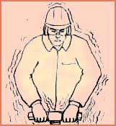
Physical Hazards and Controls
Protection against vibration:
Engineering | Administrative | PPE
Vibration reduction equipment Vibration dampeners or shields to isolate source of vibration from employee | Proper positioning and grip; let the machine do the work Job rotation Limit duration of task Proper maintenance | Anti-vibration gloves
Eliminate or substitute hazard, whenever feasible
Notes:
Impact/vibrating tools or equipment
Use tools designed to reduce vibrations
Allow machine to do the work; do not grip too tightly
Maintain machines in proper working order
Alternate tasks using vibrating and non-vibrating tools
Training
PPE

Slide 53
Physical Hazards and Controls
Exposure to noise:
Health Effects | Signs and Symptoms
Tinnitus Permanent hearing loss Physical stress Psychological stress | Ears feel stuffed up Ringing in the ears Limited ability to hear high frequency sounds, understand speech, and communicate
Notes:
https://www.osha.gov/SLTC/noisehearingconservation/healtheffects.html
Health Effects
Exposure to high levels of noise can cause permanent hearing loss. Neither surgery nor a hearing aid can help correct this type of hearing loss. Short term exposure to loud noise can also cause a temporary change in hearing (your ears may feel stuffed up) or a ringing in your ears (tinnitus). These short-term problems may go away within a few minutes or hours after leaving the noise. However, repeated exposures to loud noise can lead to permanent tinnitus and/or hearing loss.
Loud noise can create physical and psychological stress, reduce productivity, interfere with communication and concentration, and contribute to workplace accidents and injuries by making it difficult to hear warning signals. The effects of noise induced hearing loss can be profound, limiting your ability to hear high frequency sounds, understand speech, and seriously impairing your ability to communicate.

Slide 54
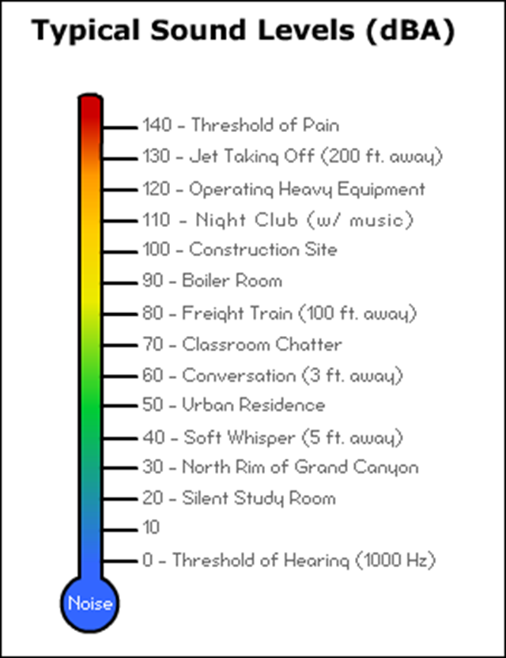
Physical Hazards and Controls
Noise – prolonged exposures to
85 dB can lead to hearing loss
Source: OSHA
Notes:
https://www.osha.gov/dts/osta/otm/new_noise/images/fig3.gif
https://www.osha.gov/SLTC/noisehearingconservation/
Action limit = 85 dBA
OSHA PEL = 90 dBA (8-hr TWA)
Hearing loss:
85 dBA = Prolonged
100 dBA = 15+ minutes
120 dBA = 9 seconds
140 dBA = Immediate
Noise
Hearing loss – temporary or permanent
Tinnitus (ringing in the ears)
Physical and psychological stress, reduced productivity, interference with communication and concentration
Signs that workplace is too noisy – ringing in ears after leaving work; having to shout to be heard by co-worker an arm’s length away; frequent headaches; experiencing temporary hearing loss when leaving work
Noise, another significant physical hazard, can be controlled by various measures. Noise can be reduced by installing equipment and systems that have been engineered, designed, and built to operate quietly; by enclosing or shielding noisy equipment; by making certain that equipment is in good repair and properly maintained with all worn or unbalanced parts replaced; by mounting noisy equipment on special mounts to reduce vibration; and by installing silencers, mufflers, or baffles.
Substituting quiet work methods for noisy ones is another significant way to reduce noise, for example, welding parts rather than riveting them. Also, treating floors, ceilings, and walls with acoustical material can reduce reflected or reverberant noise. In addition, erecting sound barriers at adjacent work stations around noisy operations will reduce worker exposure to noise generated at adjacent work stations.
It is also possible to reduce noise exposure by increasing the distance between the source and the receiver, by isolating workers in acoustical booths, limiting workers' exposure time to noise, and by providing hearing protection. OSHA requires that workers in noisy surroundings be periodically tested as a precaution against hearing loss.

Slide 55
Physical Hazards and Controls
Protection against noise:
Engineering | Administrative | PPE
Use low-noise tools and machinery Place a barrier between noise source and worker Enclose or isolate noise Weld parts rather than rivet Use acoustical materials Install silencers, mufflers, or baffles | Increase distance between source and worker Alter work schedule Limit time of noise exposure Provide quiet areas for breaks | Ear plugs Ear muffs Hearing bands
Eliminate or substitute hazard, whenever feasible
Notes:
https://www.osha.gov/SLTC/noisehearingconservation/evaluation.html
There are several ways to control and reduce worker exposure to noise in a workplace where exposure has been shown to be excessive.
Engineering controls involve modifying or replacing equipment, or making related physical changes at the noise source or along the transmission path to reduce the noise level at the worker's ear. Examples of inexpensive, effective engineering controls include some of the following: Choose low-noise tools and machinery; Maintain and lubricate machinery and equipment (e.g., oil bearings); Place a barrier between the noise source and employee (e.g., sound walls or curtains); and Enclose or isolate the noise source.
Administrative controls are changes in the workplace or schedule that reduce or eliminate the worker exposure to noise. Examples include: Operating noisy machines during shifts when fewer people are exposed; Limiting the amount of time a person spends at a noise source; Providing quiet areas where workers can gain relief from hazardous noise sources; and Controlling noise exposure through distance is often an effective, yet simple and inexpensive administrative control. Specifically, for every doubling of the distance between the source of noise and the worker, the noise is decreased by 6 dBA.
Noise reduction
Use equipment and systems that operate quietly
Enclose or shield noisy equipment; erect sound barriers
Keep equipment in good repair and properly maintained
Use special mounts that reduce noise from vibrations
Install silencers, mufflers, or baffles
Weld parts rather than rivet
Use acoustical material on floors, ceilings, and walls
Use distance between source and receiver
Provide hearing protection

Slide 56


Physical Hazards and Controls
When to wear hearing protection
  Noise or sound level exceeds 90 dBA (OSHA)
  Recommended when exceeds 85 dBA (NIOSH)
What to wear
  Personal comfort preference
  Long-term/Single use (plugs)
  Short-term/On and off (muffs)
  Consider NRR
Source of photos: OSHA
Notes:
https://www.osha.gov/dts/osta/otm/new_noise/index.html#noisecontroleng
Hearing protection devices (HPDs) are considered the last option for controlling noise exposures. HPDs are generally used during the time it takes to implement engineering or administrative controls, or when such controls are not feasible. Unless great care is taken in establishing a hearing conservation program, workers will often receive very little benefit from HPDs. The best hearing protector, when fitted correctly, is one that is accepted by the worker and worn properly. If the worker exposure is above 85 dBA (8-hour TWA), hearing protection must be made available, along with the other requirements in the hearing protection program.
All hearing protectors are provided with an NRR (Noise Reduction Rating), which is based on the attenuation of continuous noise and may not be an accurate indicator of the protection attainable against impulse noise.

Slide 57
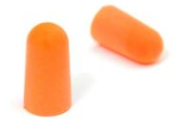

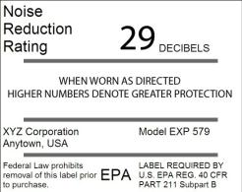

Physical Hazards and Controls
Dual hearing protection:
Formable Ear Plugs
Listed NRR = 29
Adjusted NRR (29 – 7) = 22
Earmuffs
Listed NRR = 16
Adjusted NRR for Dual Protection = 5
22 (adjusted NRR) + 5 (Dual Protection NRR) = 27
Source of graphics: OSHA
Notes:
Earplugs, earmuffs, or hearing bands alone might not provide sufficient protection from significantly high noise levels. In this case, workers should wear double hearing protection-earmuffs with earplugs. Avoid corded earplugs, as the cord would interfere with the muff seal. Additionally, hearing bands cannot be worn with earplugs or earmuffs, as the connected band would interfere with the muff seal, and there is no room to insert earplugs at the same time.
Workers whose 8-hour time weighted average exposures exceed 100 decibels should wear double hearing protection (wearing earplugs and earmuffs simultaneously).
NOTE: The term "double hearing protection" is misleading. The attenuation provided from any combination earplug and earmuff is not equal to the sum of their individual attenuation values.
To calculate the dual hearing protection using the noise reduction rating, take the higher NRR and add five (5) to the field adjusted NRR (listed NRR – 7 + 5); the extra five (5) is all that is added for the second device.

Slide 58
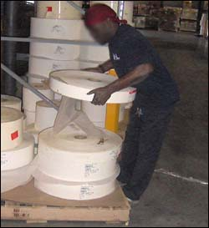
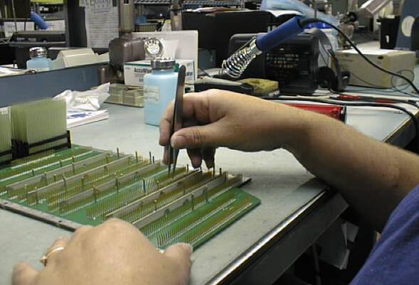

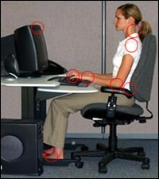

Ergonomic Hazards and Controls
Source of photos: OSHA
Notes:
https://www.osha.gov/Publications/OSHA3143/OSHA3143.htm
Ergonomic Hazards
The science of ergonomics studies and evaluates a full range of tasks including, but not limited to, lifting, holding, pushing, walking, and reaching. Many ergonomic problems result from technological changes, such as increased assembly line speeds, adding specialized tasks, and increased repetition; some problems arise from poorly designed job tasks. Any of those conditions can cause ergonomic hazards such as excessive vibration and noise, eye strain, repetitive motion, and heavy lifting problems. Improperly designed tools or work areas also can be ergonomic hazards. Repetitive motions or repeated shocks over prolonged periods of time as in jobs involving sorting, assembling, and data entry can often cause irritation and inflammation of the tendon sheath of the hands and arms, a condition known as carpal tunnel syndrome.
Well-designed, ergonomic work environment can include increased efficiency, fewer accidents, lower operating costs. and more effective use of personnel.

Slide 59
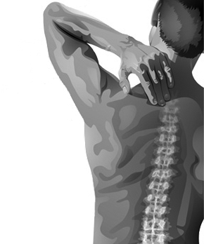
Ergonomic Hazards and Controls
Effects of exposure to ergonomic hazards:
Musculoskeletal Disorders (MSDs)
  Exposure to ergonomic risk factors for MSDs increases a worker's risk of injury
    Repetition
    High force
    Awkward postures
  Work-related MSDs are among the
  most frequently reported causes
  of lost or restricted work time.
Source: OSHA
Notes:
https://www.osha.gov/SLTC/ergonomics/index.html
Musculoskeletal disorders (MSDs) affect the muscles, nerves, blood vessels, ligaments and tendons. Workers in many different industries and occupations can be exposed to risk factors at work, such as lifting heavy items, bending, reaching overhead, pushing and pulling heavy loads, working in awkward body postures and performing the same or similar tasks repetitively.
Examples of Musculoskeletal Disorders (MSDs)
Carpal tunnel syndrome
Tendinitis
Rotator cuff injuries (affects the shoulder)
Epicondylitis (affects the elbow)
Trigger finger
Muscle strains and low back injuries

Slide 60
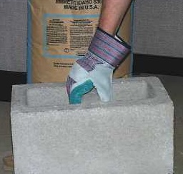
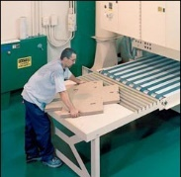
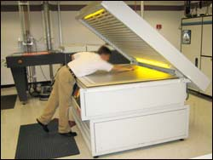
Ergonomic Hazards and Controls
Risk factors for MSDs:
Overexertion
Repetitive tasks
Awkward posture/positions
Localized pressure
Cold temperatures
Vibration
Combined exposure
Source of photos: OSHA
Notes:
https://www.osha.gov/SLTC/ergonomics/identifyprobs.html
The risk of Musculoskeletal Disorders (MSDs) injury depends on work positions and postures, how often the task is performed, the level of required effort and how long the task lasts. Risk factors that may lead to the development of MSDs include:
Exerting excessive force. Examples include lifting heavy objects or people, pushing or pulling heavy loads, manually pouring materials, or maintaining control of equipment or tools.
Performing the same or similar tasks repetitively. Performing the same motion or series of motions continually or frequently for an extended period of time.
Working in awkward postures or being in the same posture for long periods of time. Using positions that place stress on the body, such as prolonged or repetitive reaching above shoulder height, kneeling, squatting, leaning over a counter, using a knife with wrists bent, or twisting the torso while lifting.
Localized pressure into the body part. Pressing the body or part of the body (such as the hand) against hard or sharp edges, or using the hand as a hammer.
Cold temperatures. In combination with any one of the above risk factors may also increase the potential for MSDs to develop. For example, many of the operations in meatpacking and poultry processing occur with a chilled product or in a cold environment.
Vibration. Both whole body and hand-arm, can cause a number of health effects. Hand-arm vibration can damage small capillaries that supply nutrients and can make hand tools more difficult to control. Hand-arm vibration may cause a worker to lose feeling in the hands and arms resulting in increased force exertion to control hand-powered tools (e.g. hammer drills, portable grinders, chainsaws) in much the same way gloves limit feeling in the hands. The effects of vibration can damage the body and greatly increase the force which must be exerted for a task.
Combined exposure to several risk factors. May place workers at a higher risk for MSDs than does exposure to any one risk factor.

Slide 61
Ergonomic Hazards and Controls
Protection against ergonomic hazards:
Use ergonomically designed tools
Use correct work practices
  Proper lifting techniques
Ask for help when handling:
  Heavy loads
  Bulky/Awkward materials
Properly fitting PPE
Source: NIOSH
Notes:
Ergonomic hazards are avoided primarily by the effective design of a job or jobsite and better designed tools or equipment that meet workers' needs in terms of physical environment and job tasks. Through thorough worksite analyses, employers can set up procedures to correct or control ergonomic hazards by using the appropriate engineering controls (e.g., designing or re-designing work stations, lighting, tools, and equipment); teaching correct work practices (e.g., proper lifting methods); employing proper administrative controls (e.g., shifting workers among several different tasks, reducing production demand, and increasing rest breaks); and, if necessary, providing and mandating personal protective equipment. Evaluating working conditions from an ergonomics standpoint involves looking at the total physiological and psychological demands of the job on the worker.
Use ergonomically designed tools
Use correct work practices
Proper lifting techniques
Ask for help when handling:
Heavy loads
Bulky/Awkward materials
Properly fitting PPE

Slide 62
Discussion
What are examples of health hazards at your worksite?
How are they controlled?

Slide 63
Knowledge Check
Which of the following is an example of an industrial hygiene health hazard?
  Chemical hazards
  Economic hazards
  Electrical hazards
  Fall hazards
  Answer: a. Chemical hazards

Slide 64
Knowledge Check
Which of the following is an example of a physical health hazard?
  Asbestos
  Noise
  Silica
  Lead
  Answer: b. Noise

Slide 65
Knowledge Check
Which of the following controls is an example of an engineering control for protection against chemicals?
  Ventilation
  Respirators
  Training
  Signage
  Answer: a. Ventilation

Slide 66
What questions do you have?
Thank You!

