Slide 1
Fall Protection
OSHA 10-hour Outreach Training
General Industry

Slide 2
Introduction
Fatal Fall
Eighteen-Year-Old Sporting Goods Retail Store Worker Dies in a Fall From a Shelving Unit - Pennsylvania
NIOSH In-house FACE Report 2001-06
Notes:
NIOSH In-house FACE Report 2001-06; http://www.cdc.gov/niosh/face/In-house/full200106.html
“An 18-year-old male sporting-goods retail-store worker (the victim) died from a head injury after falling approximately 12 feet from the top of a shelving unit. When the incident happened, the victim was in the process of retrieving a large, heavy box from the top shelf of an H-frame shelving unit. A witness reported that as the victim leaned over and grasped the box by its nylon shipping bands, one of the bands broke and the victim fell backwards off the H-frame to the concrete floor. A registered nurse (RN) who was shopping in the store witnessed the incident, and rendered cardiopulmonary resuscitation (CPR) to the victim. The store's manager called 911 and emergency rescue personnel and police arrived within minutes. The victim was life-flighted to a nearby trauma center where he died later that day from his injuries.”

Slide 3
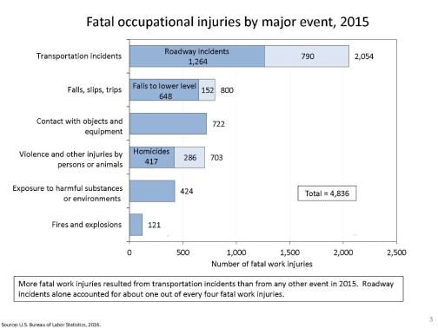
Introduction
Slips, trips, and falls make up the majority of general industry accidents
Are second only to motor vehicle crashes
Notes:
Falls are among the most common causes of serious work-related injuries and deaths. Employers must take measures in their workplaces to prevent employees from falling off overhead platforms, elevated work stations or into holes in the floor and walls.

Slide 4
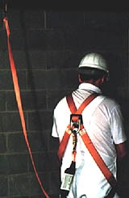
Introduction
Unless working on a ladder, scaffold or scissor lift, OSHA requires fall protection when exposed to a
4-foot fall or greater.
Source: OSHA
Notes:
Ladders, scaffolds, and scissor lifts have their own fall prevention requirements.
Regardless of height, if a worker can fall into or onto dangerous machines or equipment, employers must provide guardrails and toeboards.

Slide 5
Introduction
Lesson Objectives
Identify types of fall hazards associated with workplace environments.
Identify methods to eliminate or protect against fall hazards.
Notes:
Terminal Objective:
Given current OSHA and industry information regarding general industry worksite illnesses, injuries, and/or fatalities, the student will be able to recognize how to protect themselves from fall hazards.
Enabling Objectives:
1. Identify types of fall hazards associated with workplace environments.
2. Identify methods to eliminate or protect against fall hazards.

Slide 6
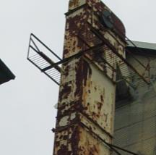
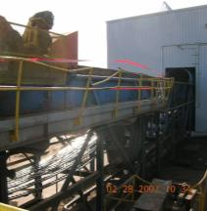
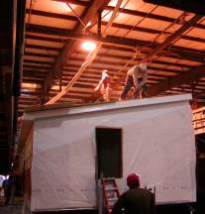


Common Fall Hazards
Overhead Platforms
Overhead Runways
Elevated Work Stations
Source of photos: OSHA
Notes:
Photo 1. This is a photo of two platforms on either side of a bucket conveyor. Access to the platforms is provided by the one ladder between them that stops at the level of the platform. Employees have to climb to either platform from the ladder. Once there they can step across the opening to the other platform when they have to access the conveyor for routine greasing or climb back down on the ladder and then climb back up to the other platform.
Phot 2. Employees exposed to a 25 foot fall from conveyor platform with defective guardrail.
Photo 3. Employees were exposed to falling 14 feet from the roof top of manufactured homes. Employees were working on the roof of manufactured home installing roof decking, roof sheating and electrical wiring without controls to prevent falls.

Slide 7
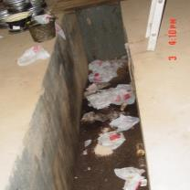
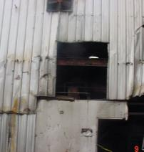
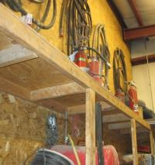
Common Fall Hazards
Floor Openings/Pits
Wall Openings
Shelving Units
Source of photos: OSHA
Notes:
Photo 1. This photo is of a service pit used for oil changes and other vehicle maintenance. The pit is 50 inches deep.
Photo 2. Sheet metal not attached to vertical steel beams. Sheet metal pushed away from floor allowing employee to fall.
Photo 3. Shelving unit used for storage. Workers would climb then stand on top.

Slide 8
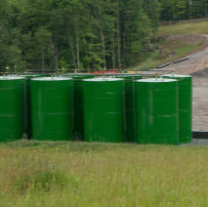
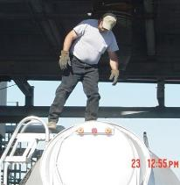
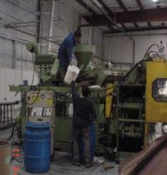
Common Fall Hazards
Stationary Storage Tanks
Tanker Trucks
Industrial Production Units
Source: WVU
Source: OSHA
Source: OSHA
Notes:
Photo 1. Industrial tanks that often require worker access on top.
Photo 2. Man climbing off/onto tanker ladder and walking the top of the tanker.
Photo 3. Employee working above 4-feet on machine platform without fall protection.

Slide 9
Fall Hazard Controls
Hierarchy of Fall Hazard Control:
First line of defense
  Eliminate the fall hazard
Second line of defense
  Prevent the fall
Third and last resort
  Control the fall

Slide 10
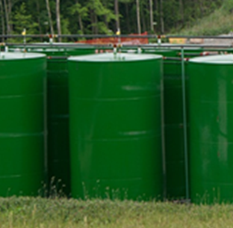
Fall Hazard Controls
Eliminate fall hazards – work from the ground
Gauge at top of tank moved to ground level
Use drone, equipped with camera, for inspections at heights
Source: WVU
Notes:
If workers must access the top of a tank to read a gauge. Moving the tank gauge to ground level would eliminate the need for fall hazard exposure.
As a worker, you could suggest such.
Using a drone equipped with a camera to inspect at heights would be another example.

Slide 11
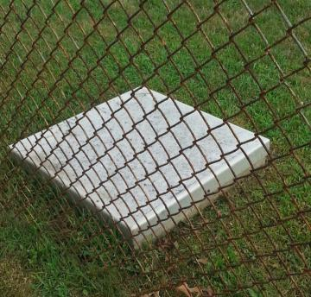
Fall Hazard Controls
Eliminate fall hazards – hole covers/grates
Very effective way to eliminate a fall hazard.
Designed to withstand intended load.
Secured-bolted, hinged, latched, locked
Source: WVU
Notes:
Covering floor openings is a very effective way to eliminate a fall hazard, especially if access to the hole is rarely necessary.
When routine travel over the opening is necessary, often a cover is used, such as a trap-door. Covers must be designed to withstand the potential load that may be placed upon them. For example a 36”x 36” floor-hole cover that will only experience foot traffic would be much different than one experiencing fork truck traffic.
They must also be secured (bolted, hinged, latched, locked) to prevent accidental displacement as well.
It should be noted that the employer should communicate who is authorized to open and/or remove the cover and that when the cover is opened or removed another means of protection is necessary. When the floor opening cover is opened, either a temporary guardrail must be in place or the opening must be constantly attended by someone until closed.

Slide 12
Fall Hazard Controls
Prevent the fall – guardrails
Standard railing
  Top rail, mid rail, and posts
  Height from upper surface of top rail to floor level is 42” (+/− 3”)
  Mid-rail height is 21”
Standard toeboard
  3.5” high
  Not more than ¼” clearance above the floor
Source: OSHA
Notes:
Guardrails – guardrail systems are vertical barriers consisting of top rails, mid-rails, and intermediate vertical members. Guardrail systems can also be combined with toe-boards, which are barriers that prevent materials and equipment from dropping to lower levels.
Standard railing.
Consists of top rail, mid rail, and posts.
Height from the upper surface of top rail to floor level is 42 inches (+/− 3”).
Mid-rail height is 21 inches.
Standard toeboard.
3.5 inches high, with not more than ¼-inch clearance above the floor.

Slide 13
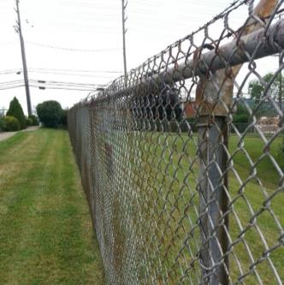
Fall Hazard Controls
Prevent the fall – fences and barricades
Prevents unauthorized employee exposure to fall hazard
Employer authorizes access
Authorized personnel must then be protected from the fall hazards within
Source: WVU
Notes:
Fences, barricades, and locked doors, whether inside the facility or outside, can be used to prevent unauthorized access to areas where a fall hazard exists. Only authorized and trained employees would have access. Once inside, a method of fall protection must be implemented for the authorized worker.

Slide 14
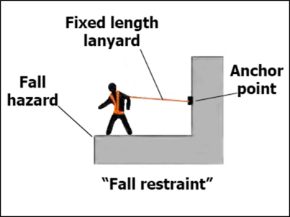
Fall Hazard Controls
Prevent the fall – personal all restraint
Prevent falls by keeping worker from reaching fall hazard
Comprised of a body belt or body harness, an anchorage, connectors
Often used when section of guardrail or hole cover is temporarily removed
Source: OSHA
Notes:
Fall restraint systems prevent falls by keeping the worker from reaching a fall hazard. While fall restraint systems are not mentioned in OSHA’s fall protection rules, OSHA will accept a properly used fall restraint system in place of a personal fall arrest system when the restraint system is rigged so that the worker cannot get to the fall hazard. In effect, (if properly used) the system tethers a worker in a manner that will not allow a fall of any distance. A fall restraint system is comprised of a body belt or body harness, an anchorage, connectors, and other necessary equipment. Other components typically include a lanyard, and may also include a lifeline and other devices. Note: A self-retracting lanyard is not appropriate for a fall restraint system unless the worker cannot reach the fall hazard when the lanyard is fully extended.
Always follow the manufacturer’s instructions or consult a qualified person to ensure proper installation of anchor points. OSHA recommends that fall restraint systems have the capacity to withstand 3,000 pounds of force or twice the maximum expected force that is needed to restrain the worker from exposure to the fall hazard. As a result, fall restraint may be a viable way to provide fall protection in situations in which the employer has concerns about the adequacy of available anchorage points for fall arrest equipment

Slide 15
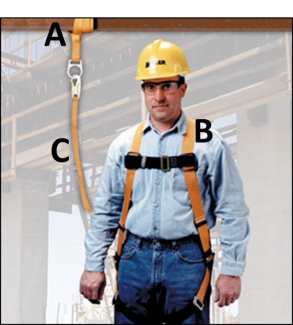
Fall Hazard Controls
Know the A, B, Cs of Personal Fall Arrest Systems
Anchorages
Body harness
Components
(connectors like snaphooks or Dee-rings, connection points, lanyards, deceleration devices, lifelines, etc.)
Source: Honeywell/Miller; used with permission.
Installed, used, and maintained according to the manufacturer
Notes:
A personal fall arrest system is a system used to safely stop (arrest) a worker who is falling from a working level. It consists of an anchorage, connectors, and a body harness. It also may include a lanyard, deceleration device, lifeline, or suitable combinations of these.
It must be set-up to ensure that the worker will not free-fall more than 6 feet before the system begins to arrest the fall, hit the ground or an object below.
The higher the anchorage the better!

Slide 16
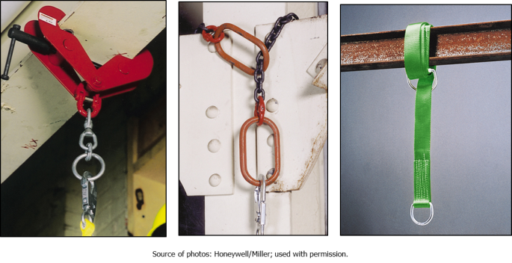
Fall Hazard Controls
PFAS – temporary anchorage
Notes:
Anchorage Connectors are designed as the intermediary for securing a connecting device to an anchorage. The anchorage should be easily accessible, located at a safe distance and support 5,000 lbs. per worker

Slide 17
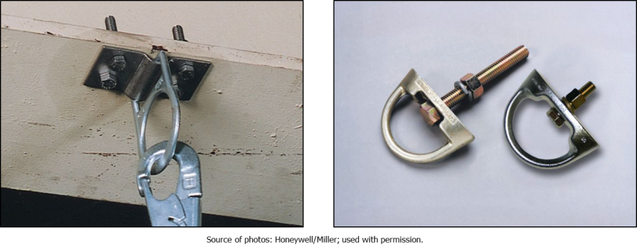
Fall Hazard Controls
PFAS – permanent anchorage
Notes:
For areas with predictable and repetitive use, permanent anchors may be installed.

Slide 18
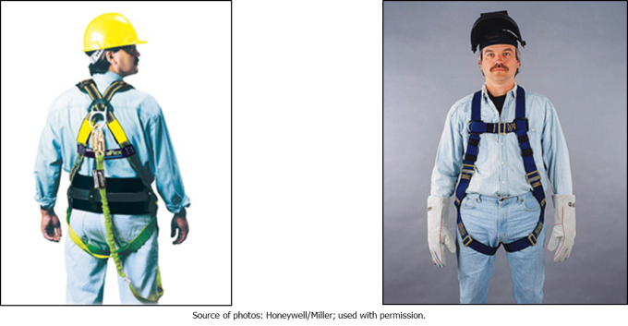
Fall Hazard Controls
PFAS – full-body harness
Notes:
The are many types of full-body harnesses. Regardless of make or model, they must be the properly sized for the wearer, inspected, used and maintained according to the manufacturer.

Slide 19
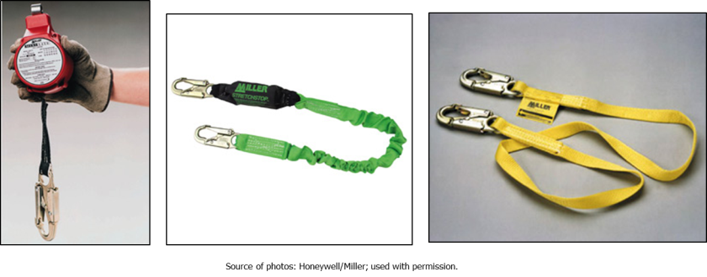
Fall Hazard Controls
PFAS – connecting components
Notes:
Photo one: A retractable lanyard. Designed to greatly decrease the free fall distance by locking-up quickly, similar to the shoulder belt in a car.
Photo two: A 6 foot shock absorbing lanyard. The shock absorber decreases the forces of the fall arrest on the body to safe levels when properly used.
Photo three: A 6 foot non-shock absorbing lanyard. Often used for fall restraint.

Slide 20
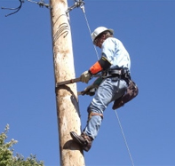
Fall Hazard Controls
Control the fall – positioning devices
Consists of a body belt and connecting device
Keeps workers from falling, while allowing their hands to be free to perform work
Source: OSHA
Notes:
Position-device system enables the worker to work with both hands free on a surface such as a wall or other vertical structure. They are typically used as protection for concrete form work and placing rebar. The difference between a positioning-device system and a personal fall-arrest system is that the positioning device system supports the worker on an elevated surface and limits a fall to two feet.

Slide 21
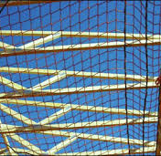
Fall Hazard Controls
Control the fall – safety net systems
Consists of specially designed mesh nets, panels, and connecting components
Must be designed, installed and maintained properly
Source: OSHA
Notes:
Safety net systems consist of mesh nets, panels, and connecting components. They are typically used as protection for those who work 25 feet or more above lower levels.

Slide 22
Employer Requirements
Training – your employer must train you on the following:
Fall hazards associated with your facility and your work
Methods used to protect you from those hazards
Proper and safe use of any personal fall arrest, positioning, or fall restraint systems
Applicable OSHA standards

Slide 23
Employer Requirements
Inspection
Your employer must inspect the:
  workplace for existing and potential fall hazards
  fall hazard controls used; such as guardrails, covers, grates, and anchorage points
You must inspect your PFAS, Positioning and Fall Restraint hardware before each use.

Slide 24
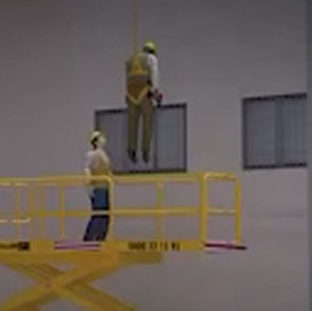
Employer Requirements
Rescue
Personal Fall Arrest Systems require a rescue plan
Employer must develop and communicate the rescue plan to all involved
Source: OSHA

Slide 25
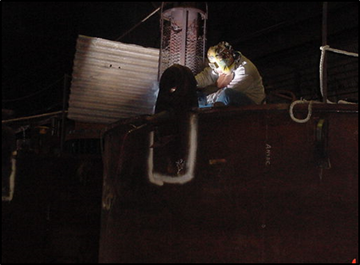
Hazard Recognition
Source of photo: OSHA
Notes:
Photo: Welder on top of tank without fall protection

Slide 26
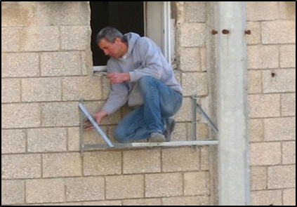
Hazard Recognition
Source of photo: OSHA
Notes:
Photo: Elevated work platform, worker without fall protection.

Slide 27
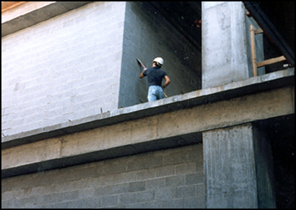
Hazard Recognition
Source of photo: OSHA
Notes:
Photo: This photo shows a worker exposed to a fall hazard while cleaning a wall.

Slide 28
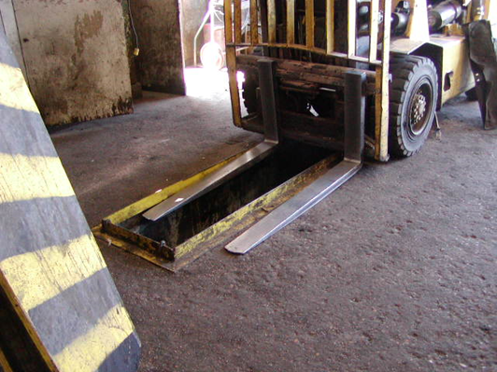
Hazard Recognition
Source of photo: OSHA
Notes:
Photo: This photo shows a pit used to service fork trucks.

Slide 29
Knowledge Check
What is the first line of defense when it comes to falls in the workplace?
    Control the fall itself once it occurs
    Eliminate the fall hazard completely
    With the fall hazard present, prevent the fall.
    Use personal protective equipment
  Answer: b. Eliminate the fall hazard completely

Slide 30
Knowledge Check
A worker is required to remove a section of guardrail in order to receive materials from a fork truck; which of the following provides the best protections to prevent a fall?
    Avoid the edge
    Use a personal fall arrest system
    Use a fall restraint system
    Use grab handles
  Answer: c. Use a fall restraint system

Slide 31
Knowledge Check
A personal fall arrest system (PFAS) anchorage point must be capable of handling ___ pounds.
    2,000
    3,000
    4,000
    5,000
  Answer: d. 5,000

