Slide 1
Exit Routes, Emergency Action Plans, Fire Prevention Plans, and Fire Protection
OSHA 10-Hour General Industry Outreach Training

Slide 2
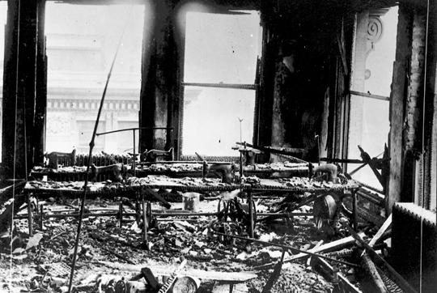
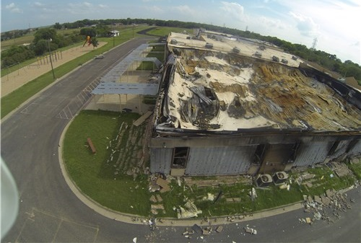
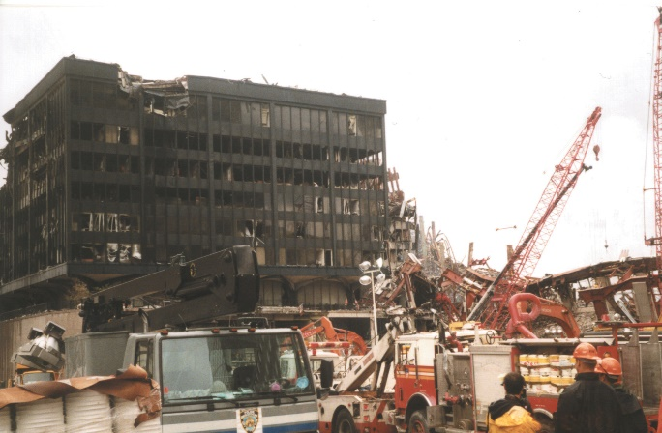
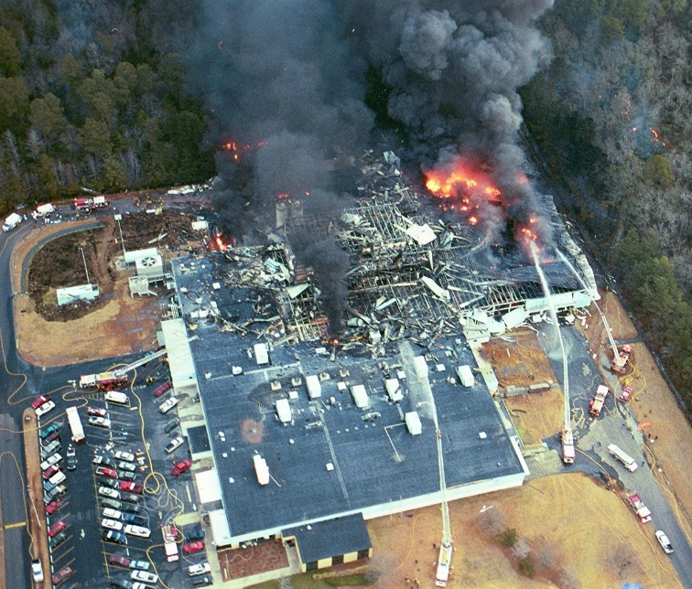
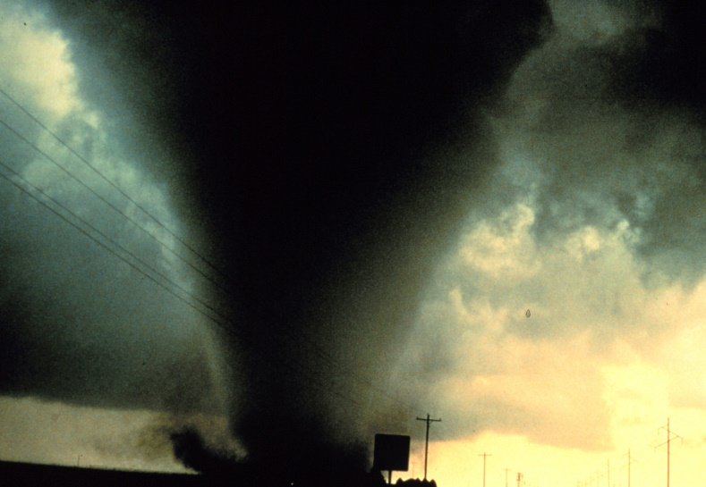
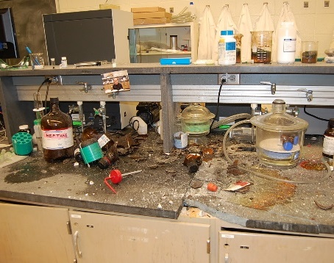
Introduction
Source: CSB
Source: National Archives
Source: OSHA
Source: CSB
Source: NOAA
Source: CSB
Fires and explosions, as well as other workplace incidents, may require emergency actions and evacuations to protect employees.
Notes:
Approximately 145 fatalities per year are the result of fires and explosions (3% of total fatalities). There has been a long and tragic history of workplace fatalities related to fires and explosions. In addition to fires and explosions, other incidents in the workplace may require emergency actions to protect employees.
Examples of emergency incidents requiring evacuation or shelter-in-place:
Fires and explosions
Severe weather
Hazardous materials spills/releases
Workplace violence

Slide 3
Introduction
Lesson objectives:
Recognize benefits of an Emergency Action Plan.
Identify elements of Fire Protection Plan.
Identify conditions under which evacuation actions may be necessary in an emergency situation.
Identify conditions under which
shelter-in-place may be necessary in
an emergency situation.

Slide 4
Introduction
  Identify characteristics of an effective emergency escape route.
  Recognize the five types of fire extinguishers, including the types of fires they can extinguish.
  Review requirements for proper maintenance of portable fire extinguishers.

Slide 5
Emergency Action Plans
Benefits of an EAP:
Written document that facilitates and organizes employer and employee actions during workplace emergencies
Fewer and less severe injuries
Less structural damage
Reduce confusion
Notes:
Source: Evacuation Plans and Procedures eTool (2002), OSHA eTool, https://www.osha.gov/SLTC/etools/evacuation/index.html
“An emergency action plan (EAP) is a written document required by particular OSHA standards. [29 CFR 1910.38(a)] The purpose of an EAP is to facilitate and organize employer and employee actions during workplace emergencies. Well developed emergency plans and proper employee training (such that employees understand their roles and responsibilities within the plan) will result in fewer and less severe employee injuries and less structural damage to the facility during emergencies. A poorly prepared plan, likely will lead to a disorganized evacuation or emergency response, resulting in confusion, injury, and property damage.”

Slide 6
Emergency Action Plans
Purpose of an EAP:
Describes actions to be taken to ensure employee safety during an emergency
Uses floor plans/maps to show emergency escape routes
Tells employees what actions to take
Covers reasonably expected emergencies
Notes:
Source: https://www.osha.gov/dte/outreach/construction_generalindustry/gi_outreach_tp.html
“Describes actions that must be taken to ensure employee safety in emergencies
Includes floor plans or maps which show emergency escape routes
Tells employees what actions to take in emergency situations
Covers reasonably expected emergencies, such as fires, explosions, toxic chemical releases, hurricanes, tornadoes, blizzards, and floods.”

Slide 7


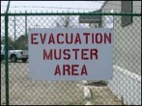
Emergency Action Plans
Required elements of plan:
Means of reporting
Evacuation procedures and emergency escape routes
Procedures for critical operations
Accounting of employees
Rescue and medical duties
Contact persons
Source of graphics: OSHA
Notes:
Source: Evacuation Plans and Procedures eTool (2002), OSHA eTool, https://www.osha.gov/SLTC/etools/evacuation/min_requirements.html
“Putting together a comprehensive emergency action plan that deals with those issues specific to your worksite is not difficult. It involves taking what was learned from your workplace evaluation and describing how employees will respond to different types of emergencies, taking into account your specific worksite layout, structural features, and emergency systems….
At a minimum, the plan must include but is not limited to the following elements [29 CFR 1910.38(c)]:
Means of reporting fires and other emergencies
Evacuation procedures and emergency escape route assignments
Procedures for employees who remain to operate critical plant operations before they evacuate
Accounting for all employees after an emergency evacuation has been completed
Rescue and Medical Duties for Employees Performing Them
Names or job titles of persons who can be contacted
Although they are not specifically required by OSHA, you may find it helpful to include the following in your plan:
A description of the alarm system to be used to notify employees (including disabled employees) to evacuate and/or take other actions. The alarms used for different actions should be distinctive and might include horn blasts, sirens, or even public address systems.
The site of an alternative communications center to be used in the event of a fire or explosion.
A secure on- or off-site location to store originals or duplicate copies of accounting records, legal documents, your employees' emergency contact lists, and other essential records.”

Slide 8

Emergency Action Plans
Training employees on the EAP
  Review plan with each employee
    Initial development of plan
    Initial assignment of employee to job
    Changes to plan or employee actions/responsibilities
  Annual retraining with drills to practice evacuation and gathering in assembly area
  Educate/train
    Types of emergencies
    Course of actions
    Functions and elements of EAP
    Special hazards
    Fire hazards and fire prevention plan
Source: OSHA
Notes:
Source: Evacuation Plans and Procedures eTool (2002), OSHA eTool, https://www.osha.gov/SLTC/etools/evacuation/implementation.html
“Before implementing the emergency action plan, the employer must designate and train enough people to assist in the safe and orderly emergency evacuation of employees. [29 CFR 1910.38(e)] Employers should review the plan with each employee when the initial plan is developed and when each employee is initially assigned to the job. [29 CFR 1910.38(f)(1)] Employers should review the plan with each employee when his/her actions or responsibilities under the plan change or when the plan changes. [29 CFR 1910.38(f)(2) and 29 CFR 1910.38(f)(3)] Effective plans often call for retraining employees annually and include drills in which employees can practice evacuating their workplace and gathering in the assembly area.
Educate your employees about the types of emergencies that may occur and train them in the proper course of action. The size of your workplace and workforce, processes used, materials handled, and the availability of onsite or outside resources will determine your training requirements. Be sure all employees understand the function and elements of your emergency action plan, including types of potential emergencies, reporting procedures, alarm systems, evacuation plans, and shutdown procedures. Discuss any special hazards you may have onsite such as flammable materials, toxic chemicals, radioactive sources, or water-reactive substances. An employer must inform employees of the fire hazards to which they are exposed and review with each employee those parts of the fire prevention plan necessary for self-protection. [29 CFR 1910.39(d)]
Clearly communicate to your employees who will be in charge during an emergency to minimize confusion.”

Slide 9
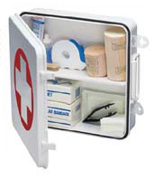

Emergency Action Plans
General training
  Roles and responsibilities
  Threats, hazards, protective actions
  Notification, warning, communications
  Locating family members
  Location/use of emergency equipment
  Procedures
    Emergency response
    Evacuation and shelter-in-place
    Assembly and accounting of
    employees
    Emergency shut-down
Source of graphics: OSHA
Notes:
Source: Evacuation Plans and Procedures eTool (2002), OSHA eTool, https://www.osha.gov/SLTC/etools/evacuation/implementation.html
“General training for your employees should also address the following:
Individual roles and responsibilities.
Threats, hazards, and protective actions.
Notification, warning, and communications procedures.
Means for locating family members in an emergency.
Emergency response procedures.
Evacuation, shelter, and accountability procedures.
Location and use of common emergency equipment.
Emergency shutdown procedures.”

Slide 10

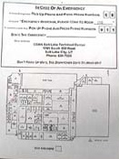

Emergency Action Plans
Examples of procedures:
Methods of reporting an emergency
Instructions for exit
Instructions for limited mobility
Source of graphics: OSHA
Notes:
Examples of procedures for elements of EAP:
Method of reporting an emergency
911
Onsite resources
Instructions for exit
Pull alarm
Use nearest staircase
Don’t use elevators
Designate rally points
Accountability – who’s out
Instructions for limited mobility
Proceed to nearest stairwell or area of refuge
Designate a buddy

Slide 11
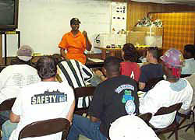
Fire Prevention Plan
FPP requirements:
Must be
  In writing
  Kept in the workplace
  Available to employees
  for review
Employer must
  Inform employees of fire hazards when initially assigned to a job
  Review with each employee applicable FPP parts
Source: OSHA
Notes:
Source: Evacuation Plans and Procedures eTool (2002), OSHA eTool, https://www.osha.gov/SLTC/etools/evacuation/fire.html
“A fire prevention plan must be in writing, be kept in the workplace, and be made available to employees for review. However, an employer with 10 or fewer employees may communicate the plan orally to employees. [29 CFR 1910.39(b)]…
An employer must inform employees upon initial assignment to a job of the fire hazards to which they are exposed. An employer must also review with each employee those parts of the fire prevention plan necessary for self-protection.”

Slide 12
Fire Prevention Plan
Included in FPP
  Lists of all major fire hazards, proper handling and storage of hazardous materials, ignition sources/controls, and fire protection equipment
  Procedures to control flammable/combustible wastes
  Procedures for maintenance of safeguards on heat-producing equipment
  Name/job titles of employees with responsibilities for maintenance of equipment and control of hazards
Notes:
Source: Evacuation Plans and Procedures eTool (2002), OSHA eTool, https://www.osha.gov/SLTC/etools/evacuation/fire.html
At a minimum, your fire prevention plan must include:
A list of all major fire hazards, proper handling and storage procedures for hazardous materials, potential ignition sources and their control, and the type of fire protection equipment necessary to control each major hazard. [29 CFR 1910.39(c)(1)]
Procedures to control accumulations of flammable and combustible waste materials. [29 CFR 1910.39(c)(2)]
Procedures for regular maintenance of safeguards installed on heat-producing equipment to prevent the accidental ignition of combustible materials. [29 CFR 1910.39(c)(3)]
The name or job title of employees responsible for maintaining equipment to prevent or control sources of ignition or fires. [29 CFR 1910.39(c)(4)]
The name or job title of employees responsible for the control of fuel source hazards. [29 CFR 1910.39(c)(5)]

Slide 13
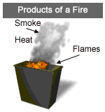

Fire Prevention Plan
Preventing fires hazards:
Understanding fires
  Rapid chemical reaction between oxygen and a combustible material
  Results in release of heat, light, flames, and smoke
  Requires four elements:
    Oxygen
    Ignition source (heat)
    Fuel
    Chemical reaction
Source of graphics: OSHA
Notes:
Source: Evacuation Plans and Procedures eTool (2002), OSHA eTool, https://www.osha.gov/SLTC/etools/evacuation/portable_about.html
In order to prevent fires, it is important to understand how fires occur.
“Fire is a very rapid chemical reaction between oxygen and a combustible material, which results in the release of heat, light, flames, and smoke.
For fire to exist, the following four elements must be present at the same time:
Enough oxygen to sustain combustion.
Enough heat to raise the material to its ignition temperature.
Some sort of fuel or combustible material.
The chemical reaction that is fire.”

Slide 14
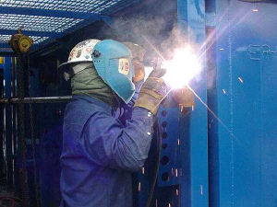

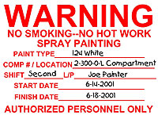

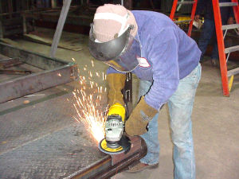
Fire Prevention Plan
Ignition sources
  Open flames
  Smoking
  Static electricity
  Hotwork
  Hot surfaces
  Electrical and mechanical sparks
  Lightning
Source: CDC
Source of graphics: OSHA
Notes:
Examples of ignition sources include:
Open flames – fires, pilot fires,
Smoking
Static electricity – can be generated when dissimilar materials make contact and separate; Examples: belts and pulleys, tires and the road, fluids flowing through a pipe, agitation/mixing of fluids, and splash filling of flammable liquids.
Hotwork – welding, cutting, and brazing
Electrical and mechanical sparks
Lightning

Slide 15
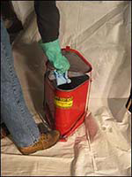
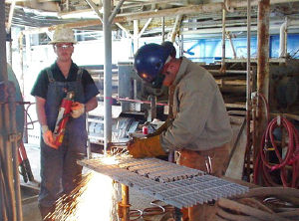
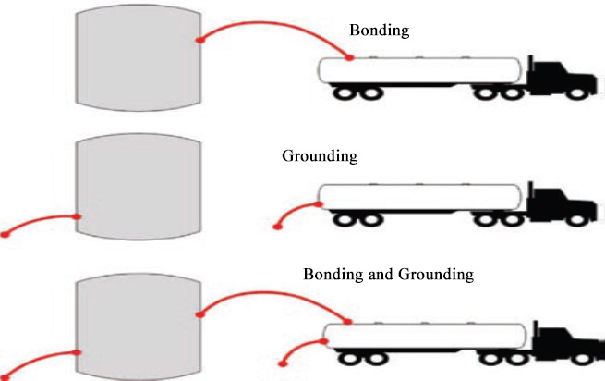
Fire Prevention Plan
Tasks that require fire protection and examples of hazards
  Hotwork – 30-minute fire watch
  Dispensing flammables and combustibles: gasoline, diesel, or natural gas
  Flammable wastes: solvent waste, oily rags, and flammable liquids
Source of graphics: OSHA
Notes:
Procedures for implementing the plan
1. Define point hazards and tasks that need fire protection
a. Determine severity and frequency of hazard
Hotwork (welding, cutting, brazing) – fire watch: https://www.osha.gov/SLTC/etools/shipyard/fire_protection/firewatch.html
“Fire watches… are used to prevent and/or extinguish fires at the incipient (beginning) stage. They monitor the hot work sites to ensure that conditions do not change when combustible materials cannot be effectively removed, protected or shielded. Fire watches also require specialized training and are assigned to minimize damage that may be caused by a fire. If a fire occurs, they take appropriate actions to protect all workers.”
Dispensing: https://www.osha.gov/dte/grant_materials/fy09/sh-18796-09/fireprotection.pdf
When transferring liquids, gases, or solids through pipes or hoses, static electricity may be generated, creating an electric charge that can ignite the flammables. It is necessary to “bond” containers when flammables are being transferred from one to the other and have the receiving container in contact with the ground so that the static can be effectively eliminated and, thereby, remove the ignition source.
https://www.osha.gov/dts/osta/otm/otm_iv/otm_iv_5.html
“Bonding and Grounding…. Bonding is the process of electrically connecting conductive objects, like tanker-trailers, to transfer pumps to equalize their individual electrical potentials and prevent sparking. Grounding (earthing) means connecting a conductive object to the earth to dissipate electricity (e.g., accumulated static, lightning strikes, and equipment faults) into the ground, away from workers, equipment, and ignitable mixtures. Bonding and grounding mechanisms must be implemented simultaneously to safely discharge static charges.”
Flammable wastes: https://www.osha.gov/dts/maritime/sltc/ships/housekeeping/intro.html
“Dispose of oils, paint thinners, solvents, rags, scraps, waste, or other flammable and combustible substances, or store them in covered fire-resistant containers, at the end of each workshift or when the job is complete, whichever occurs first.”

Slide 16
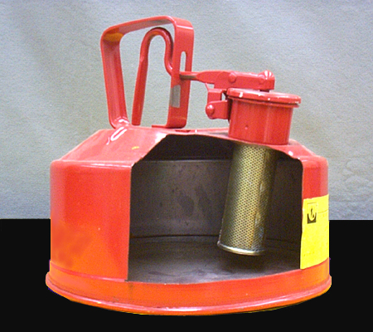
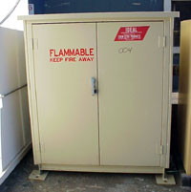
Fire Prevention Plan
Handling of flammable hazards
  Only use approved metal safety containers or original manufacturer’s containers for storage
  Practice good housekeeping
  Keep containers closed when not in use
  Store away from exits or passageways
  Keep away from ignition sources
Source of graphics: OSHA
Notes:
Source: Flammable and Combustible Liquids (n.d.) OSHA Outreach presentation, https://www.osha.gov/dte/outreach/construction_generalindustry/gi_outreach_tp.html
Safe handling fundamentals:
Carefully read the manufacturer’s label on the flammable liquid container before storing or using it
Practice good housekeeping in flammable liquid storage areas
Clean up spills immediately, then place the cleanup rags in a covered metal container
Only use approved metal safety containers or original manufacturer’s container to store flammable liquids
Keep the containers closed when not in use and store away from exits or passageways
Use flammable liquids only where there is plenty of ventilation
Keep flammable liquids away from ignition sources such as open flames, sparks, smoking, cutting, welding, etc.

Slide 17
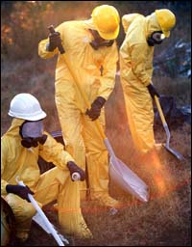
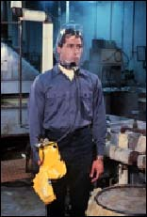
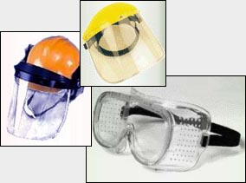
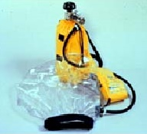
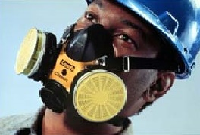
Fire Prevention Plan
Fire protection equipment
  PPE
  Fire Suppression
    Portable fire extinguishers
    Fixed systems
Source of graphics: OSHA
Notes:
Source: Evacuation Plans and Procedures eTool (2002), OSHA eTool, https://www.osha.gov/SLTC/etools/evacuation/high_hazard.html#special
“Your employees may need personal protective equipment to evacuate during an emergency. Personal protective equipment must be based on the potential hazards in the workplace. Assess your workplace to determine potential hazards and the appropriate controls and protective equipment for those hazards. Personal protective equipment may include items such as the following:
Safety glasses, goggles, or face shields for eye protection;
Hard hats and safety shoes for head and foot protection;
Proper respirators;
Chemical suits, gloves, hoods, and boots for body protection from chemicals;
Special body protection for abnormal environmental conditions, such as extreme temperatures; and
Any other special equipment or warning devices necessary for hazards associated with your worksite.”

Slide 18
Conditions Requiring Evacuation
Workplace evacuation may be required for:
Man-made emergencies
  Fires
  Explosions
  Toxic material releases
  Radiological/biological incidents
  Civil disturbances
  Workplace violence
Natural emergencies
  Floods
  Earthquakes
  Hurricanes
  Tornadoes
  Wildfires
  Winter weather
Notes:
Source: Evacuation Plans and Procedures eTool (2002), OSHA eTool, https://www.osha.gov/SLTC/etools/evacuation/evac.html
“A wide variety of emergencies both man-made and natural, may require a workplace to be evacuated. These emergencies include - fires, explosions, floods, earthquakes, hurricanes, tornadoes, toxic material releases, radiological and biological accidents, civil disturbances and workplace violence.”

Slide 19
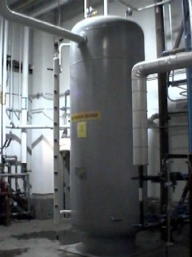
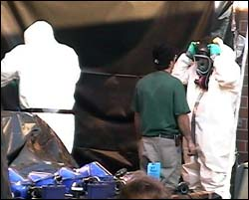
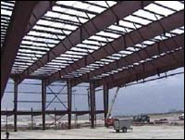
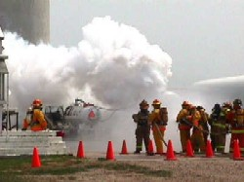
Conditions Requiring Evacuation
Factors affecting response to emergencies:
Type/extent of emergency
Location of emergency
Type of building in which workplace is located
Shutting down critical operations
Source of graphics: OSHA
Notes:
Source: Evacuation Plans and Procedures eTool (2002), OSHA eTool, https://www.osha.gov/SLTC/etools/evacuation/evac.html
“Employers will want their employees to respond differently to… different threats. For example, employers may want to have employees assemble in one area inside the workplace if threatened by a tornado or perhaps a chemical spill on an adjacent highway, but evacuate to an exterior location during a fire.”
“The type of building you work in may be a factor in your decision. Most buildings are vulnerable to the effects of disasters such as tornadoes, earthquakes, floods, or explosions. The extent of the damage depends on the type of emergency and the building's construction. Modern factories and office buildings, for example, are framed in steel and are structurally more sound than neighborhood business premises may be. In a disaster such as a major earthquake or explosion, however, nearly every type of structure will be affected. Some buildings will collapse and others will be left with weakened floors and walls.”
“Certain equipment and processes must be shut down in stages or over time. In other instances it is not possible or practical for equipment or certain process to be shut down under certain emergency situations. This condition, which is not unusual for certain large manufacturers operating complex processes, is not typical of small enterprises that normally can turn off equipment or utilities if necessary and evacuate. However some small enterprises may require designated employees remain behind briefly to operate fire extinguishers or shut down gas and/or electrical systems and other special equipment that could be damaged if left operating or create additional hazards to emergency responders (such as releasing hazardous materials).
Each employer must review their operation and determine whether total and immediate evacuation is possible for various types of emergencies. The preferred approach, and the one most often taken by small enterprises, is immediate evacuation of all their employees when the evacuation alarm is sounded.
If any employees will stay behind, the plan must describe in detail the procedures to be followed by these employees. All employees remaining behind must be capable of recognizing when to abandon the operation or task and evacuate themselves before their egress path is blocked. In small establishments it is common to include in your plan locations where utilities (such as electrical and gas) can be shut down for all or part of the facility either by your own employees or by emergency response personnel.”

Slide 20

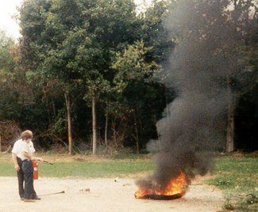
Conditions Requiring Evacuation
Fire emergencies:
Fight or Flee?
Options for evacuation
  Total evacuation
  Designated employees authorized to fight fire;
  all others evacuate
  All employees authorized to fight fire
  Extinguishers provided but not intended for employee use
Source of graphics: OSHA
Notes:
Source: Evacuation Plans and Procedures eTool (2002), OSHA eTool, https://www.osha.gov/SLTC/etools/evacuation/portable_relation.html#risk_table
“Choosing to evacuate the workplace rather than providing fire extinguishers for employee use in fighting fires will most effectively minimize the potential for fire-related injuries to employees. In addition, training employees to use fire extinguishers and maintaining them requires considerable resources. However, other factors, such as the availability of a public fire department or the vulnerability of egress routes, will enter into this decision.”
Option 1: Total evacuation of employees from the workplace immediately when alarm sounds. No one is authorized to use available portable fire
extinguishers.
Requirement: Establish an emergency action plan, fire prevention plan and train employees accordingly. Extinguishers are not existing and not
required. [29 CFR 1910.157(b)(1)]
Option 2: Designated employees are authorized to use portable fire extinguishers to fight fires. All other employees must evacuate workplace immediately
when alarm sounds.
Requirement: Establish an emergency action plan and train employees accordingly. Meet all general fire extinguisher requirements plus annually
train designated employees to use fire extinguishers. Fire extinguishers in the workplace must be inspected, tested, and maintained.
[29 CFR 1910.157(b)(2)]
Option 3: All employees are authorized to use portable fire extinguishers to fight fires.
Requirement: If any employees will be evacuating, establish an emergency action plan and train employees accordingly. Meet all general fire
extinguisher requirements plus annually train all employees to use fire extinguishers. Fire extinguishers in the workplace must be inspected, tested,
and maintained. [29 CFR 1910.157(b)(2)]
Option 4: Extinguishers are provided but not intended for employee use.
Requirement: Establish an emergency action plan, fire prevention plan and train employees accordingly. If fire extinguishers are left in the workplace,
they must be inspected, tested, and maintained. Extinguishers are provided but not intended for employee use. [29 CFR 1910.157(a)]

Slide 21
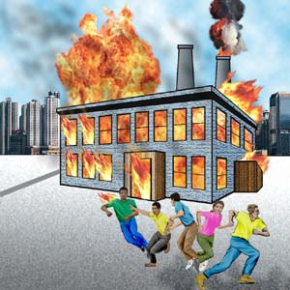
Conditions Requiring Evacuation
Fire emergencies: Fight or Flee?
Performing a risk assessment
  Is the fire too big?
  Is the air safe to breathe?
  Is the environment too hot or smoky?
  Is there a safe evacuation path?
Source: OSHA
Notes:
Source: Evacuation Plans and Procedures eTool (2002), OSHA eTool, https://www.osha.gov/SLTC/etools/evacuation/portable_relation.html#risk_table
“Portable fire extinguishers have two functions: to control or extinguish small or incipient stage fires and to protect evacuation routes that a fire may block directly or indirectly with smoke or burning/smoldering materials.
To extinguish a fire with a portable extinguisher, a person must have immediate access to the extinguisher, know how to actuate the unit, and know how to apply the agent effectively. Attempting to extinguish even a small fire carries some risk. Fires can increase in size and intensity in seconds, blocking the exit path of the fire fighter and creating a hazardous atmosphere. In addition, portable fire extinguishers contain a limited amount of extinguishing agent and can be discharged in a matter of seconds. Therefore, individuals should attempt to fight only very small or incipient stage fires.
Prior to fighting any fire with a portable fire extinguisher you must perform a risk assessment that evaluates the fire size, the fire fighters evacuation path, and the atmosphere in the vicinity of the fire..”

Slide 22
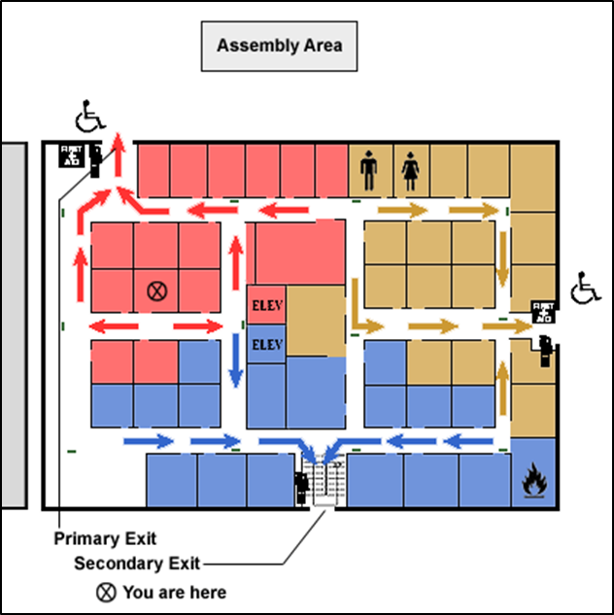
Conditions Requiring Evacuation
Evacuation maps show:
Exits: to, thru, and away
At least two ways out
  Primary exit
  Secondary exit
Assembly area
Location on the map
Additional information –
Location of fire extinguishers
Source: OSHA
Notes:
Source: Evacuation Plans and Procedures eTool (2002), OSHA eTool, https://www.osha.gov/SLTC/etools/evacuation/evac.html
“Most employers create maps from floor diagrams with arrows that designate the exit route assignments. These maps should include locations of exits, assembly points, and equipment (such as fire extinguishers, first aid kits, spill kits) that may be needed in an emergency.”
Exits
To : 1910.36(a)(2) An exit route must be permanent. Each exit route must be a permanent part of the workplace.
Thru : 1910.36(b) The number of exit routes must be adequate.
Away : 1910.36(c)(1) Each exit discharge must lead directly outside or to a street, walkway, refuge area, public way, or open space with access to the outside.

Slide 23
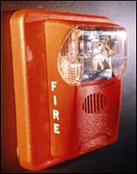

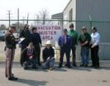
Conditions Requiring Evacuation
Evacuation actions:
Alerting employees to evacuate
  Alarm
  Enunciator panel/speaker
Accounting for who has exited
  How is that accomplished
Keeping employees informed
  All clear, re-enter, or remain at
  assembly point
  Clear to leave workplace
Source of graphics: OSHA
Notes:
Methods of alerting employees to evacuate
Alarm
Enunciator panel/Announcement Speaker
Methods of accounting for employees evacuating and at rally point/area of refuge
Methods of informing employees to actions after emergency
Re-enter the building / All clear
Remain at area of refuge
Clear to leave workplace

Slide 24


Conditions Requiring Shelter-in-Place
Incidents that may require shelter-in-place:
Release of chemical, biological, or radiological contaminants
Severe weather – tornadoes
Other situations occurring
outside the workplace
Source: CDC
Source: FEMA Region VI
Notes:
Source: Evacuation Plans and Procedures eTool (2002), OSHA eTool, https://www.osha.gov/SLTC/etools/evacuation/shelterinplace.html
“Chemical, biological, or radiological contaminants may be released into the environment in such quantity and/or proximity to a place of business that it is safer to remain indoors rather than to evacuate employees. Such releases may be either accidental or intentional. Examples of situations that might result in a decision by an employer to institute "shelter-in-place" include an explosion in an ammonia refrigeration facility across the street, or a derailed and leaking tank car of chlorine on the rail line behind your place of business.
"Shelter-in-place" means selecting an interior room or rooms within your facility, or ones with no or few windows, and taking refuge there. In many cases, local authorities will issue advice to shelter-in-place via TV or radio.”
“Depending on your circumstances and the type of emergency, the first important decision is whether you stay put or get away. You should understand and plan for both possibilities. Use common sense and available information… to determine if there is immediate danger. In any emergency, local authorities may or may not immediately be able to provide information on what is happening and what you should do. Use available information to assess the situation. If you see large amounts of debris in the air, or if local authorities say the air is badly contaminated, you may want to "shelter-in-place.“
Source: https://emergency.cdc.gov/preparedness/informed/index.asp
Watches and Warnings
“In addition to understanding HOW you will be informed of potential threats, you need to understand the terms that are used for weather threats.
A watch means that there is a high possibility that a weather emergency will occur. When a severe storm watch is issued for your area, continue to listen to the radio or television for updates and pay attention to visible weather changes around you.
A warning means that a weather emergency is already happening, or will happen soon. When you hear a warning, take immediate action.”

Slide 25
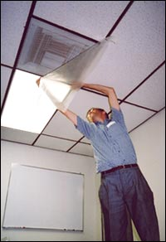
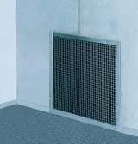

Conditions Requiring Shelter-in-Place
Shelter-in-place:
Means taking refuge in interior room(s) with no/few windows
Local authorities often issue shelter-in-place advice via TV or radio
Procedures specific to worksite
Source of graphics: OSHA
Notes:
Source: Evacuation Plans and Procedures eTool (2002), OSHA eTool, https://www.osha.gov/SLTC/etools/evacuation/shelterinplace.html
“"Shelter-in-place" means selecting an interior room or rooms within your facility, or ones with no or few windows, and taking refuge there. In many cases, local authorities will issue advice to shelter-in-place via TV or radio.”
“Specific procedures for shelter-in-place at a worksite may include the following:
Close the business.
If there are customers, clients, or visitors in the building, provide for their safety by asking them to stay - not leave. When authorities provide directions to shelter-in-place, they want everyone to take those steps immediately. Do not drive or walk outdoors.
Have employees and anyone else in the building call their emergency contacts, then turn on answering systems
Unless there is an imminent threat, ask employees, customers, clients, and visitors to call their emergency contact to let them know where they are and that they are safe.
Close or tape-off all vents in the room used for shelter-in-place
Turn on call-forwarding or alternative telephone answering systems or services. If the business has voice mail or an automated attendant, change the recording to indicate that the business is closed, and that staff and visitors are remaining in the building until authorities advise it is safe to leave.
Quickly lock exterior doors and close windows, air vents, and fireplace dampers. Have employees familiar with your building's mechanical systems turn off all fans, heating and air conditioning systems, and clothes dryers. Some systems automatically provide for exchange of inside air with outside air. These systems, in particular, need to be turned off, sealed, or disabled.
If you are told there is danger of explosion, close the window shades, blinds, or curtains.
Gather essential disaster supplies, such as nonperishable food, bottled water, battery-powered radios, first-aid supplies, flashlights, batteries, duct tape, plastic sheeting, and plastic garbage bags.
Select interior room(s) above the ground floor, with the fewest windows or vents. The room(s) should have adequate space for everyone to be able to sit. Avoid overcrowding by selecting several rooms if necessary. Large storage closets, utility rooms, pantries, copy and conference rooms without exterior windows will work well. Avoid selecting a room with mechanical equipment like ventilation blowers or pipes, because this equipment may not be able to be sealed from the outdoors.
It is ideal to have a hard-wired telephone in the room(s) you select. Call emergency contacts and have the phone available if you need to report a life-threatening condition. Cellular telephone equipment may be overwhelmed or damaged during an emergency.
Tape plastic sheeting over vents, windows, and doors to prevent contaminated air from entering the room
Take your emergency supplies and go into the room you have designated. Seal all windows, doors, and vents with plastic sheeting and duct tape or anything else you have on hand.
Consider precutting plastic sheeting (heavier than food wrap) to seal windows, doors, and air vents. Each piece should be several inches larger than the space you want to cover so that it lies flat against the wall. Label each piece with the location of where it fits. [See image at right]
Write down the names of everyone in the room, and call your business' designated emergency contact to report who is in the room with you, and their affiliation with your business (employee, visitor, client, customer).
Listen to the radio, watch television, or use the Internet for further instructions until you are told all is safe or to evacuate. Local officials may call for evacuation in specific areas at greatest risk in your community.”

Slide 26


Conditions Requiring Shelter-in-Place
Planning shelter-in-place actions:
Alerting employees – shelter-in-place
Accounting for who is in refuge
Keeping employees informed
Source of graphics: OSHA
Notes:
Identify conditions under which shelter-in-place may be necessary in an emergency situation
A. Procedures for implementing the plan
1. Method of alerting employees to evacuate
a. Alarm
b. Enunciator panel / Announcement Speaker
2. Method of accounting for employees in area of refuge and at rally point / area of refuge
3. Method of informing employees to actions after emergency
a. All clear
b. Remain at area of refuge
c. Clear to leave workplace

Slide 27

Emergency Escape Routes
Exit routes:
Continuous and unobstructed path of exit travel from any place in workplace to safety
Exit access, exit, exit discharge
Should be:
  Clearly marked
  Well-lit
  Appropriate width
  Unobstructed/clear
Source: TEEX
Notes:
Source: Evacuation Plans and Procedures eTool (2002), OSHA eTool, https://www.osha.gov/SLTC/etools/evacuation/egress_construction.html
“An exit route is a continuous and unobstructed path of exit travel from any point within a workplace to a place of safety. An exit route consists of three parts:
Exit access - portion of an exit route that leads to an exit. [29 CFR 1910.36(a)(3)]
Exit - portion of an exit route that is generally separated from other areas to provide a protected way of travel to the exit discharge.
Exit discharge - part of the exit route that leads directly outside or to a street, walkway, refuge area, public way, or open space with access to the outside.”
Source: Evacuation Plans and Procedures eTool (2002), OSHA eTool, https://www.osha.gov/SLTC/etools/evacuation/evac.html
“Exit routes should be:
Clearly marked and well lit.
Wide enough to accommodate the number of evacuating personnel.
Unobstructed and clear of debris at all times.
Unlikely to expose evacuating personnel to additional hazards.”

Slide 28

Emergency Escape Routes
Basic exit route requirements:
  Permanent
  Separated by fire-resistant materials
  Limited openings
  Adequate number of exit routes
  Discharge leading directly outside
  or to a place with access to outside
  Exit door unlocked from inside
  and side-hinged
  Adequate capacity
  Minimum height and width
Source of graphics: OSHA
Notes:
Source: Evacuation Plans and Procedures eTool (2002), OSHA eTool, https://www.osha.gov/SLTC/etools/evacuation/egress_construction.html
“Basic Requirements:
An exit route must be permanent…. [29 CFR 1910.36(a)(1)]
An exit must be separated by fire resistant materials…. [29 CFR 1910.36(a)(2)]
Openings into an exit must be limited… An opening into an exit must be protected by a self-closing fire door that remains closed or automatically closes in an emergency upon the sounding of a fire alarm or employee alarm system….”
“Number of Exits:
The number of exit routes must be adequate. [29 CFR 1910.36(b)]
At least two exit routes must be available in a workplace to permit prompt evacuation of employees and other building occupants during an emergency,…[29 CFR 1910.36(b)(1)]
More than two exit routes must be available in a workplace if the number of employees, the size of the building, its occupancy, or the arrangement of the workplace is such that all employees would not be able to evacuate safely during an emergency. [29 CFR 1910.36(b)(2)]
A single exit route is permitted where the number of employees, the size of the building, its occupancy, or the arrangement of the workplace is such that all employees would be able to evacuate safely during an emergency. [29 CFR 1910.36(b)(3)]”
“Exit Discharge:
Each exit discharge must lead directly outside or to a street, walkway, refuge area, public way, or open space with access to the outside. [29 CFR 1910.36(c)(1)]…”
“Locking Arrangements:
An exit door must be unlocked from the inside. [29 CFR 1910.36(d)]
Employees must be able to open an exit route door from the inside at all times without keys, tools, or special knowledge. A device such as a panic bar that locks only from the outside is permitted on exit discharge doors. [29 CFR 1910.36(d)(1)]
Exit route doors must be free of any device or alarm that could restrict emergency use of the exit route if the device or alarm fails. [29 CFR 1910.36(d)(2)]
An exit route door may be locked from the inside only in mental, penal, or correctional facilities… [29 CFR 1910.36(d)(3)]”
“Door Swing:
A side-hinged exit door must be used. [29 CFR 1910.36(e)]
A side-hinged door must be used to connect any room to an exit route. [29 CFR 1910.36(e)(1)]
The door that connects any room to an exit route must swing out in the direction of exit travel if the room is designed to be occupied by more than 50 people or if the room is a high hazard area (i.e., contains contents that are likely to burn with extreme rapidity or explode). [29 CFR 1910.36(e)(2)]”
“Exit Route Capacity:
The capacity of an exit route must be adequate. [29 CFR 1910.36(f)]
Exit routes must support the maximum permitted occupant load for each floor served. [29 CFR 1910.36(f)(1)]
The capacity of an exit route may not decrease in the direction of exit route travel to the exit discharge. [29 CFR 1910.36(f)(2)]”
“Height and Width Requirements:
An exit route must meet minimum height and width requirements. [29 CFR 1910.36(g)]
The ceiling of an exit route must be at least seven feet six inches (2.3 m) high. Any projection from the ceiling must not reach a point less than six feet eight inches (2.0 m) from the floor. [29 CFR 1910.36(g)(1)]
An exit access must be at least 28 inches (71.1 cm) wide at all points. Where there is only one exit access leading to an exit or exit discharge, the width of the exit and exit discharge must be at least equal to the width of the exit access. [29 CFR 1910.36(g)(2)]
The width of an exit route must be sufficient to accommodate the maximum permitted occupant load of each floor served by the exit route. [29 CFR 1910.36(g)(3)]
Objects that project into the exit route must not reduce the width of the exit route to less than the minimum width requirements for exit routes. [29 CFR 1910.36(g)(4)]”
“Outdoor Exit Routes:
An outdoor exit route is permitted. [29 CFR 1910.36(h)]
The outdoor exit route must have guardrails to protect unenclosed sides if a fall hazard exists. [29 CFR 1910.36(h)(1)]
The outdoor exit route must be covered if snow or ice is likely to accumulate along the route, unless the employer can demonstrate that any snow or ice accumulation will be removed before it presents a slipping hazard. [29 CFR 1910.36(h)(2)]
The outdoor exit route must be reasonably straight and have smooth, solid, substantially level walkways. [29 CFR 1910.36(h)(3)]
The outdoor exit route must not have a dead-end that is longer than 20 feet (6.2 m). [29 CFR 1910.36(h)(4)]”

Slide 29

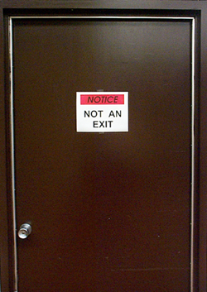
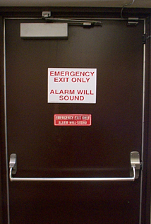

Emergency Escape Routes
Clearly communicate 3 elements of escape route
  Exit access pathway
  Nearest exits from all points of building
  Pathway away from building structure
Source of graphics: OSHA

Slide 30
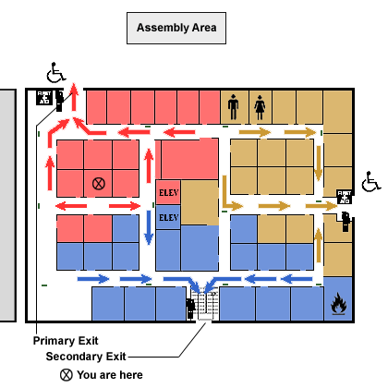
Designate an assembly area
Indicate exits with wheelchair access
No emergency exits in restrooms
No emergency exits into narrow passages
No use of elevators to reach an emergency exit
Exit signs indicating the nearest emergency exit
Designate primary and secondary exits
Exit away from rooms with hazardous materials
Indicate the employee’s current location
Notes:
Source: Evacuation Plans and Procedures eTool (2002), OSHA eTool, https://www.osha.gov/SLTC/etools/evacuation/floorplan_demo.html
“…elements of a good emergency evacuation floor plan… [are] listed below.
Designate Primary & Secondary Exits. Your evacuation floor plan should designate at least one primary exit and one secondary exit. These exits must be remote from each other and so arranged as to minimize any possibility that both may be blocked by any one fire or other emergency condition.
No Emergency Exits in Restrooms. Even if there is a door in a restroom that employees could exit out of, no emergency exits are designated through restrooms for evacuation of a building. Windows are never designated as exits. Consequently, the floor plan does not indicate the restroom as an exit.
Exit Away From Rooms With Hazardous Materials. Emergency exit routes lead away from this room containing potentially hazardous materials so that no employee will be forced to pass the area during an emergency.
No Emergency Exits Into Narrow Passages. This short passageway between the two buildings may not provide enough open space for safe evacuation during an emergency. Accordingly, no emergency exit leads to this narrow space.
Exit Signs Indicating the Nearest Emergency Exit. Signs reading "Exit" with an arrow indicating the directions, must be placed in every location where the direction of travel to reach the nearest exit is not immediately apparent.
Designate An Assembly Area. An assembly location should be designated outside the building for employees to gather during an emergency. The location of this assembly area should be clearly illustrated if shown on the map.
No Use of Elevators To Reach an Emergency Exit. The floor plan of a multiple-story building should show the locations of stairways and elevators and must indicate that the stairs, not the elevators, are the appropriate means of exit in case of emergency.
Indicate Exits with Wheelchair Access. Where applicable, exits with wheelchair access should be designated on the floorplan.
Indicate the Employee's Current Location. The floor plan should indicate the employee's current location in the building.”

Slide 31
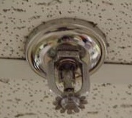
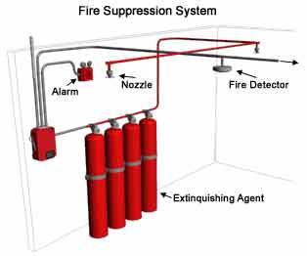
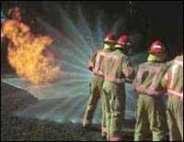
Extinguishing Fires
Methods of fire protection:
Fixed extinguishing systems
Fire brigades
Fire extinguishers
Source of graphics: OSHA
Notes:
Source: Evacuation Plans and Procedures eTool (2002), OSHA eTool, https://www.osha.gov/SLTC/etools/evacuation/fixed.html
“Fixed fire extinguishing/suppression systems are commonly used to protect areas containing valuable or critical equipment such as data processing rooms, telecommunication switches, and process control rooms. Their main function is to quickly extinguish a developing fire and alert occupants before extensive damage occurs by filling the protected area with a gas or chemical extinguishing agent.”
Source: 1910.155(c)(18)
"Fire brigade" (private fire department, industrial fire department) means an organized group of employees who are knowledgeable, trained, and skilled in at least basic fire fighting operations.”
Source: Evacuation Plans and Procedures eTool (2002), OSHA eTool, https://www.osha.gov/SLTC/etools/evacuation/portable_relation.html
“Small fires can often be put out quickly by a well-trained employee with a portable fire extinguisher. However, to do this safely, the employee must understand the use and limitation of a portable fire extinguisher and the hazards associated with fighting fires. Evacuation plans that designate or require some or all of the employees to fight fires with portable fire extinguishers increase the level of complexity of the plan and the level of training that must be provided employees.”

Slide 32
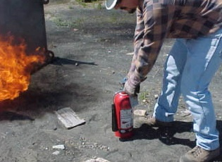
Extinguishing Fires
Portable fire extinguisher training and education
  Required for employees authorized to use fire extinguishers
  General principles of fire extinguisher use
  Hazards of incipient stage
  fire fighting
  Operation of equipment
  (instruction and
  hands-on practice)
  Required upon initial
  employment/assignment
  and at least annually thereafter
Source: OSHA
Notes:
Source: Evacuation Plans and Procedures eTool (2002), OSHA eTool, https://www.osha.gov/SLTC/etools/evacuation/portable.html
“When used properly, fire extinguishers can save lives and property by putting out a small fire or controlling a fire until additional help arrives. A fire is the most common type of emergency for which small businesses must plan. A critical decision when planning is whether or not employees should fight a small fire with a portable fire extinguisher or simply evacuate.”
Source: https://www.osha.gov/pls/oshaweb/owadisp.show_document?p_table=STANDARDS&p_id=9811
“1910.157(g)Training and education.
1910.157(g)(1)Where the employer has provided portable fire extinguishers for employee use in the workplace, the employer shall also provide an educational program to familiarize employees with the general principles of fire extinguisher use and the hazards involved with incipient stage fire fighting.
1910.157(g)(2)The employer shall provide the education required in paragraph (g)(1) of this section upon initial employment and at least annually thereafter.
1910.157(g)(3)The employer shall provide employees who have been designated to use fire fighting equipment as part of an emergency action plan with training in the use of the appropriate equipment.
1910.157(g)(4)The employer shall provide the training required in paragraph (g)(3) of this section upon initial assignment to the designated group of employees and at least annually thereafter.”

Slide 33




Extinguishing Fires
Classes of fires:
Class A – ordinary combustibles
Class B – flammable liquids and gases
Class C – energized electrical equipment
Class D – combustible metals
Class K – cooking oils and greases
A
B
C
D
K
Source: OTIEC
Notes:
Source: Evacuation Plans and Procedures eTool (2002), OSHA eTool,
“Different types of fire extinguishers are designed to fight different types of fire.”
Source: https://www.osha.gov/dte/grant_materials/fy09/sh-18796-09/fireprotection.pdf
Classes of fire are based on the type of substance fueling the fire:
Class A – ordinary combustibles (paper, trash, some plastics, wood, cloth)
Class B – flammable gases (propane, butane) or liquids (gasoline, petroleum oils, paint)
Class C – energized electrical equipment (appliances, motors, transformers)
Class D – combustible metals (potassium, lithium, sodium, aluminum, magnesium)
Class K – cooking oils and greases (animal fats, vegetable oils)

Slide 34
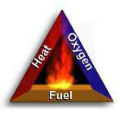
Extinguishing Fires
How fire extinguishers work
  Remove heat
  Displace/remove oxygen
  Stop chemical reaction
Source: OSHA
Notes:
Source: Evacuation Plans and Procedures eTool (2002), OSHA eTool, https://www.osha.gov/SLTC/etools/evacuation/portable_about.html
“How a Fire Extinguisher Works:
Portable fire extinguishers apply an extinguishing agent that will either cool burning fuel, displace or remove oxygen, or stop the chemical reaction so a fire cannot continue to burn. When the handle of an extinguisher is compressed, agent is expelled out the nozzle.”

Slide 35
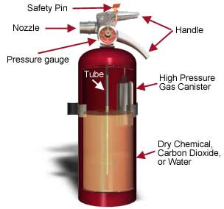
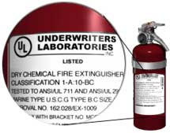
Extinguishing Fires
Parts of a fire extinguisher and labels
Source of graphics: OSHA
Notes:
Source: Evacuation Plans and Procedures eTool (2002), OSHA eTool, https://www.osha.gov/SLTC/etools/evacuation/portable_about.html
“All portable fire extinguishers must be approved by a nationally recognized testing laboratory to verify compliance with applicable standards. [29 CFR 1910.157(c)(2)] Equipment that passes the laboratory's tests are labeled and given an alpha-numeric classification based on the type and size of fire it will extinguish.
Let's take a look at the label pictured. The classification is: 1-A: 10-BC
The letters (A, B, and C) represent the type(s) of fire for which the extinguisher has been approved.
The number in front of the A rating indicates how much water the extinguisher is equal to and represents 1.25 gallons of water for every unit of one. For example, a 4-A rated extinguisher would be equal to five (4 x 1.25) gallons of water.
The number in front of the B rating represents the area in square feet of a class B fire that a non-expert user should be able to extinguish. Using the above example, a non-expert user should be able to put out a flammable liquid fire that is as large as 10 square feet.”

Slide 36
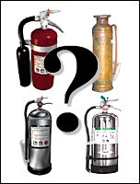
Extinguishing Fires
Types of extinguishers:
Water
Carbon Dioxide
Dry Chemical
Source: OSHA
Notes:
Source: Evacuation Plans and Procedures eTool (2002), OSHA eTool, https://www.osha.gov/SLTC/etools/evacuation/portable_about.html#water
“Different types of fire extinguishers are designed to fight different types of fire. The three most common types of fire extinguishers are: air pressurized water, CO₂ (carbon dioxide), and dry chemical.”

Slide 37
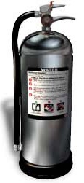

Extinguishing Fires
Water or air-pressurized water (APW) extinguishers
  Designed for Class A fires only
  Large silver container, 2 to 3 ft. tall, weighing about 25 lbs. when full
  Filled 2/3 with ordinary water, then pressurized with air
  Detergents may be added
  Cool the surface to remove the heat
  Never use to extinguish flammable
  liquid fires or electrical fires
Source of graphics: OSHA
Notes:
Source: Evacuation Plans and Procedures eTool (2002), OSHA eTool, https://www.osha.gov/SLTC/etools/evacuation/portable_about.html#water
“Water - Air-pressurized Water Extinguishers (APW)
Water is one of the most commonly used extinguishing agents for type A fires. You can recognize an APW by its large silver container. They are filled about two-thirds of the way with ordinary water, then pressurized with air. In some cases, detergents are added to the water to produce a foam. They stand about two to three feet tall and weigh approximately 25 pounds when full.
APWs extinguish fire by cooling the surface of the fuel to remove the "heat" element of the fire triangle.
APWs are designed for Class A (wood, paper, cloth, rubber, and certain plastics) fires only.
Important:
Never use water to extinguish flammable liquid fires. Water is extremely ineffective at extinguishing this type of fire and may make matters worse by the spreading the fire.
Never use water to extinguish an electrical fire. Water is a good conductor and may lead to electrocution if used to extinguish an electrical fire. Electrical equipment must be unplugged and/or de-energized before using a water extinguisher on an electrical fire.

Slide 38
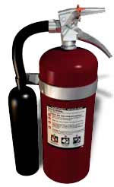

Extinguishing Fires
Carbon Dioxide (CO₂) extinguishers
  Designed for Class B and
  Class C fires only
  Red cylinders, ranging from 5 to
  100 lbs. or larger, with a hard horn and no pressure gauge
  Filled with Carbon Dioxide (CO₂), under extreme pressure
  Displace oxygen; dry ice pieces also have cooling effect
  Never use in confines space without
  respiratory protection
Source of graphics: OSHA
Notes:
Source: Evacuation Plans and Procedures eTool (2002), OSHA eTool, https://www.osha.gov/SLTC/etools/evacuation/portable_about.html#water
“CO₂ or Dry Chemical - Carbon Dioxide Extinguishers
This type of extinguisher is filled with Carbon Dioxide (CO₂), a non-flammable gas under extreme pressure. These extinguishers put out fires by displacing oxygen, or taking away the oxygen element of the fire triangle. Because of its high pressure, when you use this extinguisher pieces of dry ice shoot from the horn, which also has a cooling effect on the fire.
You can recognize this type of extinguisher by its hard horn [located at the end of the flexible hose] and absent pressure gauge.
CO₂ cylinders are red and range in size from five to 100 pounds or larger.
CO₂ extinguishers are designed for Class B and C (flammable liquid and electrical) fires only.
Important:
CO₂ is not recommended for Class A fires because they may continue to smolder and re-ignite after the CO₂ dissipates.
Never use CO₂ extinguishers in a confined space while people are present without proper respiratory protection.
Locations:
Carbon dioxide extinguishers will frequently be found in industrial vehicles, mechanical rooms, offices, computer labs, and flammable liquid storage areas.”

Slide 39
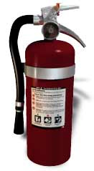

Extinguishing Fires
Dry Chemical extinguishers
(Multi-purpose)
  May be used on Class A, Class B, and/or Class C fires (check label)
  Red cylinders, ranging in size from
  5 to 20 lbs.
  Fire-retardant powder is the extinguishing agent and is propelled by a compressed, non-flammable gas
  Separates fuel from oxygen; powder also interrupts chemical reaction
Source of graphics: OSHA
Notes:
Source: Evacuation Plans and Procedures eTool (2002), OSHA eTool, https://www.osha.gov/SLTC/etools/evacuation/portable_about.html#water
“Multi-purpose - Dry Chemical Extinguishers
Dry chemical extinguishers put out fires by coating the fuel with a thin layer of fire retardant powder, separating the fuel from the oxygen. The powder also works to interrupt the chemical reaction, which makes these extinguishers extremely effective.
Dry chemical extinguishers are usually rated for class B and C fires and may be marked multiple purpose for use in A, B, and C fires. They contain an extinguishing agent and use a compressed, non-flammable gas as a propellant.
ABC fire extinguishers are red in color, and range in size from five pounds to 20 pounds.
Dry Chemical extinguishers will have a label indicating they may be used on class A, B, and/or C fires.
Locations:
These extinguishers will be found in a variety of locations including: public hallways, laboratories, mechanical rooms, break rooms, chemical storage areas, offices, commercial vehicles, and other areas with flammable liquids.”

Slide 40
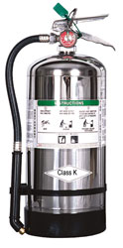
Extinguishing Fires
Class K – dry and wet chemical extinguishers
  Designed for kitchen fires
  Only intended to be used after activation of built-in hood suppression system
  Filled with electrically conductive extinguishing agents; use only after electrical power to appliance has been shut off
  Potassium bicarbonate may be used in dry types; wet chemical extinguishers spray a fine mist
Source of graphics: OSHA
Notes:
Source: Evacuation Plans and Procedures eTool (2002), OSHA eTool, https://www.osha.gov/SLTC/etools/evacuation/portable_about.html#water
“Class K - Dry and Wet Chemical Extinguishers for Kitchen Fires
Due to the higher heating rates of vegetable oils in commercial cooking appliances NFPA 10, Portable Fire Extinguishers, now includes a Class K rating for kitchen fires extinguishers which are now required to be installed in all applicable restaurant kitchens. Once a fire starts in a deep fryer, it cannot always be extinguished by traditional range hoods or Class B extinguishers.
Do not attempt to use a Class A extinguisher containing water or CO₂ on a deep fat fryer fire. An explosive type reaction may result.
Place a placard near the Class K fire extinguisher which states: "In case of appliance fire, use this extinguisher only after the fixed fire suppression system has been actuated". Class K fire extinguishers are only intended to be used after the activation of a built-in hood suppression system. If no commercial cooking system hood and fire suppression system exists, Class K extinguishers are not required.
Extinguishing agents in many Class K extinguishers are electrically conductive and should only be used after electrical power to the kitchen appliance has been shut off. Class K extinguishers use a variety of agents. Potassium bicarbonate is used in some Class K dry chemical extinguishers, and there are also Class K wet chemical extinguishers which spray a fine mist.
Travel distance to a Class K extinguisher shall not exceed 30 feet.
Install a 2-A water-type extinguisher or 6L wet chemical fire extinguisher for solid fuel cooking appliances with fire boxes.
Inspect, test and maintain Class K fire extinguishers yearly.
Locations:
These extinguishers will be found in commercial cooking operations such as restaurants, cafeterias, and other locations where food would be served.”

Slide 41
Extinguishing Fires
Using a fire extinguisher:
Steps to follow
  Sound alarm; call fire department
  Identify safe evacuation path
  Select appropriate fire extinguisher
  Discharge extinguisher using P.A.S.S. technique
  Back away once extinguished
  Evacuate immediately if necessary
    Extinguisher empty and fire is not out
    Fire progresses beyond incipient stage
Notes:
Source: Evacuation Plans and Procedures eTool (2002), OSHA eTool, https://www.osha.gov/SLTC/etools/evacuation/portable_use.html
Using a Fire Extinguisher
“The following steps should be followed when responding to incipient stage fire:
Sound the fire alarm and call the fire department, if appropriate.
Identify a safe evacuation path before approaching the fire. Do not allow the fire, heat, or smoke to come between you and your evacuation path.
Select the appropriate type of fire extinguisher.
Discharge the extinguisher within its effective range using the P.A.S.S. technique (pull, aim, squeeze, sweep).
Back away from an extinguished fire in case it flames up again.
Evacuate immediately if the extinguisher is empty and the fire is not out.
Evacuate immediately if the fire progresses beyond the incipient stage.”

Slide 42

Extinguishing Fires
P.A.S.S. technique
  Pull the pin
  Aim at base of fire
  Squeeze handle
  Sweep side-to-side at
  base of fire until fire
  appears out
  Watch area for re-ignition and repeat steps 2 – 4;
  When in doubt,
  EVACUATE IMMEDIATELY!
Source: OSHA
Notes:
Source: Evacuation Plans and Procedures eTool (2002), OSHA eTool, https://www.osha.gov/SLTC/etools/evacuation/portable_use.html
“Most fire extinguishers operate using the following P.A.S.S. technique:
PULL... Pull the pin. This will also break the tamper seal.
AIM... Aim low, pointing the extinguisher nozzle (or its horn or hose) at the base of the fire. NOTE: Do not touch the plastic discharge horn on CO₂ extinguishers, it gets very cold and may damage skin.
SQUEEZE... Squeeze the handle to release the extinguishing agent.
SWEEP... Sweep from side to side at the base of the fire until it appears to be out. Watch the area. If the fire re-ignites, repeat steps 2 - 4.
If you have the slightest doubt about your ability to fight a fire....EVACUATE IMMEDIATELY!”

Slide 43
Maintenance of Extinguisher
Elements of inspection:
Inspect bottle, handle, hose, and gauge for proper working order
Inspection tag
  Month and Year put in service current (annual)
  Monthly visual inspections completed (monthly)
  Extinguisher product still free-flowing inside bottle (turn upside down and/or shake)
Notes:
Source: Evacuation Plans and Procedures eTool (2002), OSHA eTool, https://www.osha.gov/SLTC/etools/evacuation/portable_required.html
“An employer must:
Inspect, maintain, and test all portable fire extinguishers in the workplace. [29 CFR 1910.157(e)(1)]
Visually inspect portable extinguishers or hoses monthly. [29 CFR 1910.157(e)(2)]
Perform an annual maintenance check on portable fire extinguishers. Stored pressure extinguishers do not require an internal examination. Record the annual maintenance date and retain this record for one year after the last entry or the life of the shell, whichever is less. Make the record available to the Assistant Secretary upon request. [29 CFR 1910.157(e)(3)]
Empty and maintain dry chemical extinguishers (that require a 12-year hydrostatic test) every six years. Dry chemical extinguishers that have non-refillable disposable containers are exempt from this requirement. When recharging or hydrostatic testing is performed, the six-year requirement begins from that date. [29 CFR 1910.157(e)(4)]
Provide alternate equivalent protection when portable fire extinguishers are removed from service for maintenance and recharging. [29 CFR 1910.157(e)(5)]”

Slide 44

What’s Wrong?
Source: OSHA
Notes:
Source: Evacuation Plans and Procedures eTool (2002), OSHA eTool, https://www.osha.gov/SLTC/etools/evacuation/egress_construction.html
Each number marks an element not in accordance with OSHA’s exit route requirements. See how many elements students can identify. Below are the answers:
“Furnishings and Decorations… Each exit route must be free of decorations that obscure the visibility of the exit route door. [29 CFR 1910.37(b)(3)]
Access to Exits... Each exit must be clearly visible and marked by a sign reading "Exit". [29 CFR 1910.37(b)(2)]
Discharge From Exits... Exit stairs that continue beyond the level on which the exit discharge is located must be interrupted at that level by doors, partitions, or other effective means that clearly indicate the direction of travel leading to the exit discharge. [29 CFR 1910.36(c)(3)]
Exit Marking... Each doorway or passageway along an exit access that could be mistaken fro an exit must be marked "Not an Exit" or similar designation, or be identified by a sign indicating its actual use (e.g., closet). [29 CFR 1910.37(b)(5)]
Exit Marking... If the direction of travel to the exit or exit discharge is not immediately apparent, signs must be posted along the exit access indicating the direction of travel to the nearest exit and exit discharge. Additionally, the line-of-sight to an exit sign must clearly be visible at all times. [29 CFR 1910.37(b)(4)]
Access to Exits… Exit routes must be arranged so that employees will not have to travel toward a high hazard area, unless the path of travel is effectively shielded from the high hazard area by suitable partitions or other physical barriers. [29 CFR 1910.37(a)(2)]”

Slide 45

What’s Wrong?
Source: OSHA
Notes:
Source: Evacuation Plans and Procedures eTool (2002), OSHA eTool, https://www.osha.gov/SLTC/etools/evacuation/egress_construction.html
Each number marks an element not in accordance with OSHA’s exit route requirements. See how many elements students can identify. Below are the answers:
“Exit Lighting. Each exit route must be adequately lighted so that an employee with normal vision can see along the exit route. [29 CFR 1910.37(b)(1)]
Exit Marking. Each exit sign must have the word "Exit" in plainly legible letters not less than six inches (15.2 cm) high, with the principal strokes of the letters in the word "Exit" not less than three-fourths of an inch (1.9 cm) wide. [29 CFR 1910.37(b)(7)]
Adequate Headroom. The ceiling of an exit route must be at least seven feet six inches (2.3 m) high. Any projection from the ceiling must not reach a point less than six feet eight inches (2.0 m) from the floor. [29 CFR 1910.36(g)(1)]
Access to Exits. Exit routes must be free and unobstructed. No materials or equipment may be placed, either permanently or temporarily, within the exit route. The exit access must not go through a room that can be locked, such as a bathroom, to reach an exit or exit discharge, nor may it lead into a dead-end corridor. Stairs or a ramp must be provided where the exit route is not substantially level. [29 CFR 1910.37(a)(3)]
Access to Exits. The door that connects any room to an exit route must swing out in the direction of exit travel if the room is designed to be occupied by more than 50 people or if the room is a high hazard area (i.e., contains contents that are likely to burn with extreme rapidity or explode). [29 CFR 1910.36(e)(2)]”

Slide 46
Knowledge Check
Which of the following statements is TRUE regarding Emergency Action Plans (EAPs)?
  EAPs need to be written down only if requested by employees.
  EAPs facilitate and organize actions taken during an emergency.
  EAPs have no effect on the number or severity of injuries during and emergency.
  EAPs increase confusion due to the number of documents required.
Answer: b. EAPs facilitate and organize actions taken during an emergency

Slide 47
Knowledge Check
Fire Prevention Plan (FPP) requirements include all of the following, except ___.
  it must be written document that is kept in the workplace
  it must be made available to employees for review
  the employer must review with each employee the parts of the FPP necessary for self-protection
  FPPs can be communicated orally if there are more than 10 employees
Answer: d. FPPs can be communicated orally if there are more than 10 employees

Slide 48
Knowledge Check
Which of the following elements are required in order for a fire to occur?
  Sufficient oxygen, fuel, ignition source, and chemical reaction
  Sufficient fuel, carbon dioxide, heat, and chemical reaction
  Combustible materials, spark, heat, and mechanical reaction
  Smoke, heat, flames, and light reaction
Answer: a. Sufficient oxygen, fuel, ignition source, and chemical reaction

Slide 49
Knowledge Check
Only those employees who have received training on the use of a fire extinguisher can be authorized to use a fire extinguisher during a workplace fire.
  True
  False
Answer: a. True

Slide 50
Knowledge Check
Which of the following statements represents an element of a good emergency evacuation floor plan?
  Designates one exit pathway so as not to confuse evacuees
  Indicates locations of elevators used to reach emergency exit
  Directs exits away from rooms with hazardous materials
  Indicates restrooms and windows as potential exits
Answer: c. Directs exits away from rooms with hazardous materials

Slide 51
Knowledge Check
Trash fires involving paper and wood products are __ fires.
  Class A
  Class B
  Class C
  Class D
Answer: a. Class A

Slide 52
Knowledge Check
Which fire extinguisher is appropriate for use on a fire involving gasoline in a confined space when no respiratory protection is available?
  Water (APW) extinguisher
  Carbon dioxide extinguisher
  Dry chemical extinguisher
  Class K dry-type extinguisher
Answer: c. Dry chemical extinguisher

Slide 53
Knowledge Check
The P.A.S.S. technique for using a fire extinguisher means ___.
  Position, aim, sweep, slowly
  Pull, aim, squeeze, sweep
  Point, away, side-to-side
  Pin, approach, start, stop
Answer: b. Pull, aim, squeeze, sweep

Slide 54
Knowledge Check
At minimum, how often must maintenance checks be performed on portable fire extinguishers?
  Once a month
  Once a year
  Once every two years
  Once every five years
Answer: b. once a year

