Slide 1
Introduction to Ergonomics
10-hour General Industry Outreach Training

Slide 2
Introduction
Lesson objectives:
Identify common work-related musculoskeletal disorders (MSDs).
Recognize risk factors associated with work-related MSDs.
Identify ergonomic control methods for eliminating/reducing work-related MSDs.

Slide 3
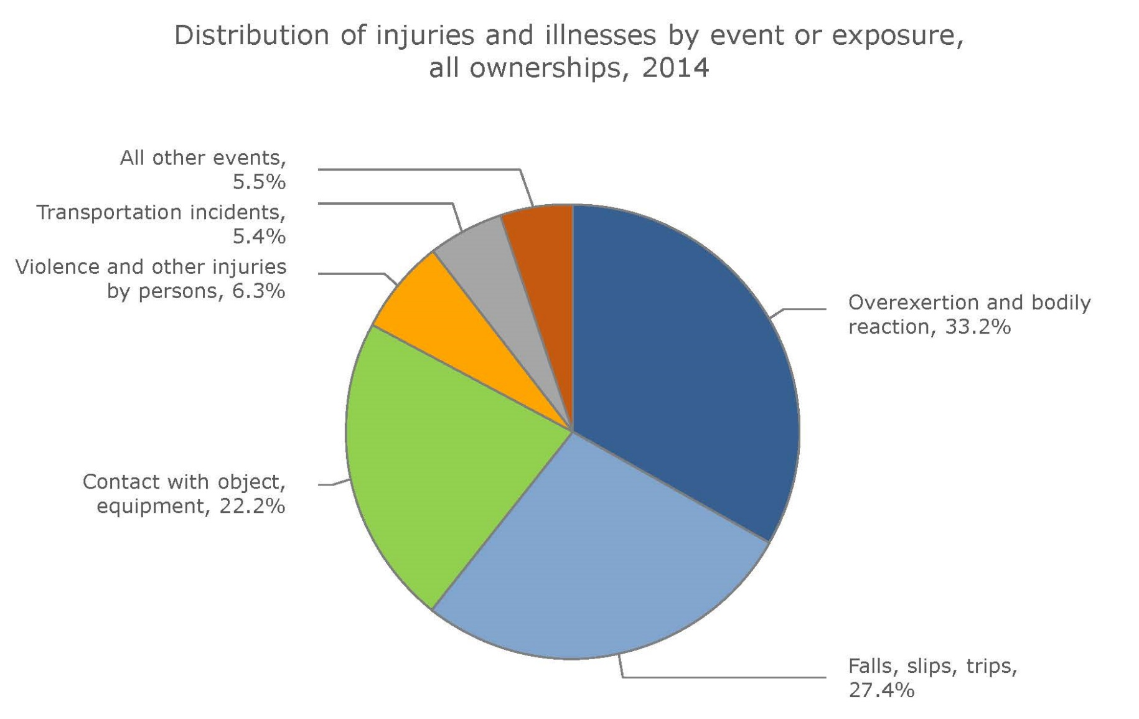
Introduction
This chart shows how MSDs compare to other hazards based on percentage of injuries and illnesses using statistics from the Bureau of Labor Statistics, FY2014.
Notes:
Musculoskeletal Disorders (MSDs) represent 1 in 3 Lost Time Injuries
Source of graphic: 2014 Nonfatal Occupational Injuries and Illnesses: Cases with days away from work (November 2015), U.S. Bureau of Labor Statistics, http://www.bls.gov/iif/oshwc/osh/case/osch0055.pdf
“Musculoskeletal disorders (MSDs) accounted for 32 percent of all injury and illness cases in 2014 for all ownerships. The MSD incidence rate decreased to 33.8 cases per 10,000 full-time workers in 2014, down from 35.8 cases. Nursing assistants and laborers and freight, stock, and material movers incurred the highest number of MSD cases in 2014…. MSD cases accounted for 54 percent of total cases that occurred to nursing assistants in 2014.”

Slide 4
Introduction
This chart shows the incident rates of musculoskeletal disorders for selected private sector industries. Source: Bureau of Labor Statistics
Notes:
Source: Nonfatal Occupational Injuries and Illnesses Requiring Days Away From Work (2014), Bureau of Labor Statistics (2015), http://www.bls.gov/news.release/pdf/osh2.pdf
“Musculoskeletal disorders: In 2014 for all workers, there were 365,580 cases of musculoskeletal disorders (MSDs), such as sprains or strains resulting from overexertion in lifting. The MSD incidence rate was 33.8 cases per 10,000 full-time workers in 2014, down from 35.8 in 2013. Workers who sustained an MSD required a median of 13 days to recuperate before returning to work in 2014, compared to 9 days for all types of cases and up from 11 days in 2013.”

Slide 5
Introduction
Ergonomics
  “The scientific discipline concerned with understanding of interactions among humans and other elements of a system, and the profession that applies theory, principles, methods and data to design in order to optimize human well-being and overall system performance”

Slide 6
Introduction
Ergonomics means
“fitting the job to the worker,” including:
Work stations
Tools
Equipment
Ergo = Work
Nomos = Law
Notes:
Designing jobs, equipment, and work tasks to fit human physical characteristics and energy limitations
It considers body dimensions, mobility, and the body’s stress behavior
“Make the work fit the person, not the person fit the work”

Slide 7
Introduction
Why is ergonomics important?
Overexertion leading cause of injuries
  Most costly
  Recurring/Persistent pain may develop in future
Bodily reaction is another leading cause of injuries in workplace
Repetitive motion also within top 10 most common workplace injuries
Notes:
Why is Ergonomics important?
Overexertion is the leading cause of injuries throughout all injuries
Most costly (32% of Workers’ Compensation expenses in 2014)
Recurring/persistent pain may develop in future
Bodily reaction (bending, climbing, reaching, standing, sitting, and slips and trips without falling) is another leading cause of injuries in the workplace
Repetitive motion is also within top 10 most common workplace injuries

Slide 8
Common Work-Related MSDs
Musculoskeletal Disorders (MSDs)
Affect the muscles, nerves, blood vessels, ligaments, and tendons
Symptoms
  Discomfort
  Pain
  Numbness
  Loss of motion/flexibility
  Spasticity
  Stiff joints
  Burning
  Swelling
  Tingling
  Inflammation
  Throbbing
  Paralysis
Notes:
Source: Prevention of Musculoskeletal Disorders in the Workplace (n.d.), OSHA Safety and Health Topics, https://www.osha.gov/SLTC/ergonomics/
“Musculoskeletal disorders (MSDs) affect the muscles, nerves, blood vessels, ligaments and tendons. Workers in many different industries and occupations can be exposed to risk factors at work, such as lifting heavy items, bending, reaching overhead, pushing and pulling heavy loads, working in awkward body postures and performing the same or similar tasks repetitively. Exposure to these known risk factors for MSDs increases a worker's risk of injury.
Work-related MSDs can be prevented. Ergonomics --- fitting a job to a person --- helps lessen muscle fatigue, increases productivity and reduces the number and severity of work-related MSDs.”
================================================
Daily stress to anatomical structures that may occur when a person is exposed to certain high risk activities If the accumulating stress exceeds the body’s normal recuperative ability, inflammation of the tissue can follow Chronic inflammation may lead to the development of WMSDs May require weeks, months or years for development - and for recovery
WMSDs are sometimes referred to using other unfamiliar terms such as :
Cumulative Trauma Disorders – CTD
Repetitive Trauma Disorders – RTD
Repetitive Strain Injuries – RSI
Repeated Motion Disorders – RMD
Overuse Syndromes

Slide 9
Common Work-Related MSDs
Common MSD disorders:
  Carpal Tunnel Syndrome
  Tennis Elbow
  Bursitis
  Ischemia
  De Quervain’s
  Sciatica
  Herniated Discs
  Neck strain/disability
  Tendinitis
  Rotator Cuff
  Neuritis
  Reynaud’s Syndrome
  Trigger Finger
  Thoracic Outlet Syndrome
  Epicondylitis
  Back strain/disability

Slide 10
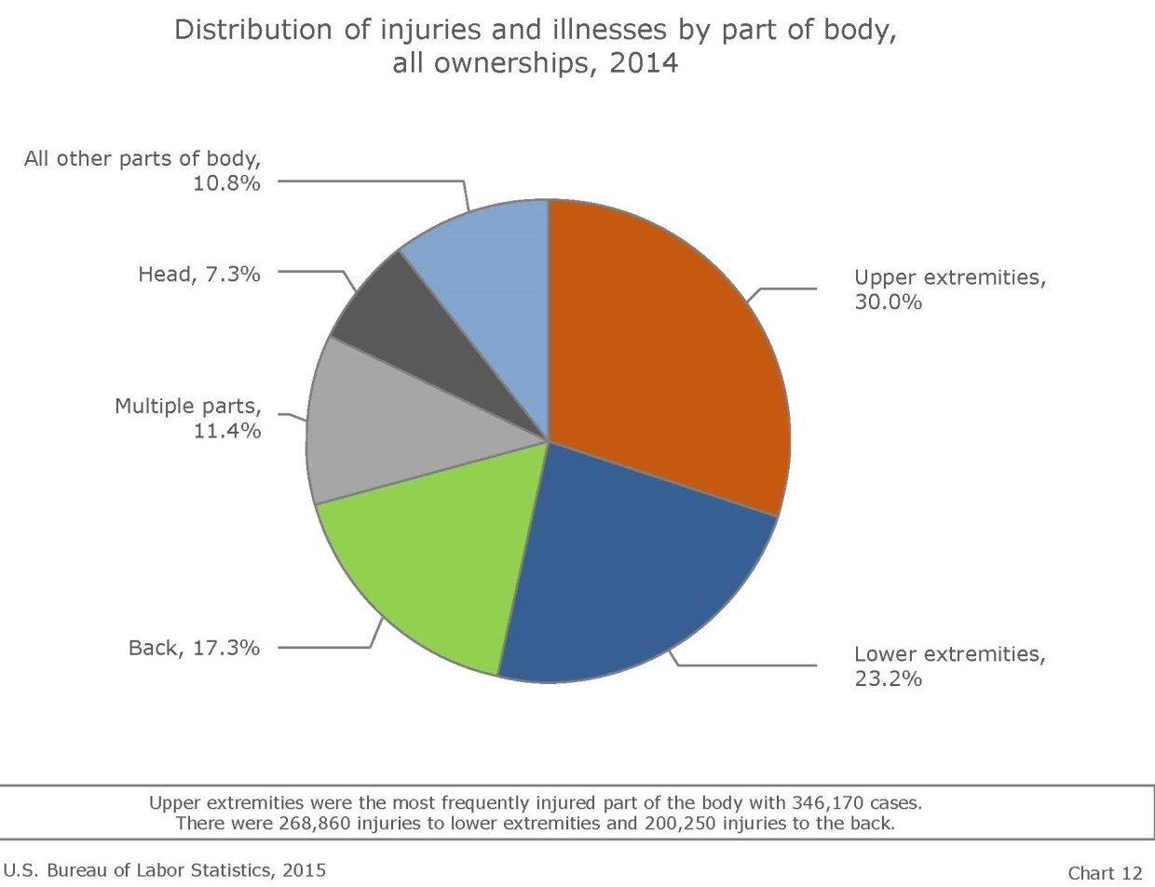
Common Work-Related MSDs
Most commonly affected areas:
Back
Arms, Elbows,
and Shoulders
Neck
Hands, Wrists,
and Fingers
Knees, Ankles,
and Feet
This chart shows a distribution of injuries and illnesses to body parts due to MSDs using statistics from the Bureau of Labor Statistics, FY2014.
Notes:
Nonfatal Occupational Injuries and Illnesses Requiring Days Away from Work (2014)
http://www.bls.gov/news.release/osh2.nr0.htm

Slide 11
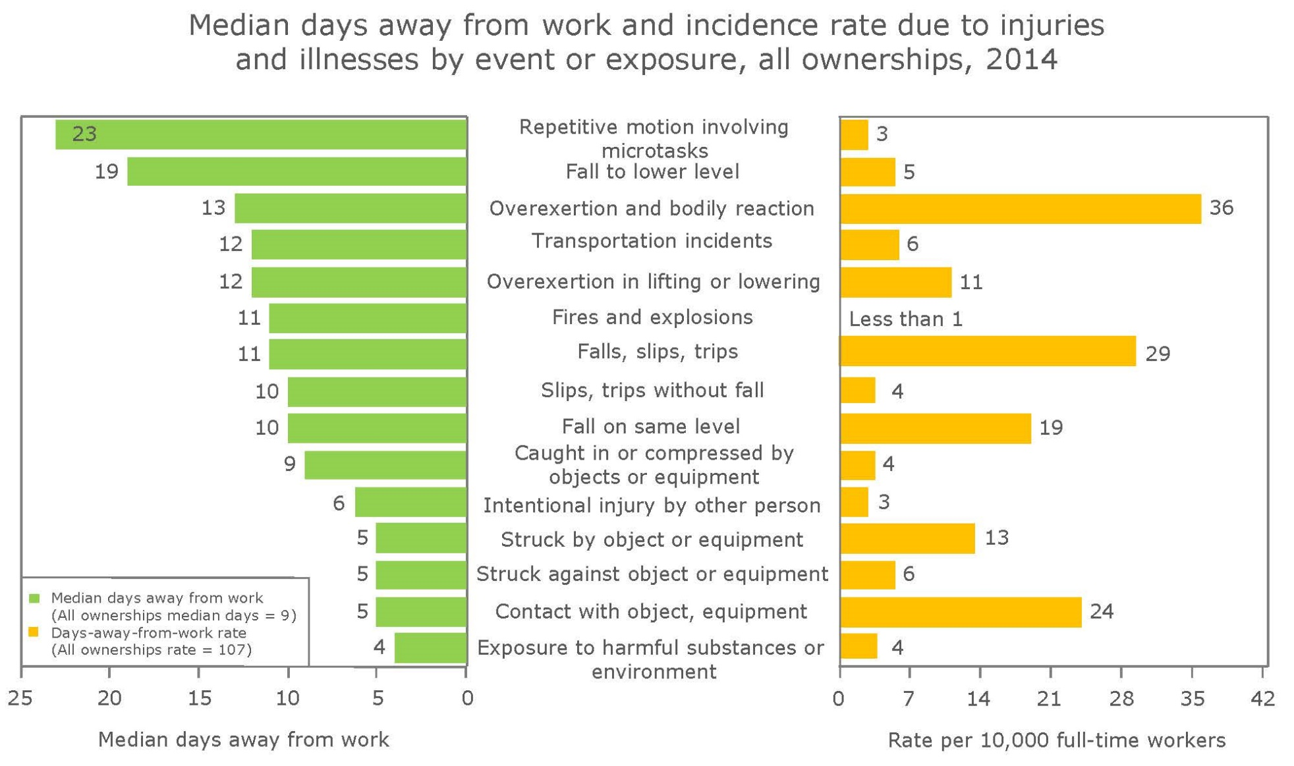
Common Work-Related MSDs
Highest rate of missed days
Highest incident rate
Source: Bureau of Labor Statistics
Notes:
Source of graphic: 2014 Nonfatal Occupational Injuries and Illnesses: Cases with days away from work (November 2015), U.S. Bureau of Labor Statistics, http://www.bls.gov/iif/oshwc/osh/case/osch0055.pdf
Of all the injuries and illnesses that involved days away from work, injuries related to Repetitive Motion Involving Microtasks had the highest rate of missed days at 23. Overexertion and Bodily Reaction had the highest incident rate of all injuries and illnesses at 36 per 10,0000 full-time workers.
The ten occupations that accounted for the highest incident rate (per 10,000 full-time workers) included the following: (number of cases in parenthesis with top 4 # of cases bolded)
Nursing Assistants (20,920 cases)
Emergency Medical Technicians and Paramedics (3,880 cases)
Firefighters (5,760 cases)
Highway Maintenance Workers (1,690 cases)
Light Truck or Delivery Services Drivers (10,390 cases)
Reservation and Travel Clerks (1,300 cases)
Heavy and Tractor-Trailer Truck Drivers (17,030 cases)
Maids and Housekeeping Cleaners (6,650 cases)
Telecommunications Installers and Repairers, except Line Installers (1,820 cases)
Janitors and Cleaners, except Maids (14,530 cases)

Slide 12
Risk Factors Associated with MSDs
Risk factors of MSD injuries:
Dependent upon:
  Work positions and postures
  How often task is performed
  Level of required effort and duration of task
Notes:
Source: Prevention of Musculoskeletal Disorders in the Workplace (n.d.), OSHA Safety and Health Topics, https://www.osha.gov/SLTC/ergonomics/identifyprobs.html
“The risk of MSD injury depends on work positions and postures, how often the task is performed, the level of required effort and how long the task lasts.”

Slide 13
Risk Factors Associated with MSDs
Examples of risk factors include:
  Exerting excessive force
    Lifting heavy objects/people
    Pushing or pulling heavy loads
    Manual pouring materials
    Maintaining control of equipment
    or tools
  Performing same/similar tasks repetitively
Source: OSHA
Notes:
Source: Prevention of Musculoskeletal Disorders in the Workplace (n.d.), OSHA Safety and Health Topics, https://www.osha.gov/SLTC/ergonomics/identifyprobs.html
“The risk of MSD injury depends on work positions and postures, how often the task is performed, the level of required effort and how long the task lasts. Risk factors that may lead to the development of MSDs include:
Exerting excessive force. Examples include lifting heavy objects or people, pushing or pulling heavy loads, manually pouring materials, or maintaining control of equipment or tools.
Performing the same or similar tasks repetitively. Performing the same motion or series of motions continually or frequently for an extended period of time. ”

Slide 14
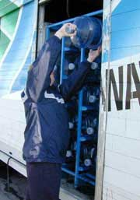
Risk Factors Associated with MSDs
  Working in awkward postures or
  same postures for long periods
    Prolonged/repetitive reaching above shoulder height
    Kneeling
    Squatting
    Leaning over a counter/bending
    Using a knife with wrists bent
    Twisting the torso while lifting
  Localized pressure into the body part
    Pressing the body/part of the body against hard or sharp edges
    Using the hand as a hammer
Source: OSHA
Notes:
Source: Prevention of Musculoskeletal Disorders in the Workplace (n.d.), OSHA Safety and Health Topics, https://www.osha.gov/SLTC/ergonomics/identifyprobs.html
“Working in awkward postures or being in the same posture for long periods of time. Using positions that place stress on the body, such as prolonged or repetitive reaching above shoulder height, kneeling, squatting, leaning over a counter, using a knife with wrists bent, or twisting the torso while lifting.
Localized pressure into the body part. Pressing the body or part of the body (such as the hand) against hard or sharp edges, or using the hand as a hammer.”

Slide 15
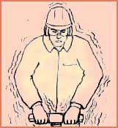
Risk Factors Associated with MSDs
  Cold temperatures
  (in combination with other risk factors)
  Vibration
    Whole body
    Hand-arm
  Combined exposure to
  several risk factors
Source of graphics: OSHA
Notes:
Source: Prevention of Musculoskeletal Disorders in the Workplace (n.d.), OSHA Safety and Health Topics, https://www.osha.gov/SLTC/ergonomics/identifyprobs.html
“Cold temperatures. In combination with any one of the above risk factors may also increase the potential for MSDs to develop. For example, many of the operations in meatpacking and poultry processing occur with a chilled product or in a cold environment.
Vibration. Both whole body and hand-arm, can cause a number of health effects. Hand-arm vibration can damage small capillaries that supply nutrients and can make hand tools more difficult to control. Hand-arm vibration may cause a worker to lose feeling in the hands and arms resulting in increased force exertion to control hand-powered tools (e.g. hammer drills, portable grinders, chainsaws) in much the same way gloves limit feeling in the hands. The effects of vibration can damage the body and greatly increase the force which must be exerted for a task.
Combined exposure to several risk factors. May place workers at a higher risk for MSDs than does exposure to any one risk factor.”

Slide 16
Ergonomic Control Methods
Methods of protecting against MSDs:
Establish ergonomics program
  Training
  Feedback from all levels
Conduct job hazard analysis (JHAs)
Early recognition and reporting of potential MSDs
Notes:
Training
Training is an important element in the ergonomic process. Training should be conducted in a language and vocabulary that all workers understand and is best provided by individuals who have experience with ergonomic issues in your particular industry. When training is effective workers will:
Learn the principles of ergonomics and their applications.
Learn about the proper use of equipment, tools, and machine controls.
Use good work practices, including proper lifting techniques.
Become more aware of work tasks that may lead to pain or injury.
Recognize early symptoms of MSDs.
Understand the importance of reporting and addressing early indications of MSDs before serious injuries develop.
Understand procedures for reporting work-related injuries and illnesses, as required by OSHA's injury and illness recording and reporting regulation (29 CFR Part 1904).

Slide 17
Ergonomic Control Methods
Job Hazard Analysis
Tasks | Hazards | Controls
This table provides an example of a tool that can be used when conducting a job hazard analysis. The first column provides a list of tasks performed by a job; the middle column is provided for listing identified hazards; and, the third column provides a list of controls that can be used to mitigate the hazards.
Notes:
Job Hazard Analysis and Control – Where a work-related MSD exists all employees performing a similar job must be observed and the job evaluated using either one or more of the job hazard analysis tools provided by OSHA or another reasonable method appropriate for the situation. Once ergonomic risks have been identified the employer must implement controls to reduce, minimize or eliminate the risks. Four kinds of controls can be implemented in any combination:

Slide 18
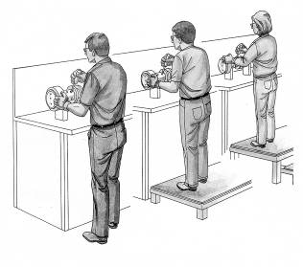
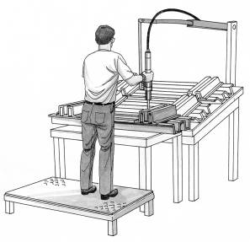
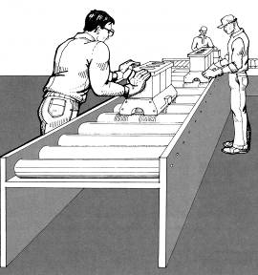
Ergonomic Control Methods
Examples of engineering controls
  Work station design and setup
  Ergonomically designed tools
  Ergonomically designed equipment
  Load weight reduction
Source: OSHA (International Labor Organization)
Notes:
Engineering Controls (implement physical change to the workplace, which eliminates/reduces the hazard on the job/task)
- Use a device to lift and reposition heavy objects to limit force exertion
- Reduce the weight of a load to limit force exertion
- Reposition a work table to eliminate a long/excessive reach and enable working in neutral postures
- Use diverging conveyors off a main line so that tasks are less repetitive
- Install diverters on conveyors to direct materials toward the worker to eliminate excessive leaning or reaching
- Redesign tools to enable neutral postures

Slide 19
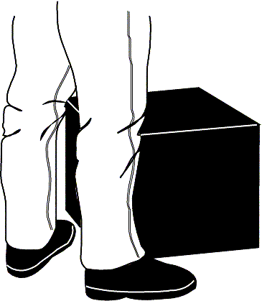
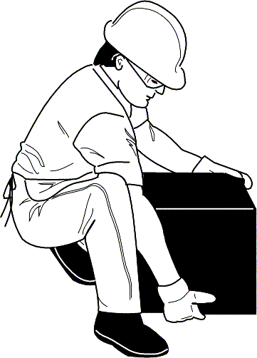
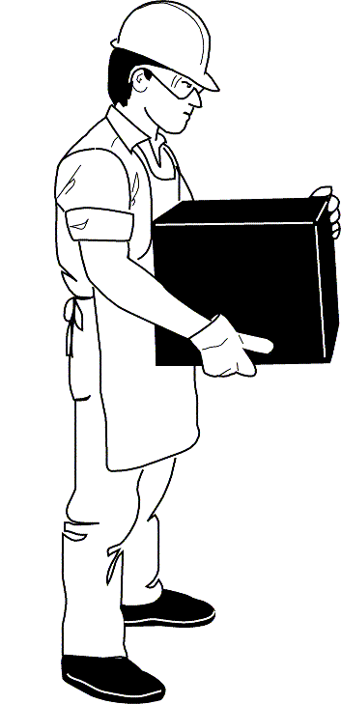
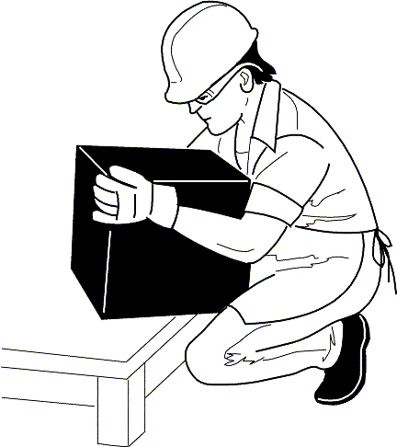
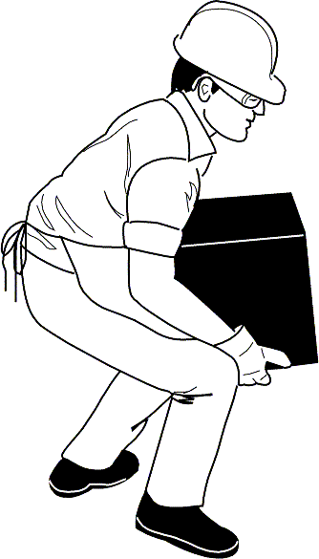
Ergonomic Control Methods
Examples of proper work practices:
  Proper lifting techniques (NIOSH)
  Team lift heavy/bulky/awkward loads
  Stretch
  Work rotation
  Task variety
  Increase rest breaks
Source of graphics: OSHA
Notes:
Administrative and Work Practice Controls (establish efficient processes or procedures)
- Require that heavy loads are only lifted by two people to limit force exertion
- Establish systems so workers are rotated away from tasks to minimize the duration of continual exertion, repetitive motions, and awkward postures. Design a job rotation system in which employees rotate between jobs that use different muscle groups
- Staff "floaters" to provide periodic breaks between scheduled breaks
Properly use and maintain pneumatic and power tools
Applications Manual for the Revised NIOSH Lifting Equation (1994)
http://www.cdc.gov/niosh/docs/94-110/pdfs/94-110.pdf

Slide 20
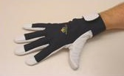

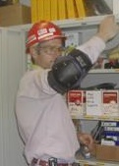
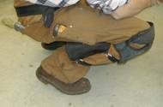
Ergonomic Control Methods
Examples of PPE:
  Gripping gloves
  Knee pads
  Vibration gloves
  Thermal gloves
  Lifting straps
  Shoulder harness
  Lifting braces
Source of graphics: OSHA
Notes:
Personal Protective Equipment (use protection to reduce exposure to ergonomics-related risk factors)
- Use padding to reduce direct contact with hard, sharp, or vibrating surfaces
- Wear good fitting thermal gloves to help with cold conditions while maintaining the ability to grasp items easily
Letter of interpretation:
1995 - 05/31/1995 - Requesting clarification of Slings

Slide 21
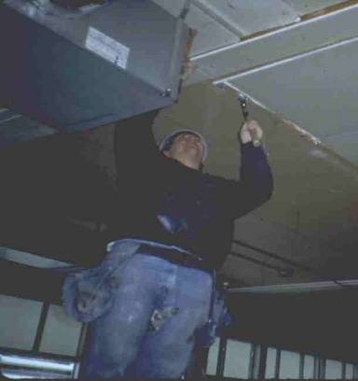
Ergonomic Control Methods
Physical ergonomic hazards and solutions:
Reaching above the head/shoulders - hazards
  Working with the hands above head for more than
  2 hours per day
Source of graphics: OSHA
Notes:
Source: Ergonomics eTool: Solutions for Electrical Contractors (2003), OSHA eTool,
https://www.osha.gov/SLTC/etools/electricalcontractors/index.html
“Potential Hazards:
Working on overhead tasks in awkward posture with the hands raised above the shoulder may restrict blood flow and result in nerve compression that affects the upper extremities and shoulders causing numbness, tingling, discomfort and fatigue when these postures are maintained for long periods of time.”

Slide 22

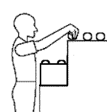
Ergonomic Control Methods
  Working with the elbows above shoulders for more than 2 hours per day
Source of graphics: OSHA
Notes:
Source: Ergonomics eTool: Solutions for Electrical Contractors (2003), OSHA eTool,
https://www.osha.gov/SLTC/etools/electricalcontractors/index.html
“Potential Hazards:
Awkward postures while pulling with the hands above the shoulder cause an increased load imposed on the shoulders, neck and back. When performed repeatedly, these tasks may result in overexertion of the back and upper extremities.”

Slide 23
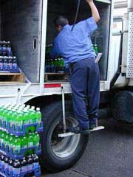
Ergonomic Control Methods
Reaching above the head/shoulders - solutions
  Keep items within close reach
  Elevate work areas
Source: NIOSH
Source: NIOSH
Source: OSHA
Notes:
Simple ways to reduce reach distances:
Keep items within close reach (design reach distance for the shortest worker)
Platform allowing for easier access to items
Pullout steps on vehicles
Elevated racks that can be lowered to an appropriate height when access is needed
Source: Ergonomics eTool: Solutions for Electrical Contractors (2003), OSHA eTool,
https://www.osha.gov/SLTC/etools/electricalcontractors/index.html
“Possible Solutions:
Conduct pre-planning to ensure that employees are provided with appropriate height ladders.
Use platform ladders, lifts or other devices to get closer to the work area. “

Slide 24
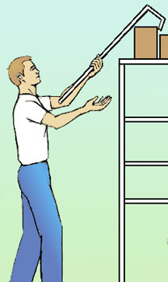
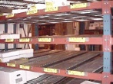
Ergonomic Control Methods
Reaching above the head/shoulders - solutions
  Remove obstacles
  Utilize equipment to raise and
  lower items or move items
  closer to worker
Source: OSHA
Source: OSHA
Source: NIOSH
Notes:
Simple ways to reduce reach distances:
Remove obstacles
Utilize equipment to raise and lower items or move items closer to worker, such as:
Use gravity feed racks (these are racks on shelves with little wheels that allow boxes stored on them to slide forward as the front box is removed. (Kind of like taking a can of beverage out of the cooler case at a convenience store.)
Small portable forklift
“Provide “pick sticks” or “bow peep” hooks to pull small, light-weight items closer to edge prior to lifting.” Source: OSHA eTool: Grocery Warehousing: Ergonomics
Source: Ergonomics eTool: Solutions for Electrical Contractors (2003), OSHA eTool,
https://www.osha.gov/SLTC/etools/electricalcontractors/index.html
“Possible Solutions:
Remove impediments such as work tables, bins or power equipment to improve access.
Adjust height of the work pieces to allow elbows to stay close to the body within the power zone….
Use of a portable pulley… combined with mechanical pullers may significantly reduce overhead reaches and force requirements of the task.”

Slide 25
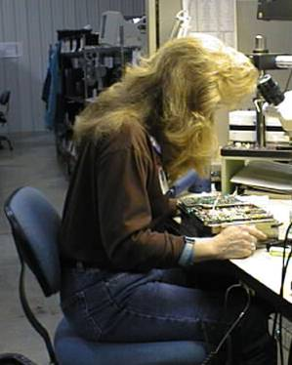
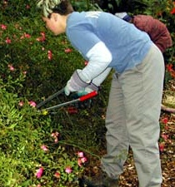
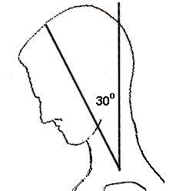
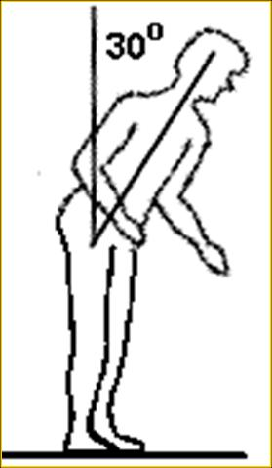
Ergonomic Control Methods
Awkward body postures - hazards
  Working with the neck or back bent forward more than 30° for more than 2 hours per day
Source of graphics: OSHA
Notes:
Your head weighs 10 to 12 pounds, so it can be quite a strain to work with your neck bent.
Neck posture is only covered by the rule if the worker is not able to vary his or her posture. Working with the neck bent like this is pretty common in inspection jobs, such as with this cherry sorter. It also is common in job such as:
welding,
microscope work,
dental hygienists
Your upper body is 60 percent of your total body weight, so like your neck holding up your head, it’s also a strain for your back to hold you in a bent over position for more than two hours per day, such as landscapers who work near ground level.
Like neck posture, back posture is only covered if the worker is not able to vary his or her posture.
If the location of your work is too low, you’re going to have to get into an awkward posture to get to it. Typically that means bending your back, kneeling or squatting. It can also mean bending your head and neck forward.
If ergonomics is about adapting the work to fit you, instead of asking you to adapt to the work, what do you think some ergonomic solutions might be?
Posture – repeated working in a deviated body posture (e.g. bent neck, back, wrists, arms above the head etc.) for more than 2 hours per day.

Slide 26
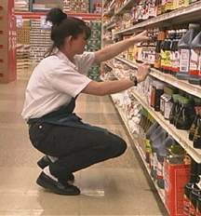
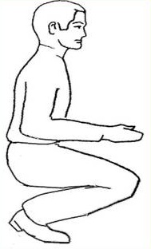
Ergonomic Control Methods
  Squatting for more than 2 hours per day
Source of graphics: OSHA
Notes:
If the location of your work is too low, you’re going to have to get into an awkward posture to get to it. Typically that means bending your back, kneeling or squatting. It can also mean bending your head and neck forward.
If ergonomics is about adapting the work to fit you, instead of asking you to adapt to the work, what do you think some ergonomic solutions might be?
Squatting is one alternative to bending at the back to get down low, and it’s fine to do for short periods of time. Unfortunately it creates a lot of pressure behind the knee cap and can cause knee injuries over time.
Grocery Warehousing: Ergonomics, OSHA eTool
https://www.osha.gov/SLTC/etools/grocerywarehousing/index.html
Ergonomics: Guidelines for Retail Grocery Stores - Ergonomics for the Prevention of Musculoskeletal Disorders
OSHA's Guidelines for Retail Grocery Stores provide practical recommendations to help grocery store employers and employees reduce the number and severity of injuries in their workplaces. (OSHA 3192 - 2004) (English: HTML PDF)

Slide 27
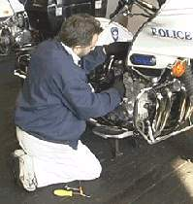
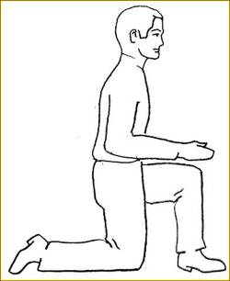
Ergonomic Control Methods
  Kneeling for more than 2 hours per day
Source: OSHA
Notes:
Kneeling also is a risk factor for knee injuries, since it creates pressure both in front of and behind the knee cap.
Ergonomics eTool: Solutions for Electrical Contractors, OSHA eTool
https://www.osha.gov/SLTC/etools/electricalcontractors/index.html

Slide 28

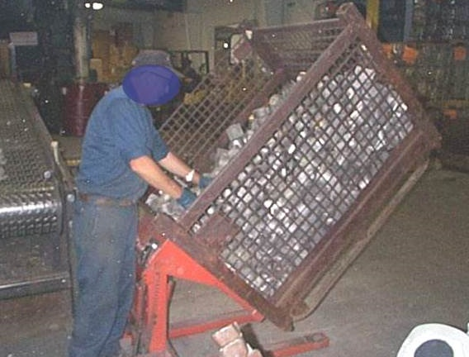
Ergonomic Control Methods
Awkward body postures - solutions
  Raise and/or tilt the work for better access
  Use a stool for ground-level work
Source: OSHA
Source: NIOSH
Source: OSHA
Notes:
If the work is too low, one solution to consider is finding a way to raise the work.
If that’s not possible, can you use a low stool to provide support so that you can sit lower near the level of the work?

Slide 29
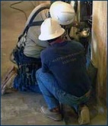
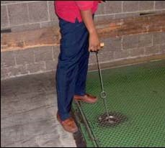
Ergonomic Control Methods
Awkward body postures - solutions
  Use tools with longer handles
  Alternate between bending, kneeling, sitting, and squatting
Source: OSHA
Source: NIOSH
Source: OSHA
Notes:
If the work is too low, one solution to consider is finding a way to raise the work.
If that’s not possible, can you use a low stool to provide support so that you can sit lower near the level of the work?
Long-handled tools can be used in some cases so that you can stand upright and work.
If none of these will work, it at least helps some to alternate between different postures, so that you don’t spend too much time in any one position.

Slide 30
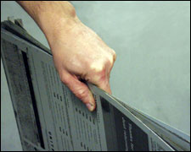
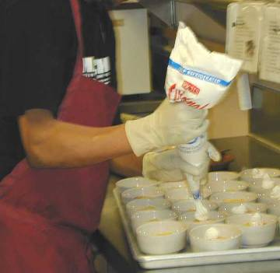
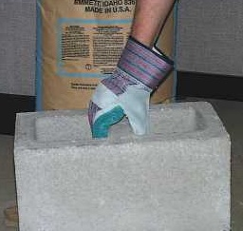
Ergonomic Control Methods
Awkward grips - hazards
  Gripping 10 or more pounds or force for 2 or more hours per day
Source of graphics: OSHA
Notes:
Using a lot of hand force increases the risk for hand, wrist and elbow injuries, and in some cases shoulder injuries.
Holding something between the tips of the fingers and the thumb is called a pinch grip. This type of grip uses very small muscles in the hand and wrist, so even holding something that weighs only 2 pounds can be a risk for injury if it’s done for more than 2 hours per day.
Because you can’t get as good a grip with your fingertips as with your whole hand, you tend to use more force to hold onto something than just the weight of the object. For example, in order to hold onto a stack of paper that weighs two pounds, you actually have to use four pounds of grip force.
Jobs involving pinch force of 4 pounds are also covered, even if the weight being handled is really low. An example would be an assembly job where one of the parts inserted are spring clips that require a pinch force of 4 pounds to open.
When you grip something with your whole hand you’re able to use the larger muscles in your forearm, and this gives you a grip that’s five times stronger than a pinch grip. You’re also able to get a better grip so the amount of grip force you use is pretty much equal to the weight of the object you’re holding.
Therefore, grip force only enters the caution zone if it’s 10 or more pounds of weight held or 10 or more pounds of force exerted, and it’s done for more than 2 hours per day.
Ergonomics: Guidelines for Retail Grocery Stores - Ergonomics for the Prevention of Musculoskeletal Disorders
OSHA's Guidelines for Retail Grocery Stores provide practical recommendations to help grocery store employers and employees reduce the number and severity of injuries in their workplaces.
Letter of interpretation:
1991 - 10/16/1991 - Ergonomics in the Baking Industry.

Slide 31
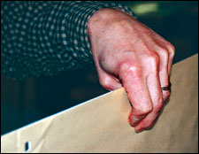
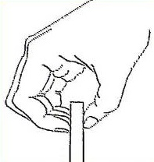
Ergonomic Control Methods
Awkward grips - hazards
  Pinching 2 or more pounds of weight or 4 or more pounds of force for 2 or more hours per day
Source of graphics: OSHA
Notes:
Using a lot of hand force increases the risk for hand, wrist and elbow injuries, and in some cases shoulder injuries.
Holding something between the tips of the fingers and the thumb is called a pinch grip. This type of grip uses very small muscles in the hand and wrist, so even holding something that weighs only 2 pounds can be a risk for injury if it’s done for more than 2 hours per day.
Because you can’t get as good a grip with your fingertips as with your whole hand, you tend to use more force to hold onto something than just the weight of the object. For example, in order to hold onto a stack of paper that weighs two pounds, you actually have to use four pounds of grip force.
Jobs involving pinch force of 4 pounds are also covered, even if the weight being handled is really low. An example would be an assembly job where one of the parts inserted are spring clips that require a pinch force of 4 pounds to open.
When you grip something with your whole hand you’re able to use the larger muscles in your forearm, and this gives you a grip that’s five times stronger than a pinch grip. You’re also able to get a better grip so the amount of grip force you use is pretty much equal to the weight of the object you’re holding.
Therefore, grip force only enters the caution zone if it’s 10 or more pounds of weight held or 10 or more pounds of force exerted, and it’s done for more than 2 hours per day.
Ergonomics in the Printing Industry, OSHA eTool
https://www.osha.gov/SLTC/etools/printing/
Sewing and Related Procedures: Ergonomics, OSHA eTool
https://www.osha.gov/SLTC/etools/sewing/index.html

Slide 32
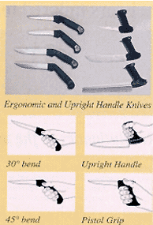
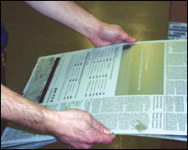
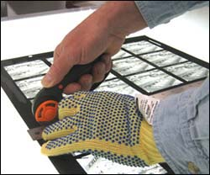
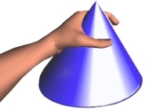
Ergonomic Control Methods
Awkward grips - solutions
  Design work layout to reduce hand-carrying
  Reduce amount of items carried at one time
  Use non-pinch grip postures
  Use ergonomically designed tools/aids
  Use job/task rotation
“C” shaped posture
Source of graphics: OSHA
Notes:
Limit hand-carrying stresses through:
Design of work layout that reduces hand-carrying of items
Reduce amount of items carried at one time
Use non-pinch grip postures to hold and carry items
Use ergonomically designed tools/aids, such as:
Friction-reducing aids on fingers to reduce amount of force exerted in the pinch grip (1)
Use job/task rotation that includes tasks not requiring pinch grip
“Possible Solutions:
Maintain hand postures that provide maximal finger force. Generally, the hand span should be about 1.75 to 2.25 inches for maximum finger exertion and the hand should be in the shape of a "C“….
Limit the amount of product that is lifted at one time to reduce the finger force exerted. Some recommendations for repetitive tasks that require pinch grips and that include force should be limited to about 2 to 4 pounds of force. Note: It takes about 2 pounds of force to hold a 12 oz. soda can and about 5 pounds of force to fully open a small binder clip….
Ensure that the hand is maintained in a neutral posture where it is not bent either up or down or to either side. Bending the wrist reduces the amount of force that can be safely exerted by the fingers. “ (2)
Sources:
1. https://www.osha.gov/SLTC/etools/sewing/stitching.html
2. https://www.osha.gov/SLTC/etools/printing/lithography/lithography_index.html

Slide 33

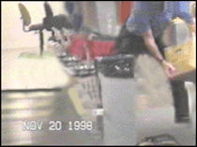
Ergonomic Control Methods
Repetitive motions - hazards
  Repeating same motion for more than two hours per day with hands, wrists, elbows, shoulders, or neck
Source: OSHA
Notes:
Fewer people know that repetitive lifting can be just as hazardous [as heavy lifting] because of the fatigue it causes. When you lift frequently you can tire out the muscles, making them more prone to injury. If your muscles can’t handle the load, the strain can be shifted to your joints and the disks in your spine, placing them at risk for injury, too.
Repetition – high repetition rate for the same movements for at least 2 hours at a time; or, using a high repetition device (e.g. keyboard, mouse) for more than 4 hours a day.
Solutions for Baggage Handling, OSHA eTool
https://www.osha.gov/SLTC/etools/baggagehandling/index.html
Beverage Delivery: Ergonomics, OSHA eTool
https://www.osha.gov/SLTC/etools/beverage/index.html
Grocery Warehousing: Ergonomics, OSHA eTool
https://www.osha.gov/SLTC/etools/grocerywarehousing/index.html
Poultry Processing Industry eTool, OSHA eTool
https://www.osha.gov/SLTC/etools/poultry/index.html

Slide 34
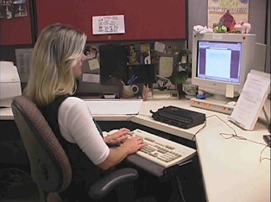
Ergonomic Control Methods
Repetitive motions - hazards
  Intense keying for more than 4 hours per day
Source: OSHA
Notes:
Computer Workstations eTool, OSHA eTool
https://www.osha.gov/SLTC/etools/computerworkstations/index.html

Slide 35
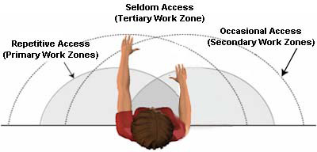
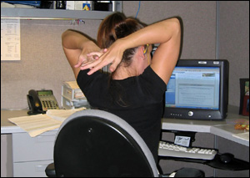
Ergonomic Control Methods
Repetitive motions - solutions
  Arrange work to avoid unnecessary motions
  Let power tools and machinery do the work
  Spread repetitive work out during the day
  Take stretch pauses
  Rotate task with co-workers if possible
  Change hands or motions frequently
Source of graphics: OSHA
Notes:
Repetitive motions may be required by your job. However, a lot of times you have some control over what motions you make and how often you make them. Things you can do to reduce repetitive motions include:
Arrange work to avoid unnecessary motions
Let power tools and machinery do the work
Spread repetitive work out during the day
Take stretch pauses
Rotate tasks with co-workers if possible
Change hands or motions frequently

Slide 36
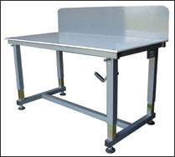
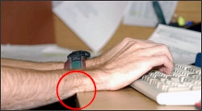
Ergonomic Control Methods
Localized pressure on body part - hazards
  Pressing the body/part of the body against
  hard or sharp edges
  Standing/kneeling for prolonged periods on hard surfaces
  Using tools with hard handle surfaces or
  short handles
Source of graphics: OSHA
Notes:
Source: https://www.osha.gov/SLTC/etools/computerworkstations/components_desk.html
“Some desks and computer equipment have hard, angled leading edges that come in contact with a user’s arm or wrist. This can create contact stress, affecting nerves and blood vessels, possibly causing tingling and sore fingers.”
Source: https://www.osha.gov/SLTC/etools/electricalcontractors/prefabrication/assembly.html
“Sharp edges on work tables may create contact stress to soft tissues of the forearm, hand, and wrist.”
Source: https://www.osha.gov/SLTC/etools/electricalcontractors/installation/using.html
“Short handles may press or rub against the palm and fingers… causing contact stress. Small handle diameter may increase force requirements of tool leading to fatigue, discomfort and pain.”

Slide 37
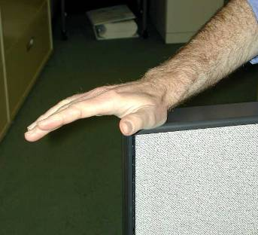
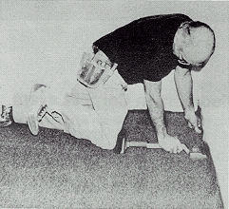
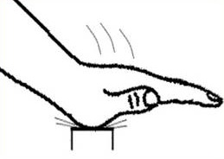

Ergonomic Control Methods
Localized pressure on body part - hazards
  Using hands/knees as a hammer more than 10 times in 1 hour or more than 2 times per day (long-term)
Source of graphics: OSHA
Notes:
Contact stress – applying contact force with a body part more than 10 times per hour for more than 2 hours per day (e.g. using the hand or knee as a hammer).

Slide 38





Ergonomic Control Methods
Localized pressure on body part - solutions
  Use tools with longer handles
  Use tools with padded grips
  Alternate between bending, kneeling, sitting,
  and squatting; use sit/stand stools or tables
Source of graphics: OSHA
Notes:
Source: https://www.osha.gov/dsg/guidance/shipyard-guidelines.html
Long extension handles for hand tools allow the operator to work standing instead of kneeling or crouching to use the tool.
Source: https://www.osha.gov/SLTC/etools/electricalcontractors/installation/using.html
“Use tools with padded grips and handles that extend across the whole palm of the hand to minimize contact pressure.
Ensure that tools such as screwdrivers have appropriately sized and shaped handles. Generally, handles should be about 1 1/2 inches to 3 inches in diameter. Triangular handles with rounded edges provide a better grip.”
https://www.osha.gov/SLTC/etools/poultry/general_hazards/ergonomics.html#contact_stress
“General controls to reduce contact stress:
Use electric or power tools, knives and scissors.
Use spring-loaded scissors.
Attached well-designed handles to tools.
Wrap of coat tool handles and grips with cushioning material.
Use palm pads.
Use sit stand stools to reduce static loading on legs and back.
Use shoes with thick or cushioned soles.”

Slide 39




Ergonomic Control Methods
Localized pressure on body part - solutions
  Pad table edges or use tables/desktops with rounded edges
  Use wrist rests, anti-fatigue mats,
  knee pads, shoe inserts or other
  items that reduce stress on body parts
Source of graphics: OSHA
Notes:
Source: https://www.osha.gov/SLTC/etools/computerworkstations/components_desk.html
“To minimize contact stress [on desks/computer stations]:
Pad table edges with inexpensive materials such as pipe insulation.
Use a wrist rest.
Buy furniture with rounded desktop edges.”

Slide 40



Ergonomic Control Methods
Lifting objects - hazards
  Lifting more than
    75 lbs. once/day
    55 lbs. ten times/day
    10 lbs. more than twice/minute or
    for more than 2 hours/day
    25 lbs. above shoulders, below knees,
    or at arms length more than
    25 times/day
Source of graphics: OSHA
Notes:
Just about every job requires some lifting, but lifting only becomes a risk for injury if it’s heavy lifting, it the lifting is done frequently, or if it’s done in an awkward posture.
For the caution zone, heavy lifting is any lift of 75 lbs or more once per day, or 55 lbs ten or more times per day.
Frequent lifting is 10 lbs or more, more than twice per minute, for more than 2 hours per day.
Awkward lifts are lifts of 25 lbs or more above the shoulders, below the knees, or out at arms’ length done more than 25 times per day.
Force –any lift of more than 34 Kilograms (75 pounds); any pushing/pulling of more than 9 kilograms (20 pounds) of initial force for more than 2 hours per day.
Healthcare Wide Hazards: Ergonomics, OSHA eTool
https://www.osha.gov/SLTC/etools/hospital/hazards/ergo/ergo.html
Ergonomics: Guidelines for Nursing Homes: Ergonomics for the Prevention of Musculoskeletal Disorders
OSHA's Guidelines for Nursing Homes focuses on practical recommendations for employers to reduce the number and severity of workplace injuries by using methods found to be successful in the nursing home environment. (OSHA 3182 - 2009)
Letters of interpretation:
2005 - 07/08/2005 - Formaldehyde exposure and ergonomic hazards in the embalming/funeral home industry.
1991 - 09/12/1991 - Ability to reconcile the Occupational Safety and Health Administration's meatpacking guidelines.

Slide 41



Ergonomic Control Methods
Lifting objects - hazards
  Heavy, frequent, and awkward lifting
Source of graphics: OSHA
Notes:
Most people are aware that lifting heavy objects increases the risk for injury. The load on the low back when lifting something heavy can strain the muscles and damage the disks in your spine. The load can strain the muscles in the shoulders and upper back as well.
Refer to the NIOSH lifting equation but explain that it only works in controlled situations.
Fewer people know that repetitive lifting can be just as hazardous because of the fatigue it causes. When you lift frequently you can tire out the muscles, making them more prone to injury. If your muscles can’t handle the load, the strain can be shifted to your joints and the disks in your spine, placing them at risk for injury, too.
Lifting even moderate loads while bent over or reaching up or out can also place you at risk of injury, to either your back or your shoulders. When you bend over to pick something up from below your knees, not only does your back have to lift the object, but it also has to lift the weight of your upper body. Something else to keep in mind, the same stresses are there when you lower something as when you lift it.

Slide 42
Ergonomic Control Methods
Lifting - solutions
  Managing for safer lifting
    Plan lifts
    Minimize lifting distances
    Position materials to power zone levels
    Avoid manually lifting/lowering loads to/from floor
    Identify/reduce unstable or heavy loads
    Reduce frequency of lifting and duration of lifting tasks
    Provide clear access
Source of graphics: NIOSH
Notes:
Source: Ergonomic Guidelines for Manual Material Handling (2007), NIOSH, DHHS Publication No. 2007-131, http://www.cdc.gov/niosh/docs/2007-131/pdfs/2007-131.pdf
“Management Guidelines for Safer Lifting:
Plan the workflow to eliminate unnecessary lifts.
Organize the work so that the physical demands and work pace increase gradually.
Minimize the distances loads are lifted and lowered.
Position pallet loads of materials at a height that allows workers to lift and lower within their power zone.
Avoid manually lifting or lowering loads to or from the floor.
Store materials and/or products off the floor.
Arrange materials to arrive on pallets, and keep materials on pallets during storage. Use a forklift to lift or lower the entire pallet of material, rather than lifting or lowering the material individually.
Arrange to have material off-loaded directly onto storage shelves. Store only lightweight or infrequently lifted items on the floor.
Use mechanical devices (e.g., lifts, hoists ) whenever possible.
Avoid designing jobs that require workers to lift or lower materials to or from floor level.
For loads that are unstable and/or heavy:
Tag the load to alert workers.
Test the load for stability and weight before carrying the load.
Use mechanical devices or equipment to lift the load.
Reduce the weight of the load by:
Putting fewer items in the container.
Using a smaller and/or lighter-weight container.
Repack containers so contents will not shift and the weight is balanced.
Use team lifting as a temporary measure for heavy or bulky objects.
Reduce the frequency of lifting and the amount of time employees perform lifting tasks by:
Rotating workers in lifting tasks with other workers in non-lifting tasks.
Having workers alternate lifting tasks with non-lifting tasks.
Clear spaces to improve access to materials or products being handled. Easy access allows workers to get closer and reduces reaching, bending, and twisting.” (pg. 18)

Slide 43
Ergonomic Control Methods
Lifting - solutions
  Employee guidelines for safer lifting
    Stretch before lifting
    Check for tags on loads
    Test load for stability and weight
    Plan the lift
    Use proper lifting techniques –
    grip; two hands; smooth, even motions; load close to body; legs to push up and lift load; avoid twisting; alternate with less physically demanding tasks;
    rest breaks
    Get assistance when necessary
Source of graphics: OSHA
Notes:
Source: Ergonomic Guidelines for Manual Material Handling (2007), NIOSH, DHHS Publication No. 2007-131, http://www.cdc.gov/niosh/docs/2007-131/pdfs/2007-131.pdf
“Employee Guidelines for Safer Lifting
The use of stretching is appropriate as part of a comprehensive ergonomic program. Stretching must not be used in place of engineering and/or administrative improvements.
Check for tags on loads.
Before lifting, always test the load for stability and weight.
For loads that are unstable and/or heavy, follow management guidelines…
Plan the lift:
Wear appropriate shoes to avoid slips, trips, or falls.
If you wear gloves, choose the size that fits properly. Depending on the material the gloves are made of and the number of pairs worn at once, more force may be needed to grasp and hold objects. For example, wearing a single pair of heat-resistant gloves can reduce your grip strength up to 40 percent. Wearing two or more pairs of gloves at once can reduce your grip strength up to 60 percent.
Lift only as much as you can safely handle by yourself.
Keep the lifts in your power zone (i.e., above the knees, below the shoulders, and close to the body), if possible.
Use extra caution when lifting loads that may be unstable.
When lifting:
Get a secure grip.
Use both hands whenever possible.
Avoid jerking by using smooth, even motions.
Keep the load as close to the body as possible.
To the extent feasible use your legs to push up and lift the load, not the upper body or back.
Do not twist your body. Step to one side or the other to turn.
Alternate heavy lifting or forceful exertion tasks with less physically demanding tasks.
Take rest breaks.” (pg. 19)
“Team lifting can reduce the load in half. Discuss your lifting plan so you don’t make surprise movements. .” (pg. 21)

Slide 44
Ergonomic Control Methods
Lifting - solutions
  Use proper lifting techniques
Caution: This technique may be effective only if loads are small, light-weight, and can easily fit between the knees.
Keep the load close to your body and lift by pushing up with your legs.
Source: NIOSH
Notes:
Source: Ergonomic Guidelines for Manual Material Handling (2007), NIOSH, DHHS Publication No. 2007-131, http://www.cdc.gov/niosh/docs/2007-131/pdfs/2007-131.pdf

Slide 45
Ergonomic Control Methods
Lifting - solutions
  Use proper lifting techniques
Lean the sack onto your kneeling leg.
Slide the sack up onto your kneeling leg.
Slide the sack onto the other leg while keeping the sack close to your body.
As you stand up, keep the sack close to your body.
Source: NIOSH
Notes:
Source: Ergonomic Guidelines for Manual Material Handling (2007), NIOSH, DHHS Publication No. 2007-131, http://www.cdc.gov/niosh/docs/2007-131/pdfs/2007-131.pdf

Slide 46



Ergonomic Control Methods
Vibration – hazards
Moderate – more than 2 hours per day
High – more than 30 minutes per day
Prolonged
Source of graphics: OSHA
Notes:
Vibration – using hand tools with high vibration levels for more than 30 minutes per day; using hand tools with moderate vibration levels for more than 2 hours per day;
Source: https://www.osha.gov/SLTC/etools/electricalcontractors/supplemental/solutions/tasks_back.html
Whole body vibration occurs while standing or seated in vibrating environments, such as trucks or heavy machinery.
Whole body vibration in a seated position has been found to increase the prevalence of reported low back pain. Operations such as tractor driving, forklift operating, truck driving, and driving earth moving machines have been found to result in increased back pain.
Source: https://www.osha.gov/SLTC/etools/woodworking/production_vibration.html
“Both hand-held and stationary tools that transmit vibration through a work piece can cause vibration "white fingers" or hand-arm vibration syndrome (HAVS). White fingers, or Raynaud's Syndrome, is a disease of the hands in which the blood vessels in the fingers collapse due to repeated exposure to vibration. The skin and muscle tissue do not get the oxygen they need and eventually die. HAVS is a more advanced condition, and the entire hand or arm may be affected by exposure to vibration. Early signs of HAVS are infrequent feelings of numbness and/or tingling in the fingers, hands, or arms, or numbness and whiteness in the tip of the finger when exposed to cold. As the disease progresses, a worker experiences more frequent attacks of numbness, tingling, and pain and finds it difficult to use his or her hands. A worker with advanced HAVS may be disabled for a long time.”

Slide 47



Ergonomic Control Methods
Vibration – solutions
Use low-vibration tools and devices that may reduce vibration (tool balancers, extension handles, vibration isolators, damping techniques)
Adequate rest periods
Rotate jobs
Maintenance
PPE
Source of graphics: OSHA
Notes:
Source: https://www.osha.gov/dsg/guidance/shipyard-guidelines.html
Use low-vibration tools that are specifically designed to reduce vibration.
Use tool balancers (portable devices that support and positon tools), which may reduce exposure to tool vibration.
Source: https://www.osha.gov/SLTC/etools/woodworking/production_vibration.html
“Vibration isolators or damping techniques on equipment offer the most effective protection. Isolate machine vibrations from the surface if it is mounted or by use of vibration-isolation mounts. Vibrating panels of machine housings and guards may be controlled by use of damping materials applied to the panels. Felts, liquid mastics, and elastomeric damping sheets are effective damping materials. Determining the correct type and quantity of damping material to use for a particular machine is a complicated process and should be left to a knowledgeable person.”
Source: https://www.osha.gov/SLTC/etools/sawmills/vibration.html
“Choose chain saws [tools] with the lowest vibration level suitable for the job.
Allow adequate rest periods.
Rotate jobs.
Wear warm gloves when in cold temperatures, or anti-vibration gloves.
Perform routine chain saw [tool] maintenance.
Instruct workers not to grip saws too tightly.
Remind workers that smoking decreases blood flow to fingers.
Advise workers to exercise hands and fingers frequently to increase blood flow.”

Slide 48
Ergonomic Control Methods
Environmental ergonomic hazards:
Amplify/increase risk of MSDs
Examples
  Hot weather
  Cold weather – affects worker coordination and dexterity
  High-temperature indoor (steam rooms, attics)
  Cold-temperature indoor (walk-in freezers, cold process rooms)
  Low visibility

Slide 49
Employer/Employee Requirements
General Duty Clause
Each Employer:
    Shall furnish to each of his employees employment and a place of employment which are free from recognized hazards that are causing or are likely to cause death or serious physical harm to his employees;
    Shall comply with occupational safety and health standards promulgated under this Act.
Each Employee:
    Shall comply with occupational safety and health standards and all rules, regulations, and orders issued pursuant to this Act which are applicable to his own actions and conduct.
Notes:
The following are important elements of an ergonomic process: Note: An ergonomic process uses the principles of an injury and illness prevention program to address MSD hazards. Such a process should be viewed as an ongoing function that is incorporated into the daily operations, rather than as an individual project
Provide Management Support - A strong commitment by management is critical to the overall success of an ergonomic process. Management should define clear goals and objectives for the ergonomic process, discuss them with their workers, assign responsibilities to designated staff members, and communicate clearly with the workforce.
Involve Workers - A participatory ergonomic approach, where workers are directly involved in worksite assessments, solution development and implementation is the essence of a successful ergonomic process. Workers can:
Identify and provide important information about hazards in their workplaces.
Assist in the ergonomic process by voicing their concerns and suggestions for reducing exposure to risk factors and by evaluating the changes made as a result of an ergonomic assessment.
Provide Training - Training is an important element in the ergonomic process. It ensures that workers are aware of ergonomics and its benefits, become informed about ergonomics related concerns in the workplace, and understand the importance of reporting early symptoms of MSDs.
Identify Problems - An important step in the ergonomic process is to identify and assess ergonomic problems in the workplace before they result in MSDs.
Encourage Early Reporting of MSD Symptoms - Early reporting can accelerate the job assessment and improvement process, helping to prevent or reduce the progression of symptoms, the development of serious injuries, and subsequent lost-time claims.
Implement Solutions to Control Hazards - There are many possible solutions that can be implemented to reduce, control or eliminate workplace MSDs.
Evaluate Progress - Established evaluation and corrective action procedures are required to periodically assess the effectiveness of the ergonomic process and to ensure its continuous improvement and long-term success. As an ergonomic process is first developing, assessments should include determining whether goals set for the ergonomic process have been met and determining the success of the implemented ergonomic solutions.

Slide 50
Employee/Employer Requirements
Report signs or symptoms if:
Pain is persistent, severe or worsening
Pain radiates
Symptoms include numbness or tingling
Symptoms keep you from sleeping at night
Fingers blanch or turning white
Notes:
Of course, it wouldn’t make sense to report all the little aches and pains you experience. But how do you know when symptoms are serious enough to need attention? Report your symptoms if:
Pain is persistent, severe or worsening.
Pain radiates (spreads or “travels” down an arm or leg.
Symptoms include numbness or tingling.
Symptoms keep you from sleeping at night.
Fingers blanch or turning white” that may indicate potential Hand-Arm Vibration Syndrome
When in doubt, it’s better to report symptoms and be told there’s nothing wrong than to wait too long.
(Discuss your company’s specific reporting policy with the employees at this point.)

Slide 51
Employee/Employer Requirements
Getting involved:
Look at jobs
Come up with solutions
Work with solutions
Take part in training
Take responsibility for changing the way you do your job
Help to make sure efforts are successful
Notes:
Now that you’ve learned something about ergonomics you can get involved. Your employer may ask you or some of your co-workers to be involved in our efforts to prevent WMSDs. For example, you may be asked to help look at jobs with risk factors to see if hazards exist. Your input can be very helpful, since you are the expert on your job.
If jobs are found to be hazardous, you may be asked to take part in coming up with solutions. If you have any ideas on how to fix the job, share them with us. If changes are made to your job, do the best you can to work with those changes since they’re there for your safety. Once you get used to the changes you may find that they actually make your job easier. Take part in any training that comes along with the changes, so you’ll be able to adapt quickly. Your work habits are important, too, so you may need to change the way you do some parts of your job so that you can do them more safely. You should also try to apply the principles of ergonomics you learn to your home life as well. Finally, make sure you let us know whether the changes have worked or not.

Slide 52
Five Key Points to Remember
Ergonomics can help you on your job
WMSDs can happen in jobs with risk factors
Risk factors can be reduced and WMSDs prevented
Reporting signs and symptoms early is important
You can help your company put ergonomics changes into place
Notes:
In summary, here are six key points to remember about ergonomics:
Ergonomics is a tool you can use to make your job safer and better.
Washington state has a rule that requires some employers to implement ergonomics in the workplace.
In jobs with enough exposure to risk factors, work-related musculo-skeletal disorders, or WMSDs, can occur.
By applying ergonomics, risk factors can be reduced and WMSDs prevented.
We can’t stress this point enough: If you start having symptoms of a WMSD, be sure you report them early to avoid more serious injury.
You are the expert when it comes to your job, and you can play an important role in your company’s ergonomics efforts. Ergonomics can be more than just a one-time fix. It can be an on-going process that you and your employer can use to make things better.
Thank you for your attention.

Slide 53
Knowledge Check
Ergonomics is the science of ___.
  designing the job to fit the worker
  fitting the worker to the job
  lifting injuries
  safety and health
Answer: a. designing the job to fit the worker
Notes:
Ergonomics is the science of designing the job to fit the worker, rather than the worker to fit the job, through adaptation of:
Work stations
Tools
Equipment

Slide 54
Knowledge Check
MSDs account for approximately ___ of all injuries and illnesses.
  1%
  10%
  33%
  54%
Answer: c. 33%

Slide 55
Knowledge Check
Which of the following is an example of an ergonomic risk factor?
  Neutral postures
  Rest
  Repetition
  Personal protective equipment
Answer: c. Repetition

Slide 56
Knowledge Check
Ergonomic hazards can be prevented or reduced by which of the following control methods?
  Engineering controls
  Proper work practices/administrative controls
  Personal protective equipment
  All of the above
Answer: d. All of the above

Slide 57
What questions do you have?
Thank You
Notes:
Ergonomics Standard Interpretations (Letters of Interpretation)
https://www.osha.gov/pls/oshaweb/searchresults.relevance?p_text=Ergonomics&p_osha_filter=INTERPRETATIONS&p_logger=1
1991 - 10/16/1991 - Ergonomics in the Baking Industry.
1987 - 02/17/1987 - OSHA has no standards for the design and implementation of video display workstations.
1991 - 09/12/1991 - Ability to reconcile the Occupational Safety and Health Administration's meatpacking guidelines.
1995 - 05/31/1995 - Requesting clarification of Slings
2004 - 06/07/2004 - OSHA's guidelines are advisory, do not create new employer obligations, and are not basis for citations.
2005 - 07/08/2005 - Formaldehyde exposure and ergonomic hazards in the embalming/funeral home industry.
2011 - 12/20/2011 - Clarification on the applicability of the Hazard Communication standard DEF tank operations.

