Slide 1
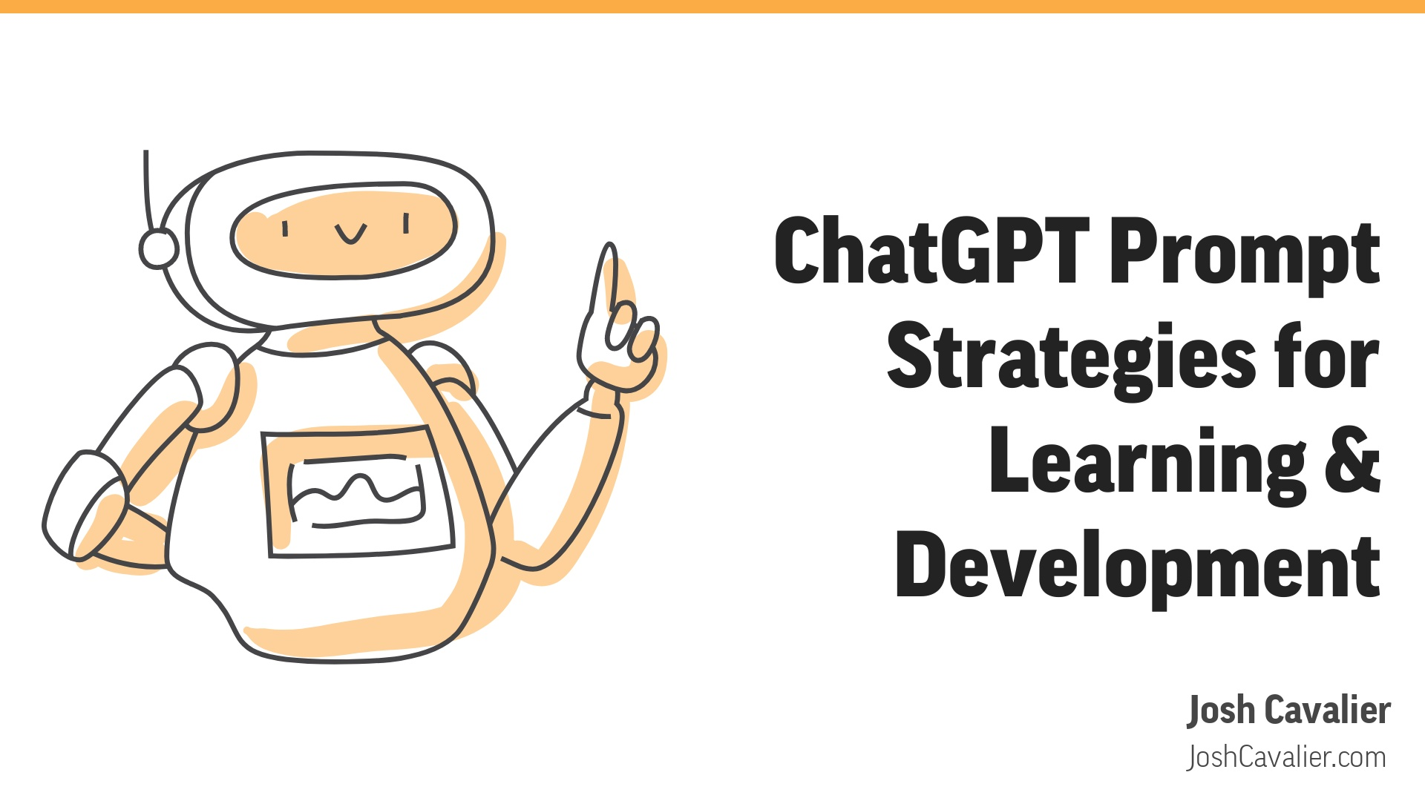

Slide 2

Notes:
Greet students and express enthusiasm for the course!!!!Briefly mention the importance of ChatGPT in Learning & DevelopmentEmphasize the interactive nature of the course and the use of chat for communicationEncourage students to remain engaged and participate actively in chat discussions

Slide 3
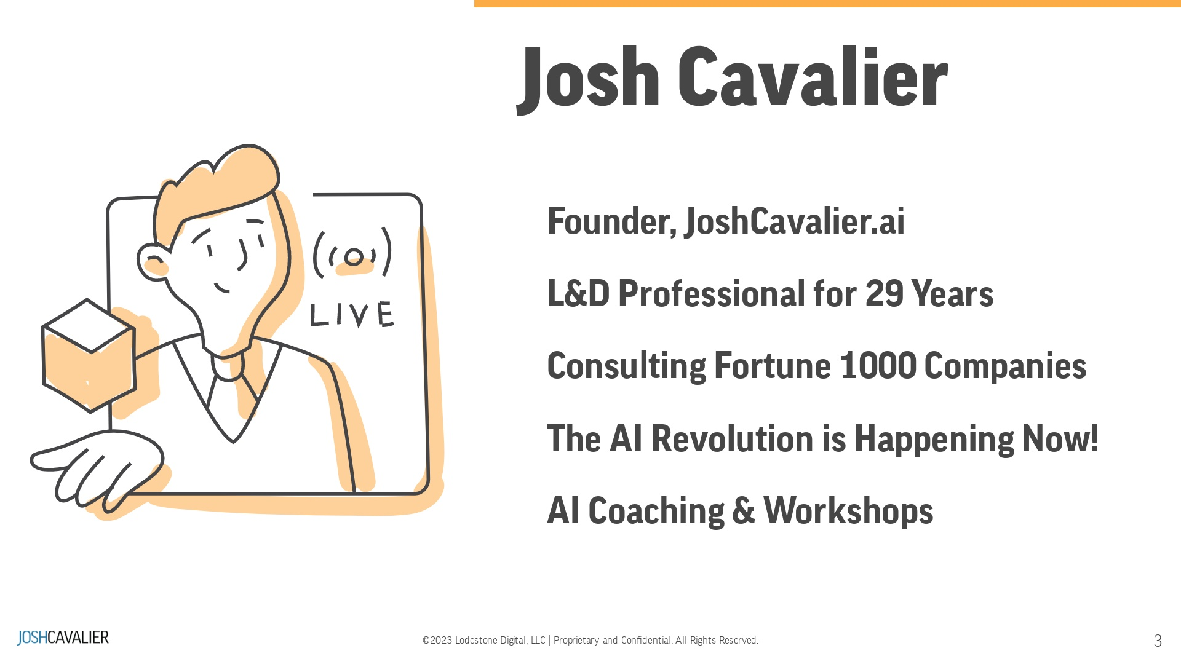
Notes:
Share your name and current roleHighlight your professional background and experience in Learning & DevelopmentMention your expertise in ChatGPT applications and any relevant projects or researchExplain your motivation for teaching the course and your passion for the subject matter

Slide 4
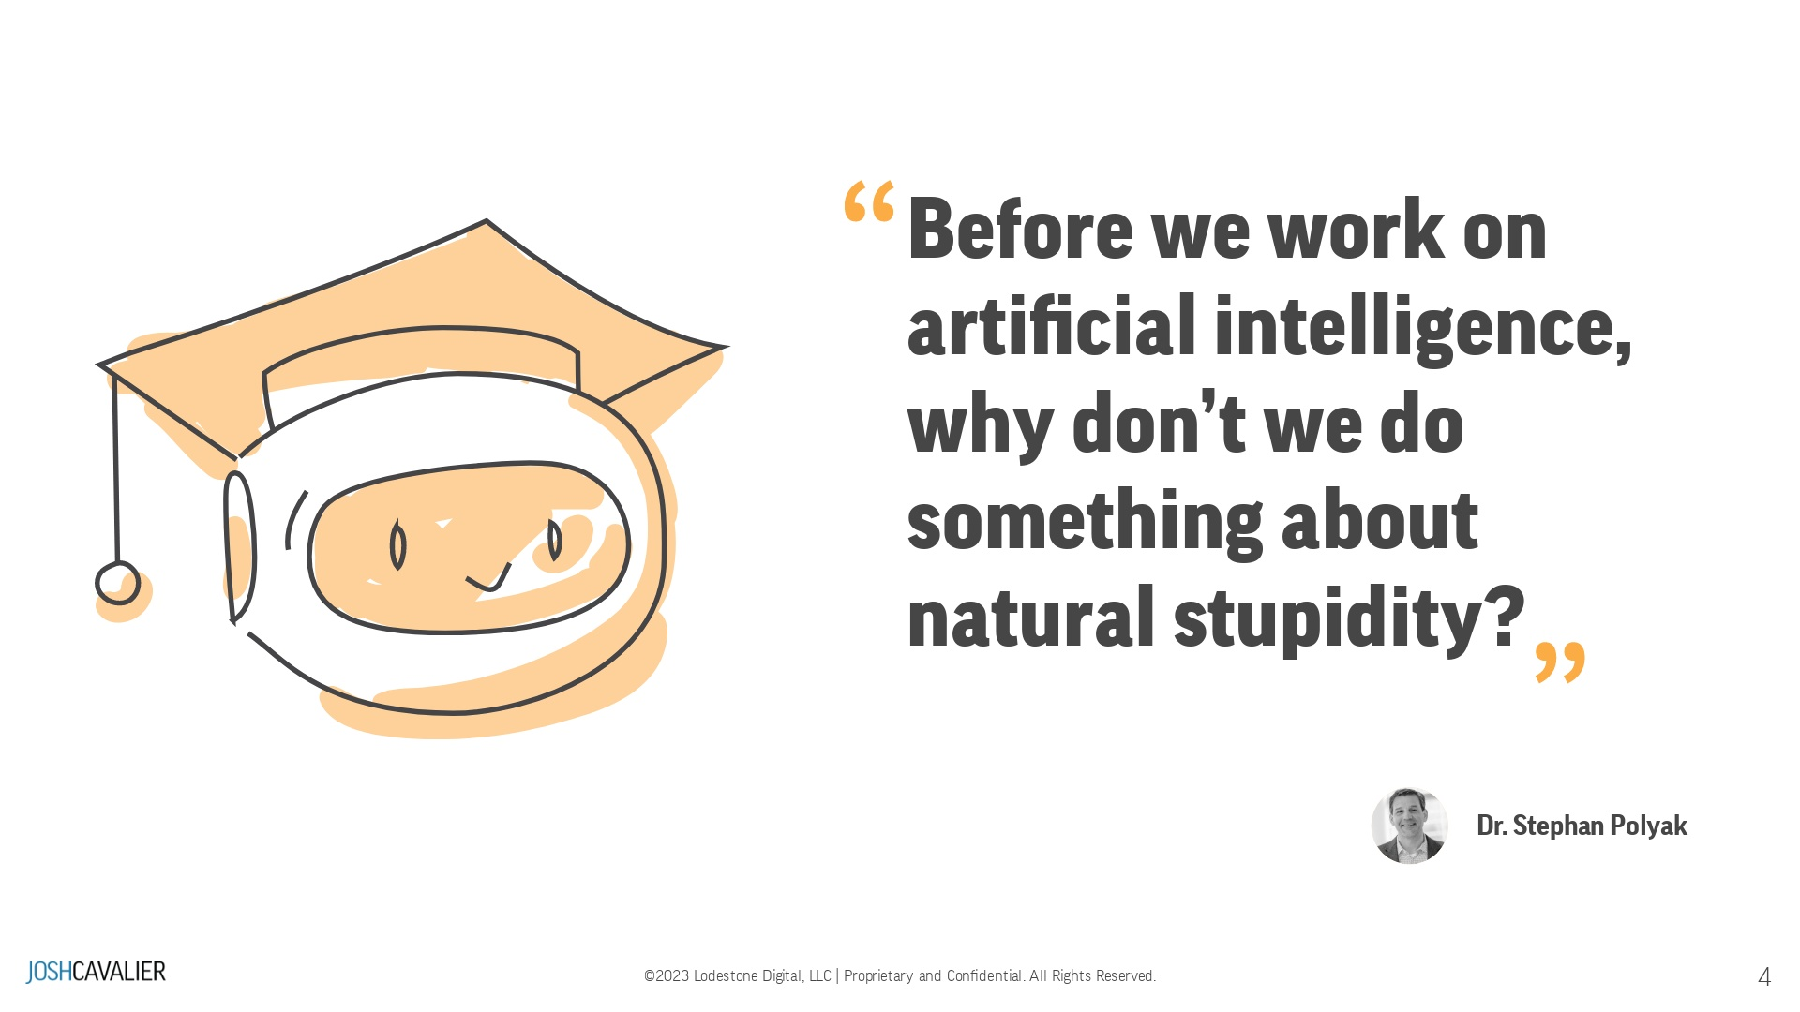
Notes:
Stephen Polyak has a Ph.D. in artificial intelligence from the University of Edinburgh in Scotland, U.K. Areas of Expertise:Artificial intelligenceAgile methodologies for software developersParticipant Reactions (1 minute)Please encourage students to share their reactions, questions, and comments in the chat box.Explain that you will pause the presentation periodically to address their input.Reinforce the importance of active participation in the learning processRemind students that their engagement will contribute to a richer and more enjoyable learning experience for all attendees

Slide 5
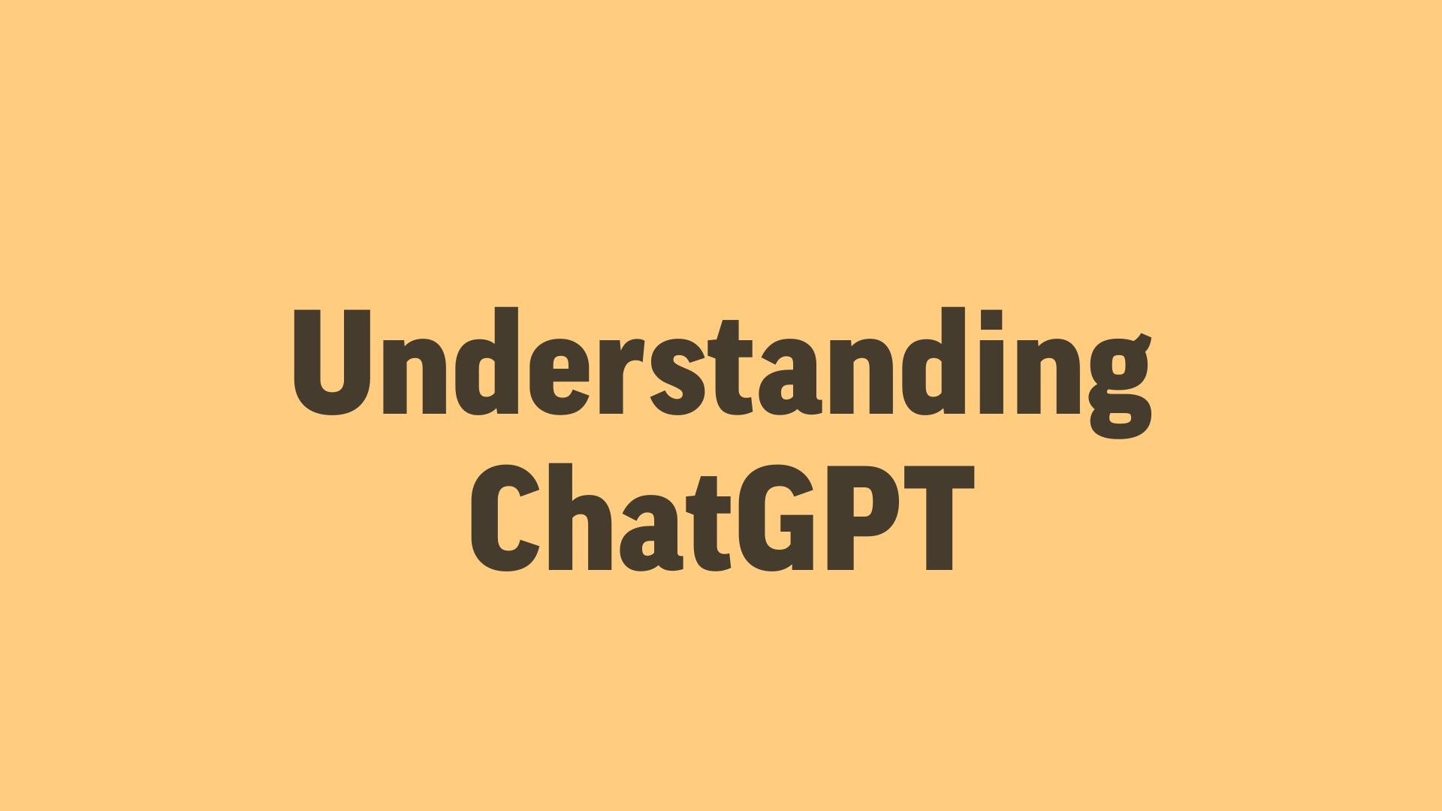

Slide 6
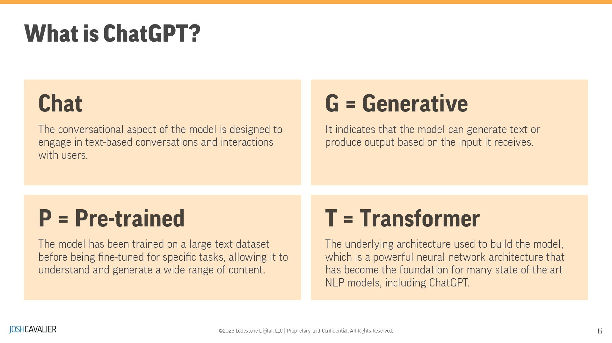
Notes:
Introduce the concept of ChatGPT and its significance in the field of AI

Slide 7
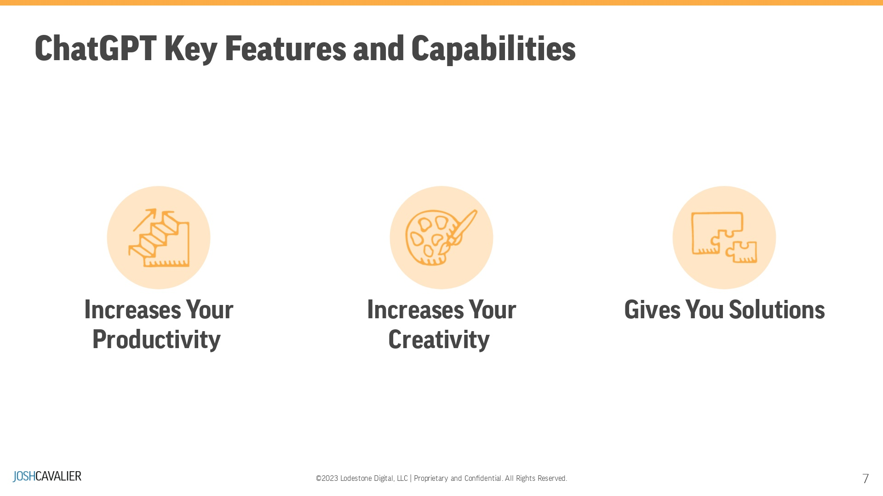
Notes:
Explain the primary features of ChatGPT, such as language understanding, context awareness, and response generation

Slide 8
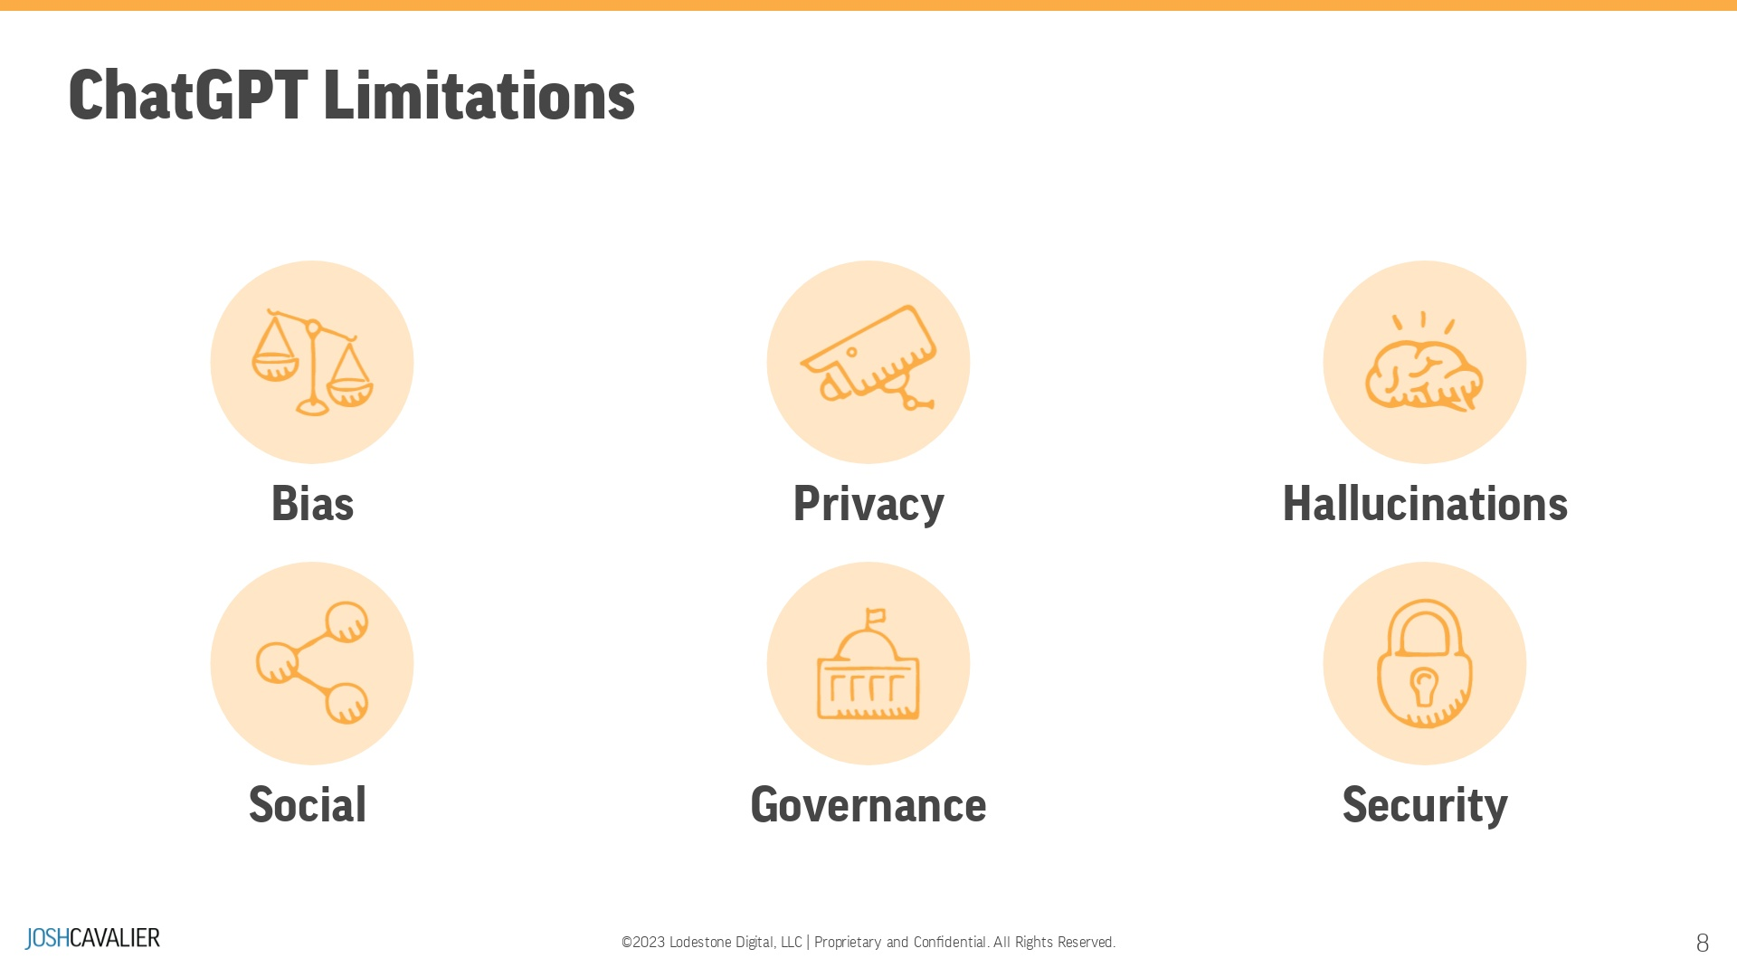
Notes:
Discuss potential applications and limitations of ChatGPTInvite students to submit examples of ChatGPT applications in the chat box

Slide 9
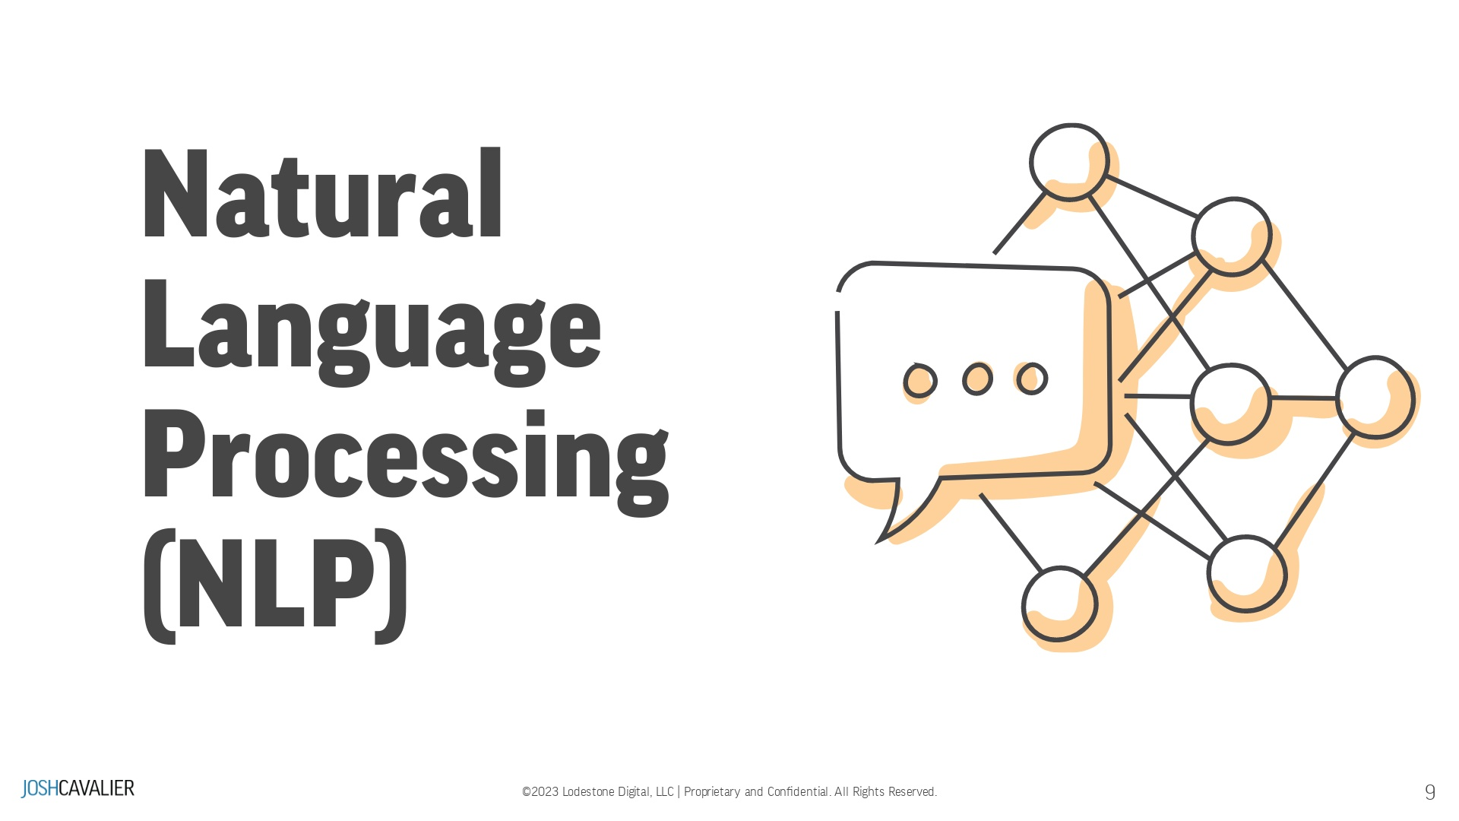

Slide 10
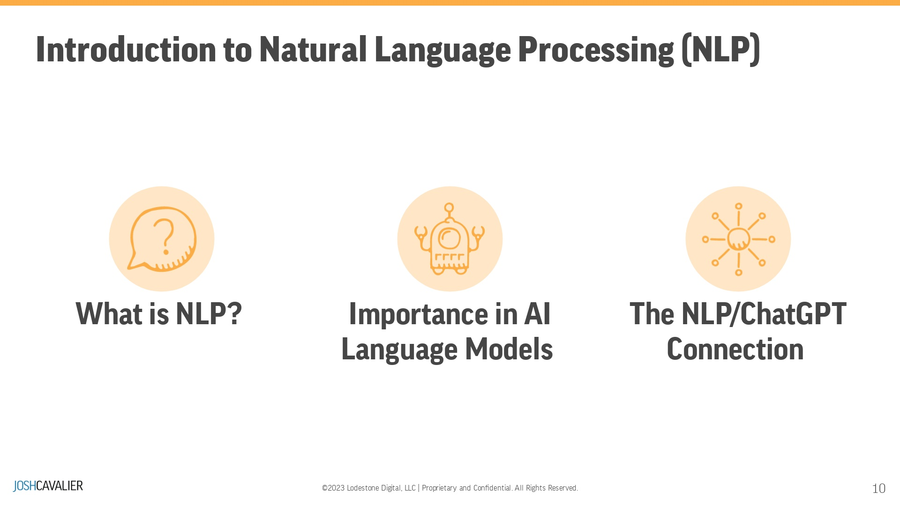
Notes:
For natural language processing (NLP), tasks include conversations (chatbots), speech recognition, translation, and summarization. NLP, or Natural Language Processing, is important because it helps computers understand, interpret, and communicate with humans using our natural language. This makes it easier for us to interact with technology, access information, and automate tasks, ultimately improving our daily lives and making technology more accessible and user-friendly.ChatGPT is an AI language model that utilizes NLP techniques to understand and generate human-like text. The connection between NLP and ChatGPT is that ChatGPT is an application of NLP designed to process natural language data, enabling it to have meaningful conversations, answer questions, and generate text based on the user's input. By leveraging advanced NLP techniques, ChatGPT can provide helpful information, assistance, and engaging user interaction.Chat box: What applications have you used that applies NLP?

Slide 11
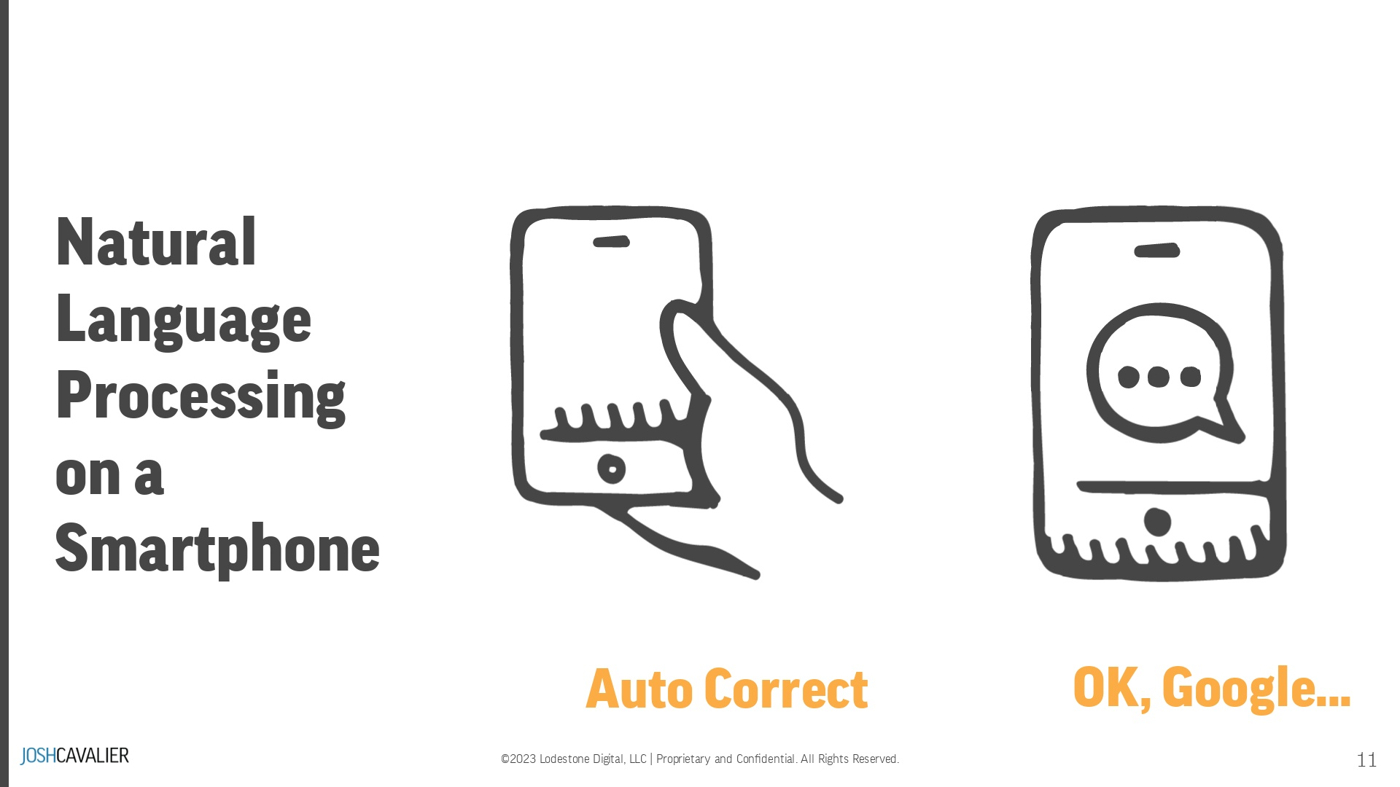
Notes:
We use Natural Language Processing (NLP) each day:When you create a text message, the auto-correct feature uses Natural Language processing and probability to determine the suggested words. Suppose you speak to your mobile device using Google or Siri. In that case, your audio is converted into text through natural language processing processed, using a search query, and then a result is returned. User: "I'm going to pick up my niece from daycare."
Autocorrect: "I'm going to pick up my nachos from daycare."

Slide 12
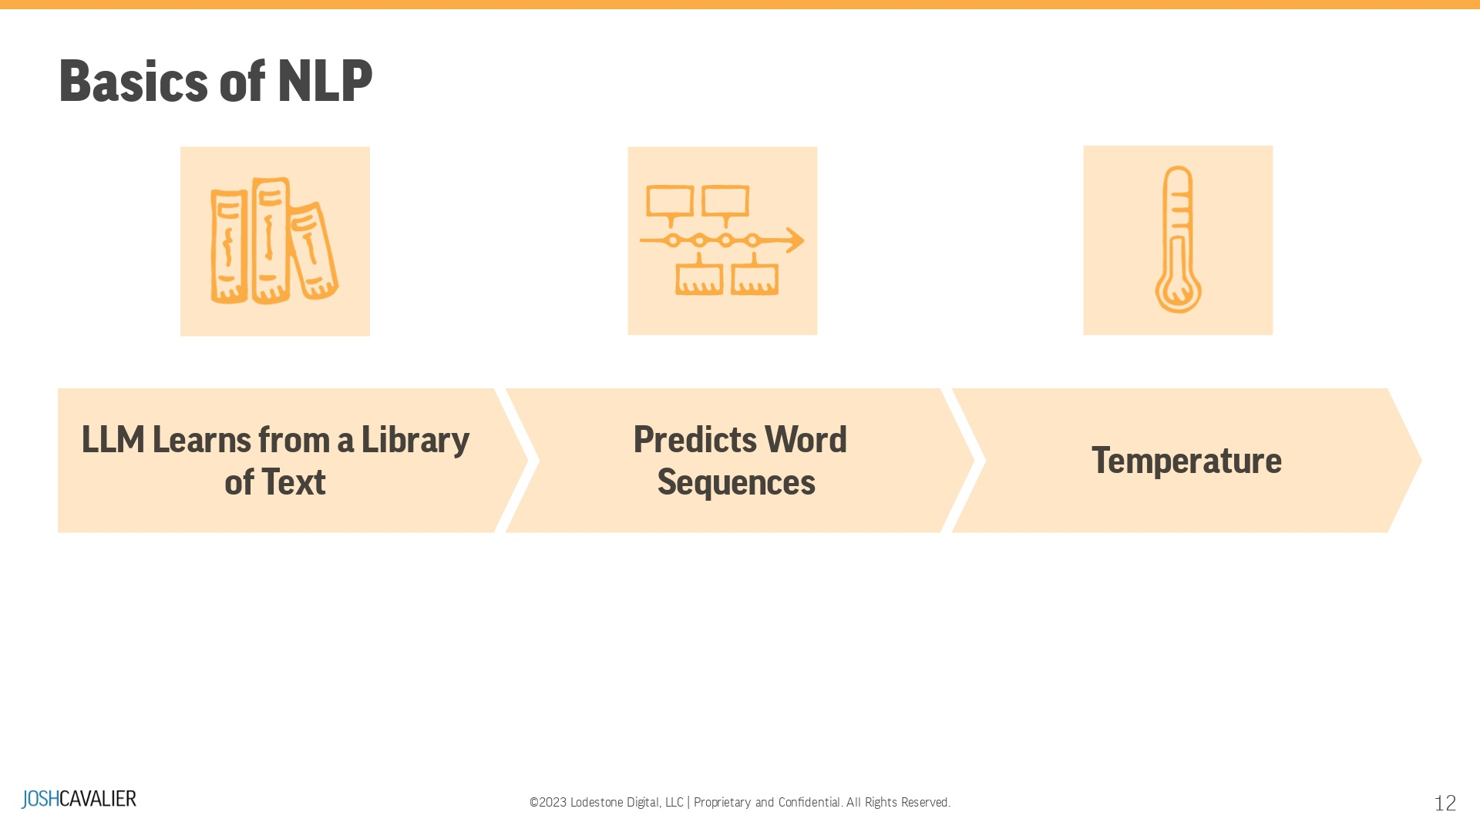
Notes:
Large Language Models (LLM) learn a library of text (called corpus) - The more parameters, the more extensive the libraryLLM predicts words or sequences of words with probability - or how likely a word or sequence can occur The best word choice selected with probability is not always the best choice. Temperature adds randomness to the word selection so there is less repetition.

Slide 13
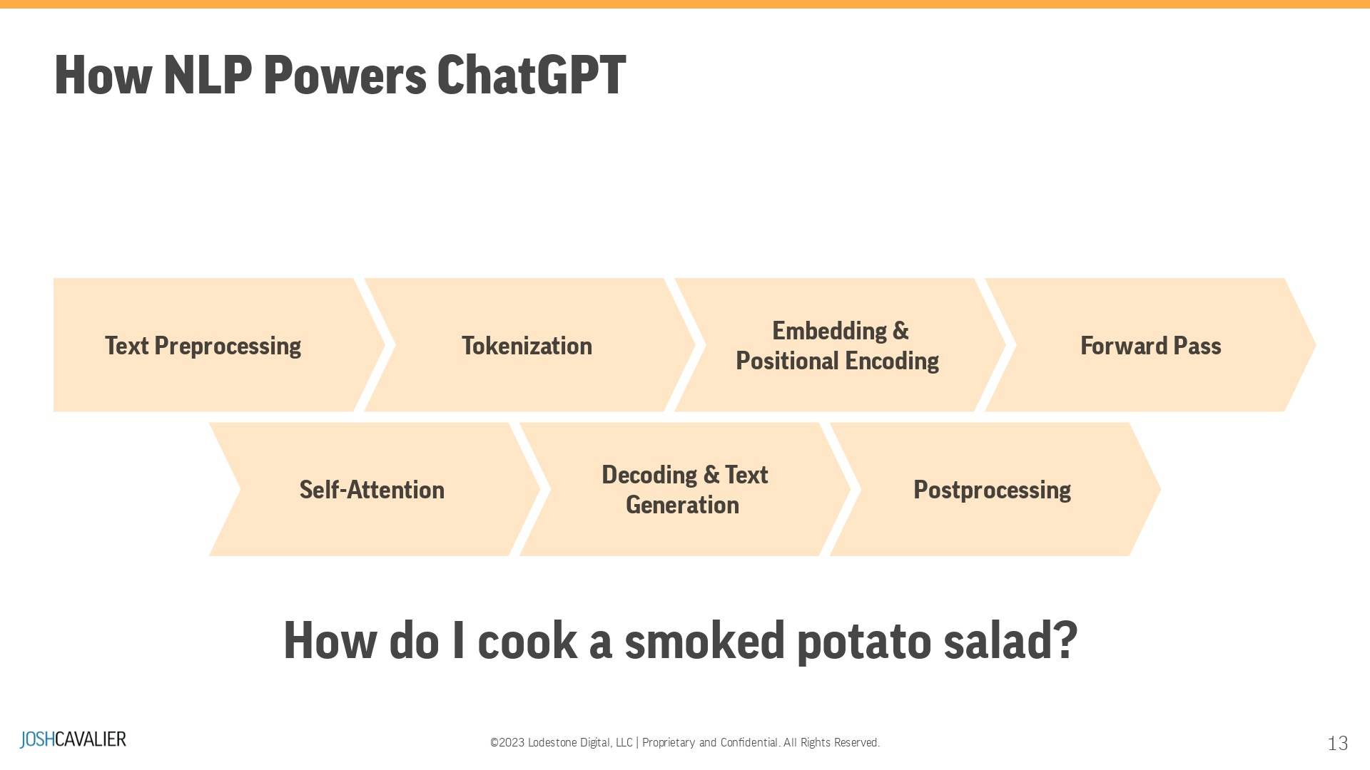
Notes:
Text PreprocessingTokenizationPositional EncodingForward Pass through GPTSelf-Attention MechanismDecoding and Text GenerationPostprocessingLet's use my favorite control question: "How do I cook a smoked potato salad?"

Slide 14
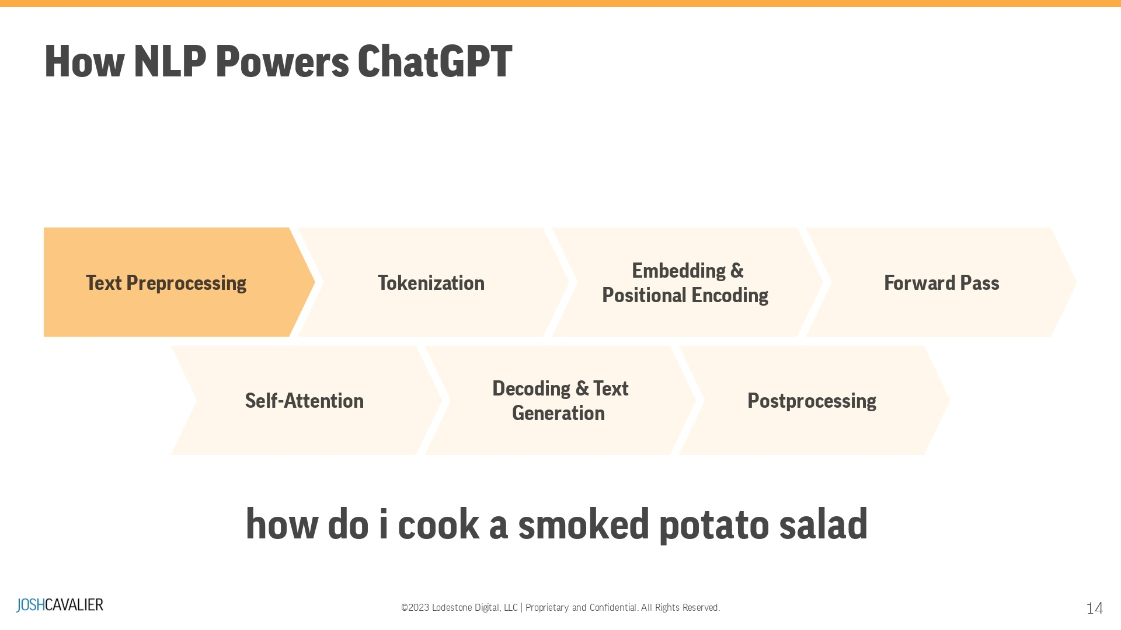
Notes:
Text Preprocessing: The input sentence, "How do I cook a smoked potato salad?", is preprocessed, which may include converting text to lowercase, removing special characters, and handling contractions. For GPT, most of the preprocessing steps are minimal, as the model is designed to handle diverse and noisy text.

Slide 15
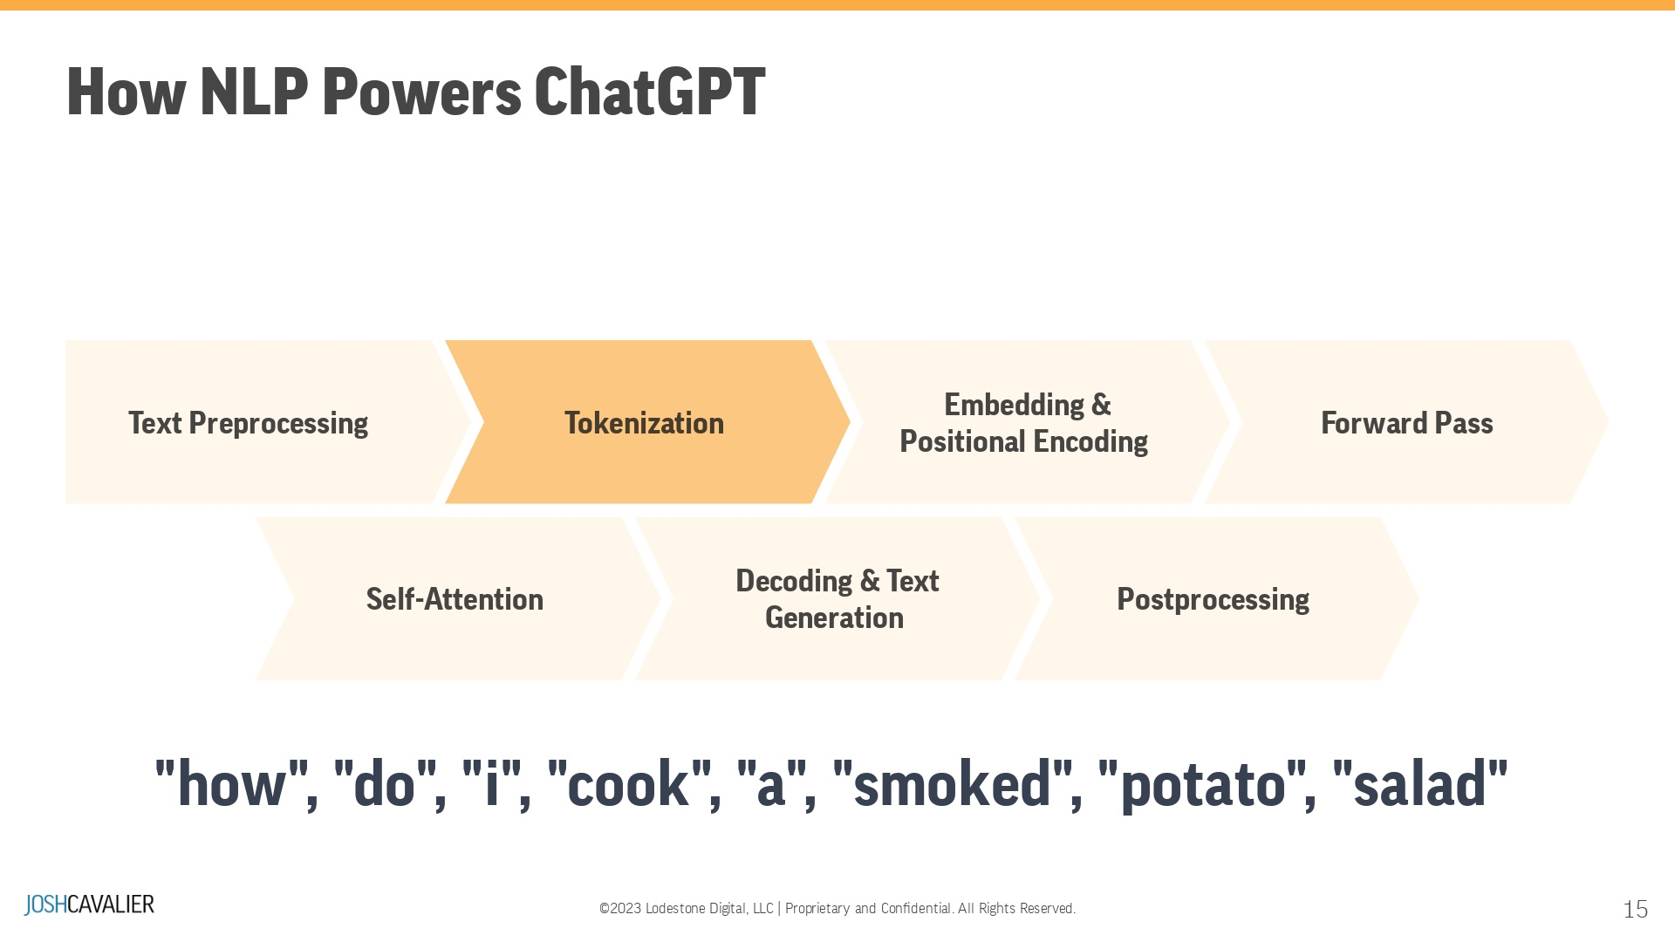
Notes:
Tokenization: The preprocessed text is tokenized into individual units called tokens. GPT uses Byte Pair Encoding (BPE), a subword tokenization technique that splits the text into smaller units based on the most frequent character sequences. The tokenized sequence might look like: ["how", " do", " i", " cook", " a", " smoked", " potato", " salad"] --- Remove punctuation.

Slide 16
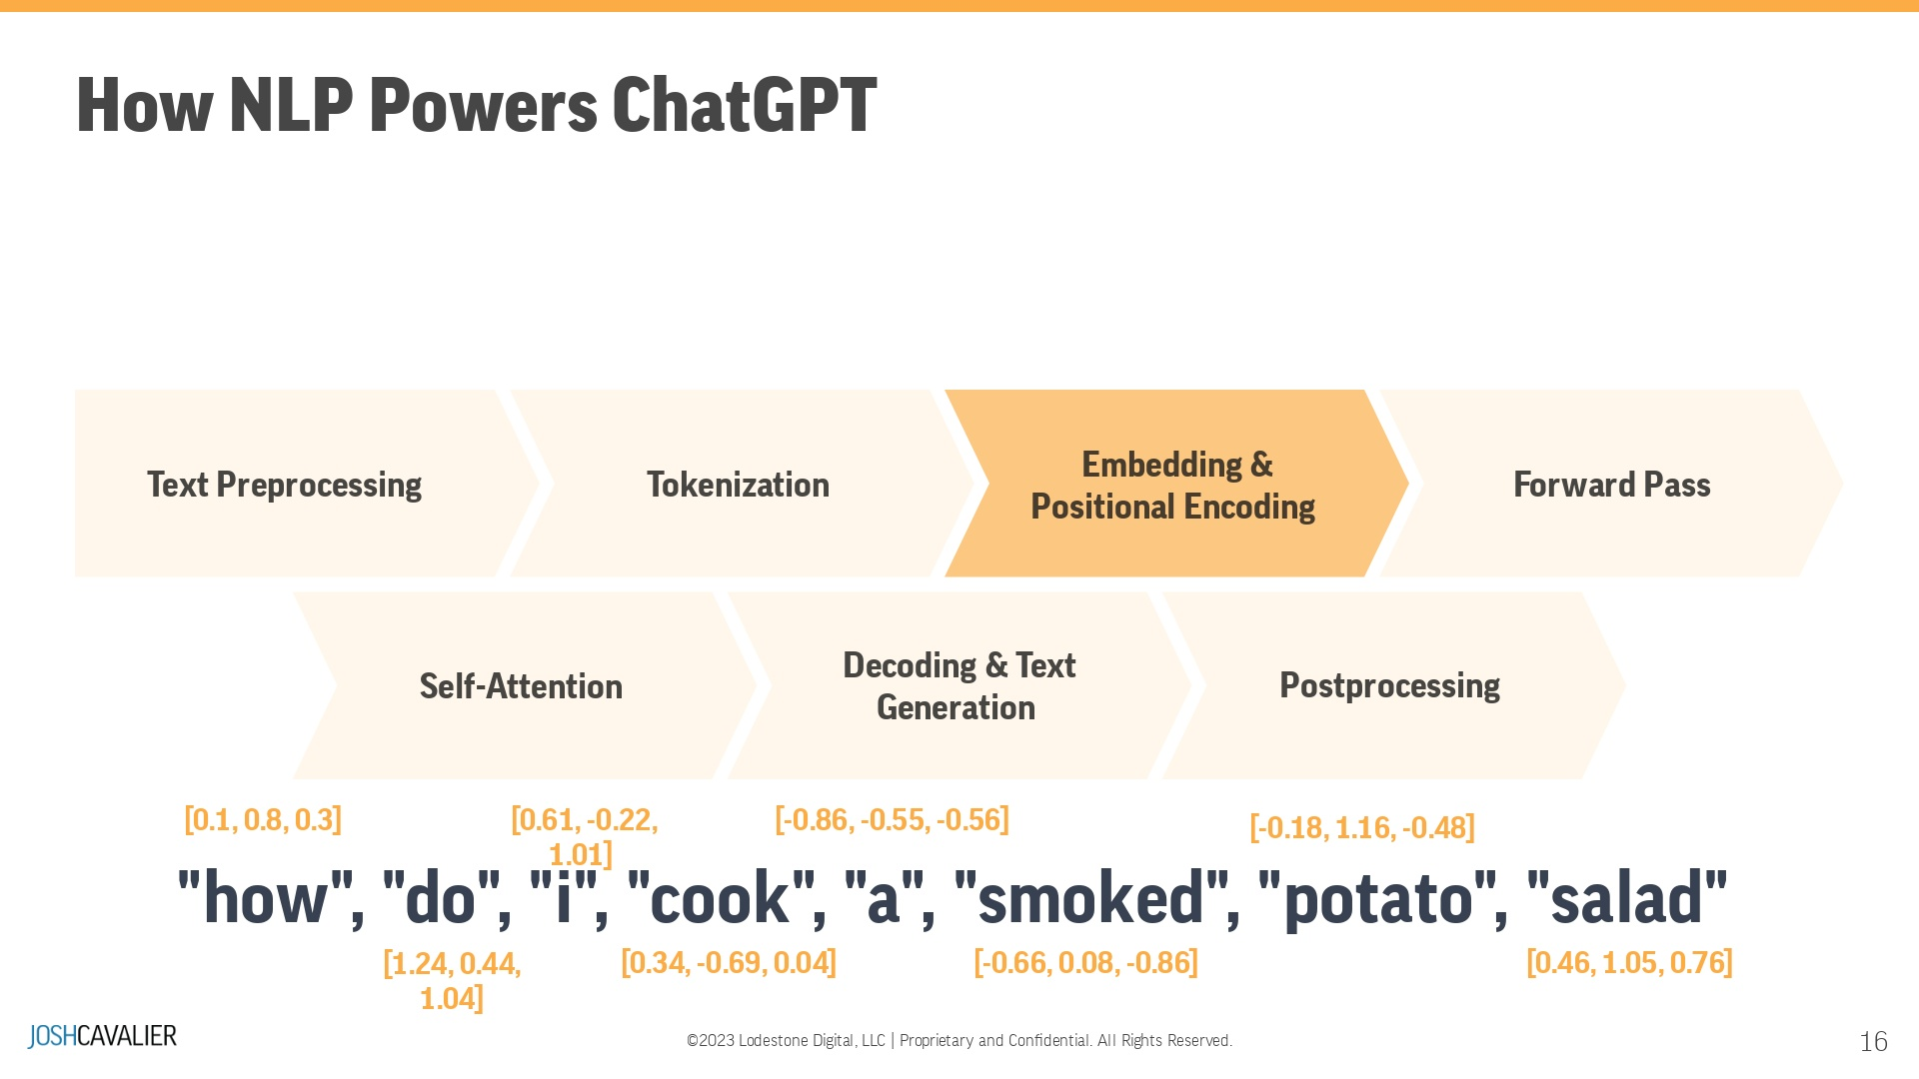
Notes:
Embedding: Each token is mapped to a number. The numbers are semantic representations. Positional Encoding: GPT adds positional encoding to the input tokens to capture the order of the words in the sentence. This information helps the model understand the sequence of words and their relationships.

Slide 17
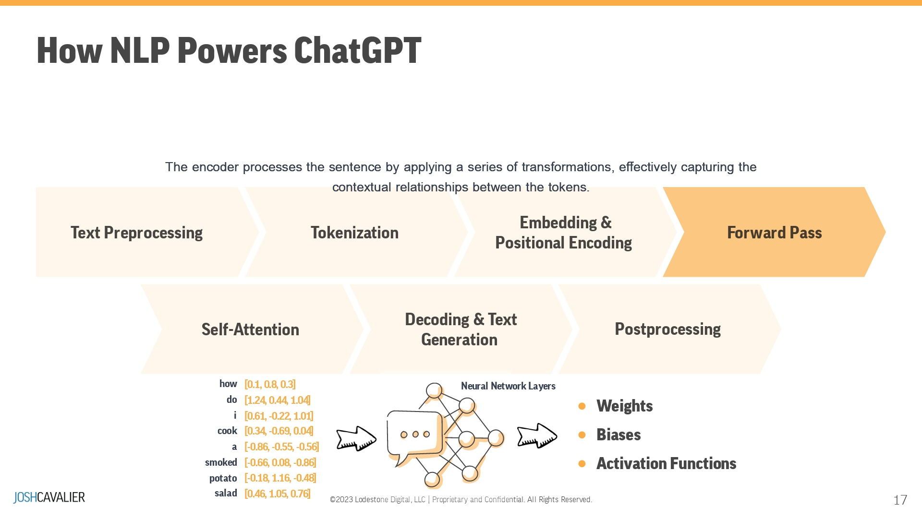
Notes:
Forward Pass through GPT: The tokenized and positionally encoded input is fed through the layers of the GPT model. Each layer consists of multi-head self-attention mechanisms and feedforward neural networks that process and refine the input representation. Pass the input data through each layer of the neural network. The encoder processes the sentence by applying transformations, effectively capturing the contextual relationships between the tokens.The data is typically multiplied by weights, added to biases, and transformed using an activation function in each layer. The output of each layer becomes the input for the next layer.

Slide 18
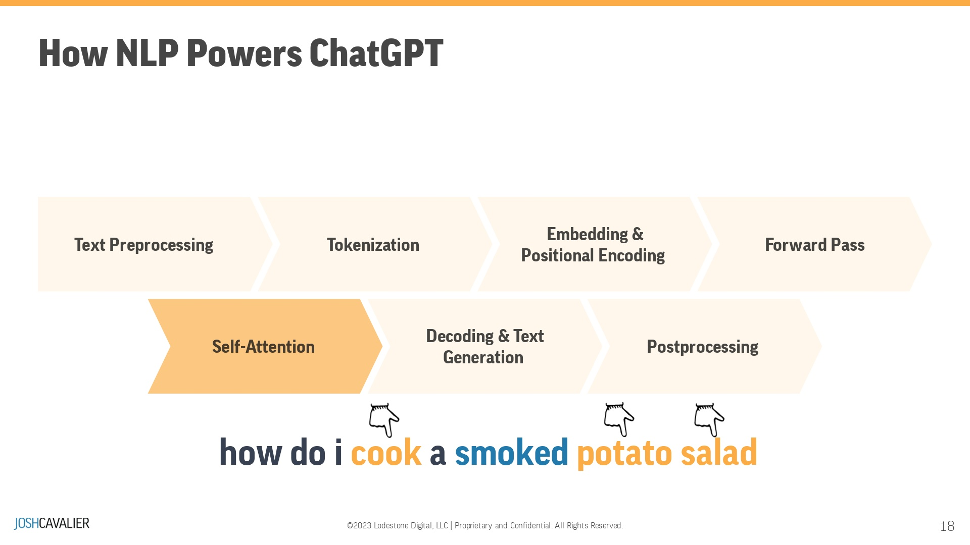
Notes:
Self-Attention Mechanism: The self-attention mechanism within each layer computes a weighted representation of the input tokens, considering the relationships between words in the sentence. This allows GPT to capture long-range dependencies and complex patterns in the text.The Transformer model uses multi-head self-attention to compute attention scores for each token in the sequence based on its relationship with all other tokens. The self-attention mechanism computes three sets of vectors from the input: Query (Q), Key (K), and Value (V). The attention scores are obtained by calculating the dot product between Q and K, followed by a softmax operation.

Slide 19
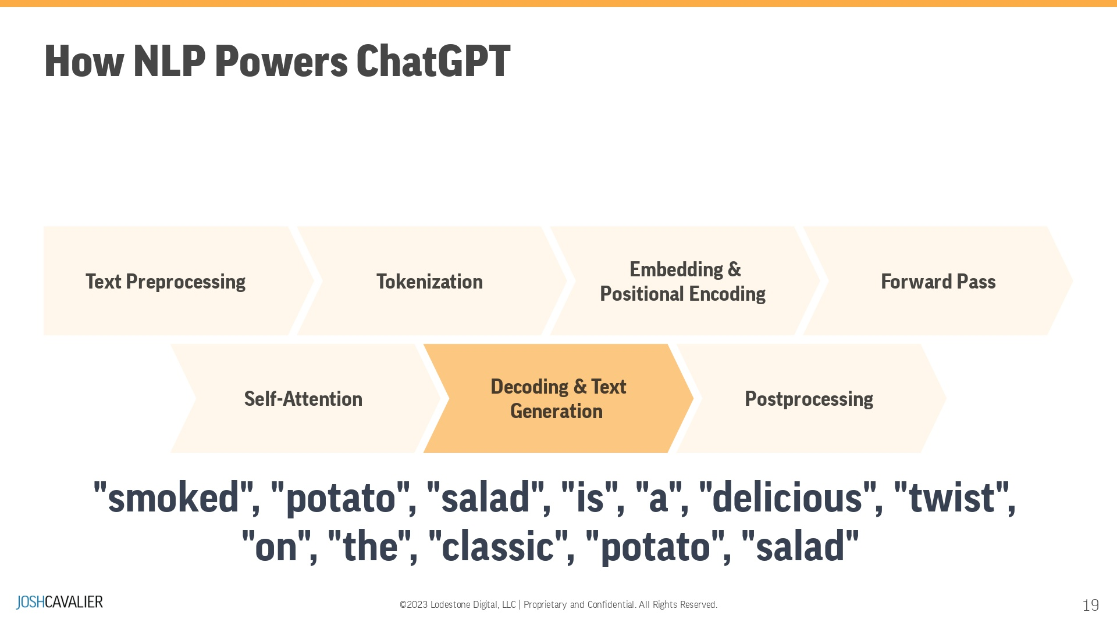
Notes:
Decoding and Text Generation: In the case of text generation, GPT-3 generates an output sequence token by token, conditioned on the input sequence and the context learned during pretraining. The model selects the most likely next token based on the probabilities generated by the final layer. This process is repeated until the desired output length or an end-of-sequence token is reached.The final layer of the network produces the output or prediction. Depending on the task, this output can be a probability distribution (e.g., for classification), a single value (e.g., for regression), or a sequence of values (e.g., for sequence-to-sequence tasks).

Slide 20
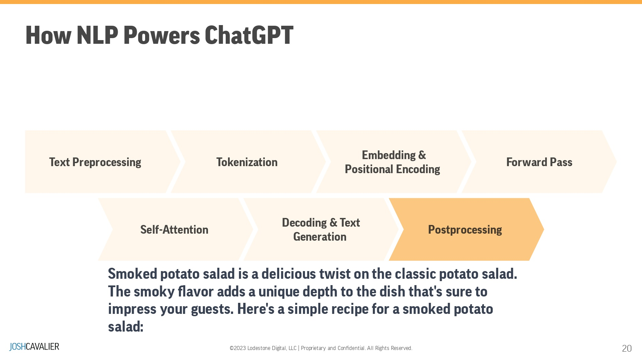
Notes:
Postprocessing: The generated output tokens are combined and transformed into human-readable text. Any special tokens or formatting may be handled during this step, resulting in the final generated text.

Slide 21
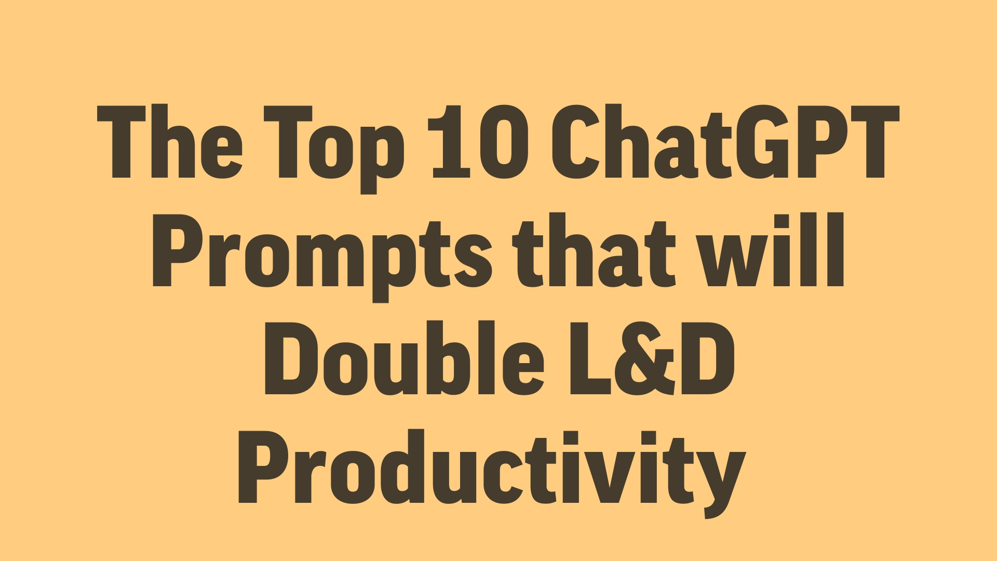

Slide 22
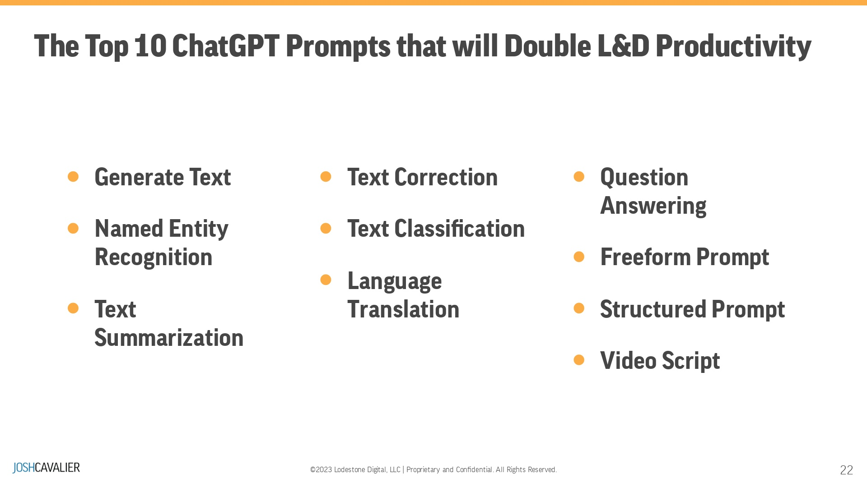
Notes:
The Seven Things You Can Do with ChatGPT: It's more than generating text! You can do some fantastic things with Open AI's NLM. In this section, we are going to explore what ChatGPT can do. AAt this point, do NOT be concerned with the phrasing or structure of the prompts. This is an exploration of the possibilities so you can build the foundation for future applications for ChatGPT. So let's have fun and explore.

Slide 23
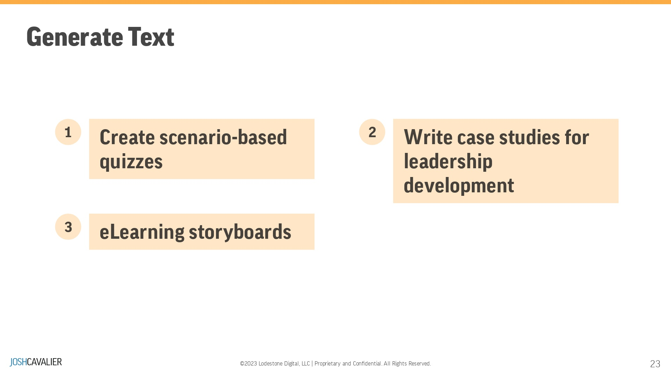
Notes:
Generate Text: ChatGPT can generate human-like text by predicting the most likely sequence of words, given a specific context. In Learning and Development (L&D), this can be used to create personalized learning content, draft quiz questions, or even simulate realistic conversations for training purposes.

Slide 24
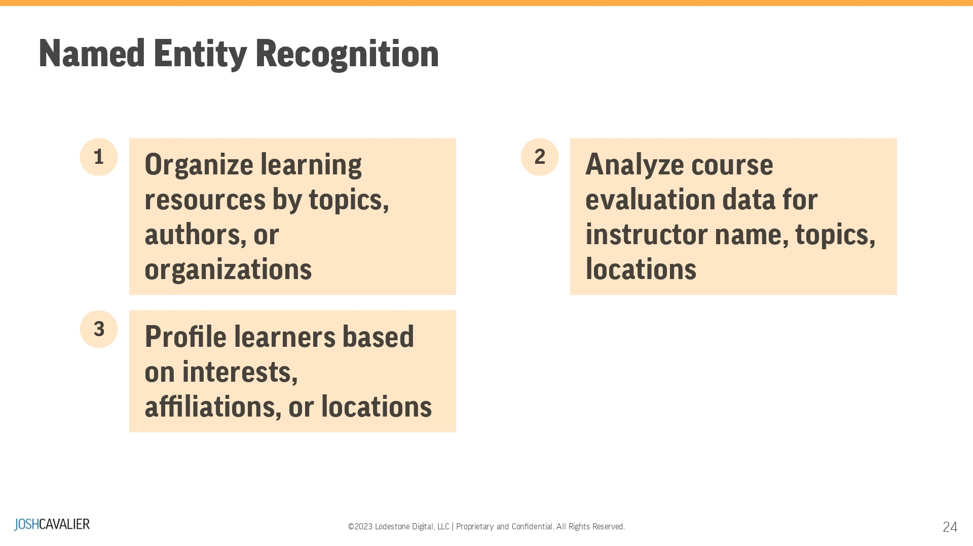
Notes:
Named Entity Recognition (NER): NER involves identifying and categorizing entities in a text, such as names, organizations, dates, etc. In L&D, this can extract critical information from documents, enabling the creation of targeted learning materials or identifying potential case studies from real-world examples.

Slide 25
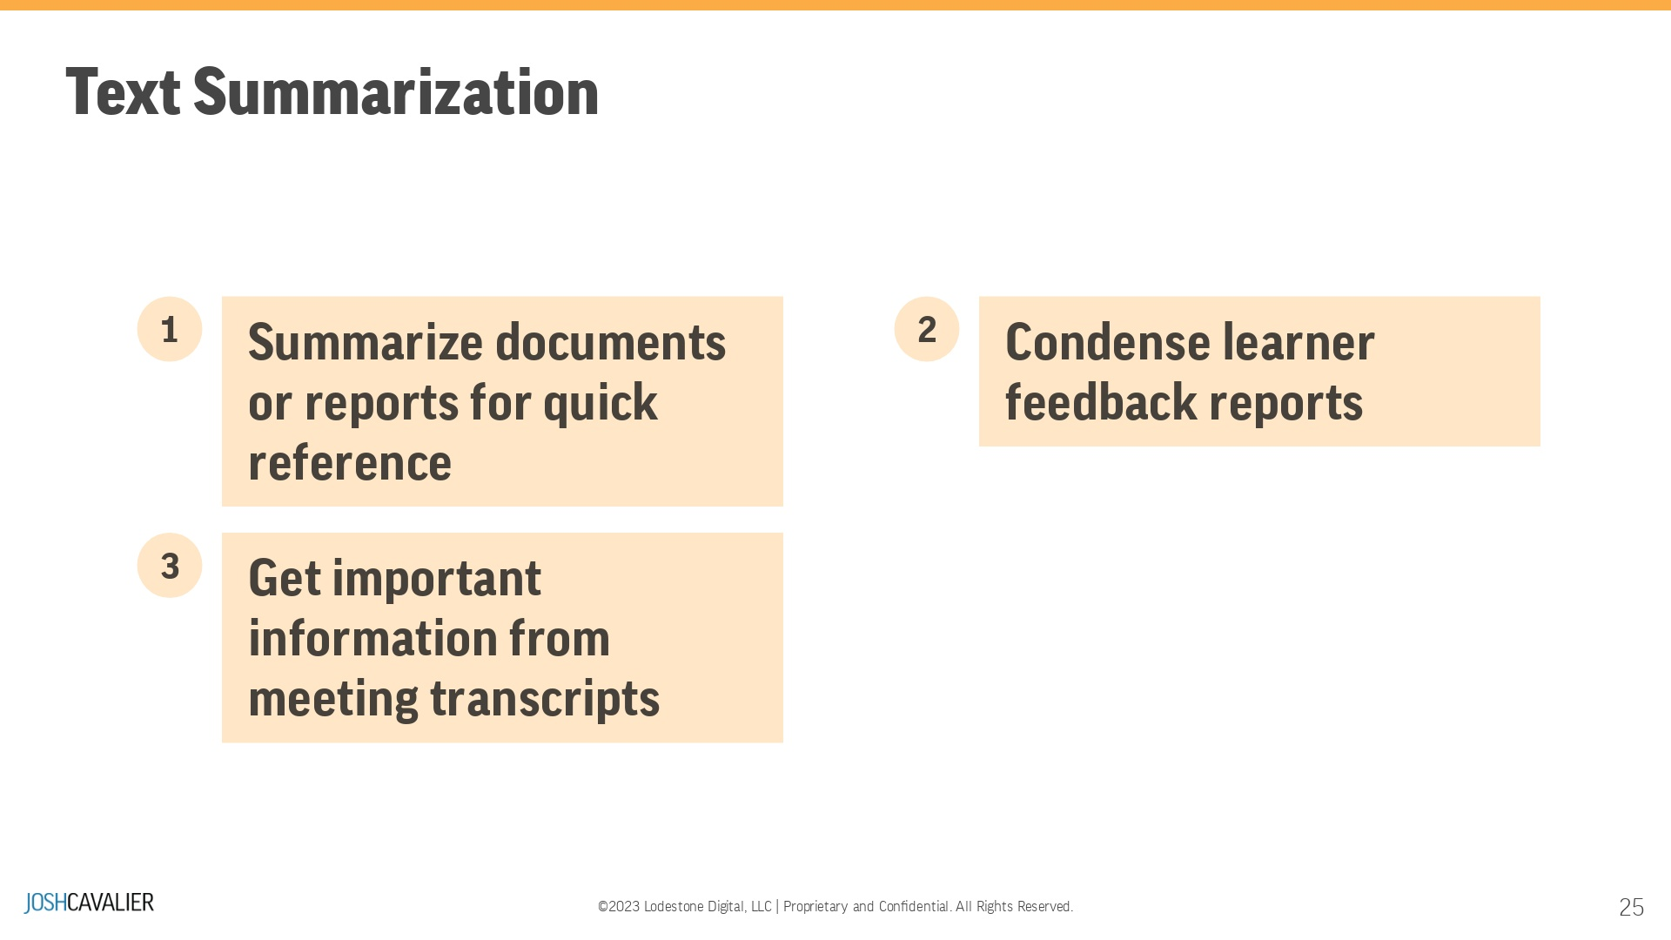
Notes:
Text Summarization: This function condenses large amounts of text into a shorter, coherent summary while retaining the key information. In L&D, this can help learners quickly grasp essential concepts from long articles or reports, saving time and improving knowledge retention.

Slide 26
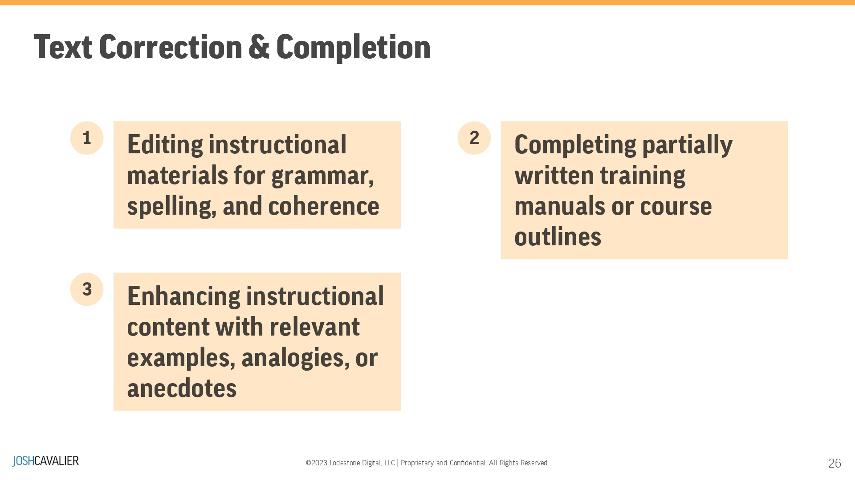
Notes:
Text Correction: LLMs can detect and correct grammatical, punctuation, or spelling errors in a text. In L&D, this can be used to improve the quality of learning materials, ensuring that content is accurate and professionally written, or to provide instant feedback on learners' written work.

Slide 27
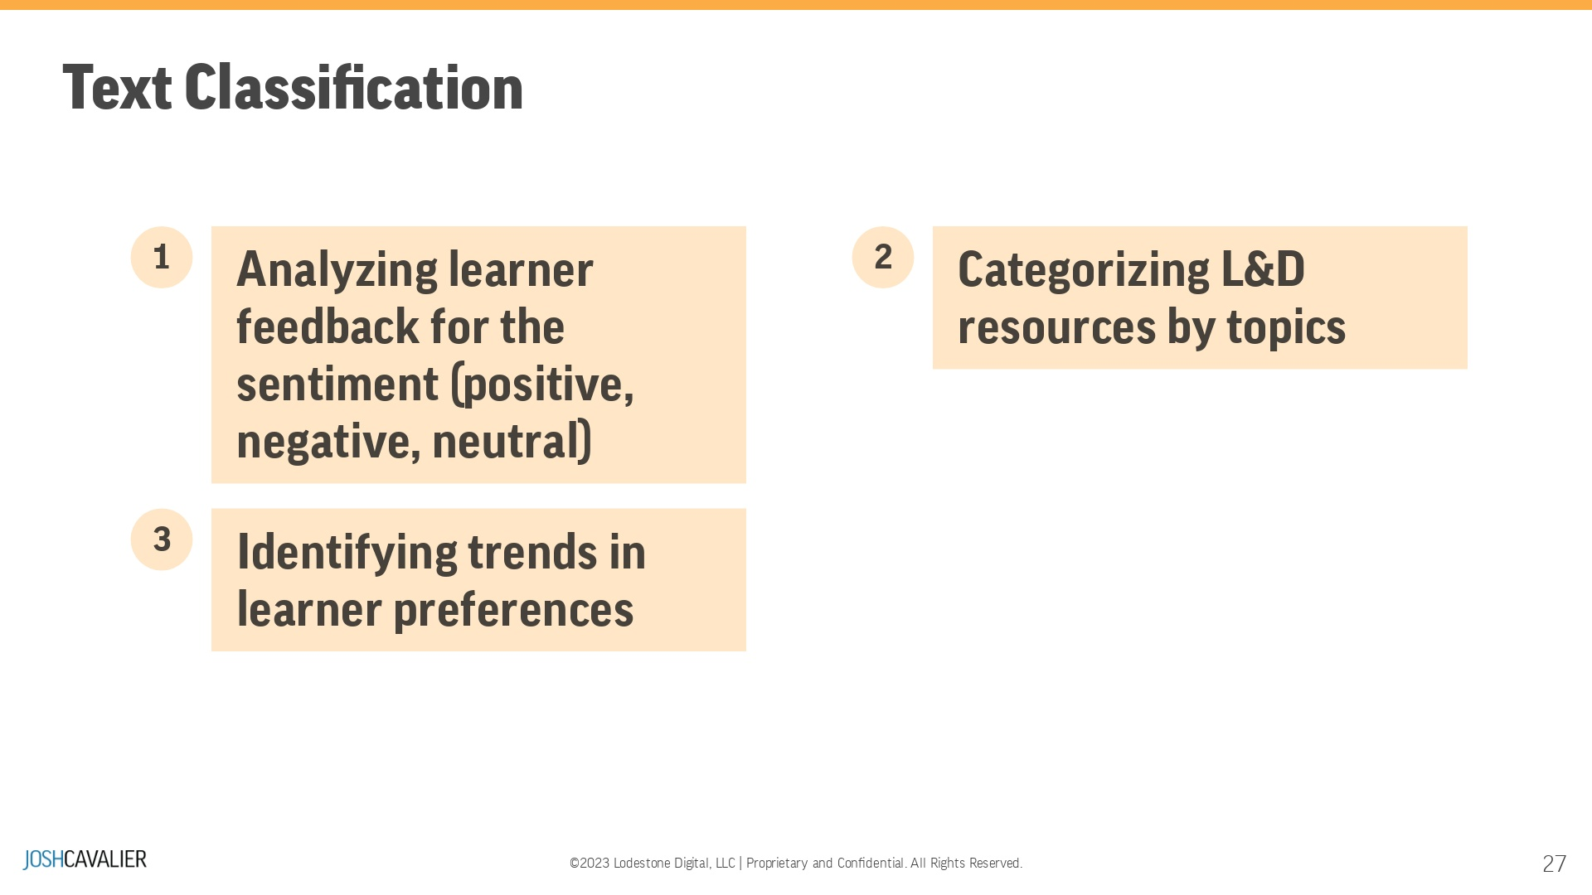
Notes:
Text Classification: This involves categorizing text into predefined groups based on specific criteria. In L&D, this can help identify appropriate resources for a particular topic, create custom learning paths, or automatically evaluate learners' understanding by analyzing their written responses.

Slide 28
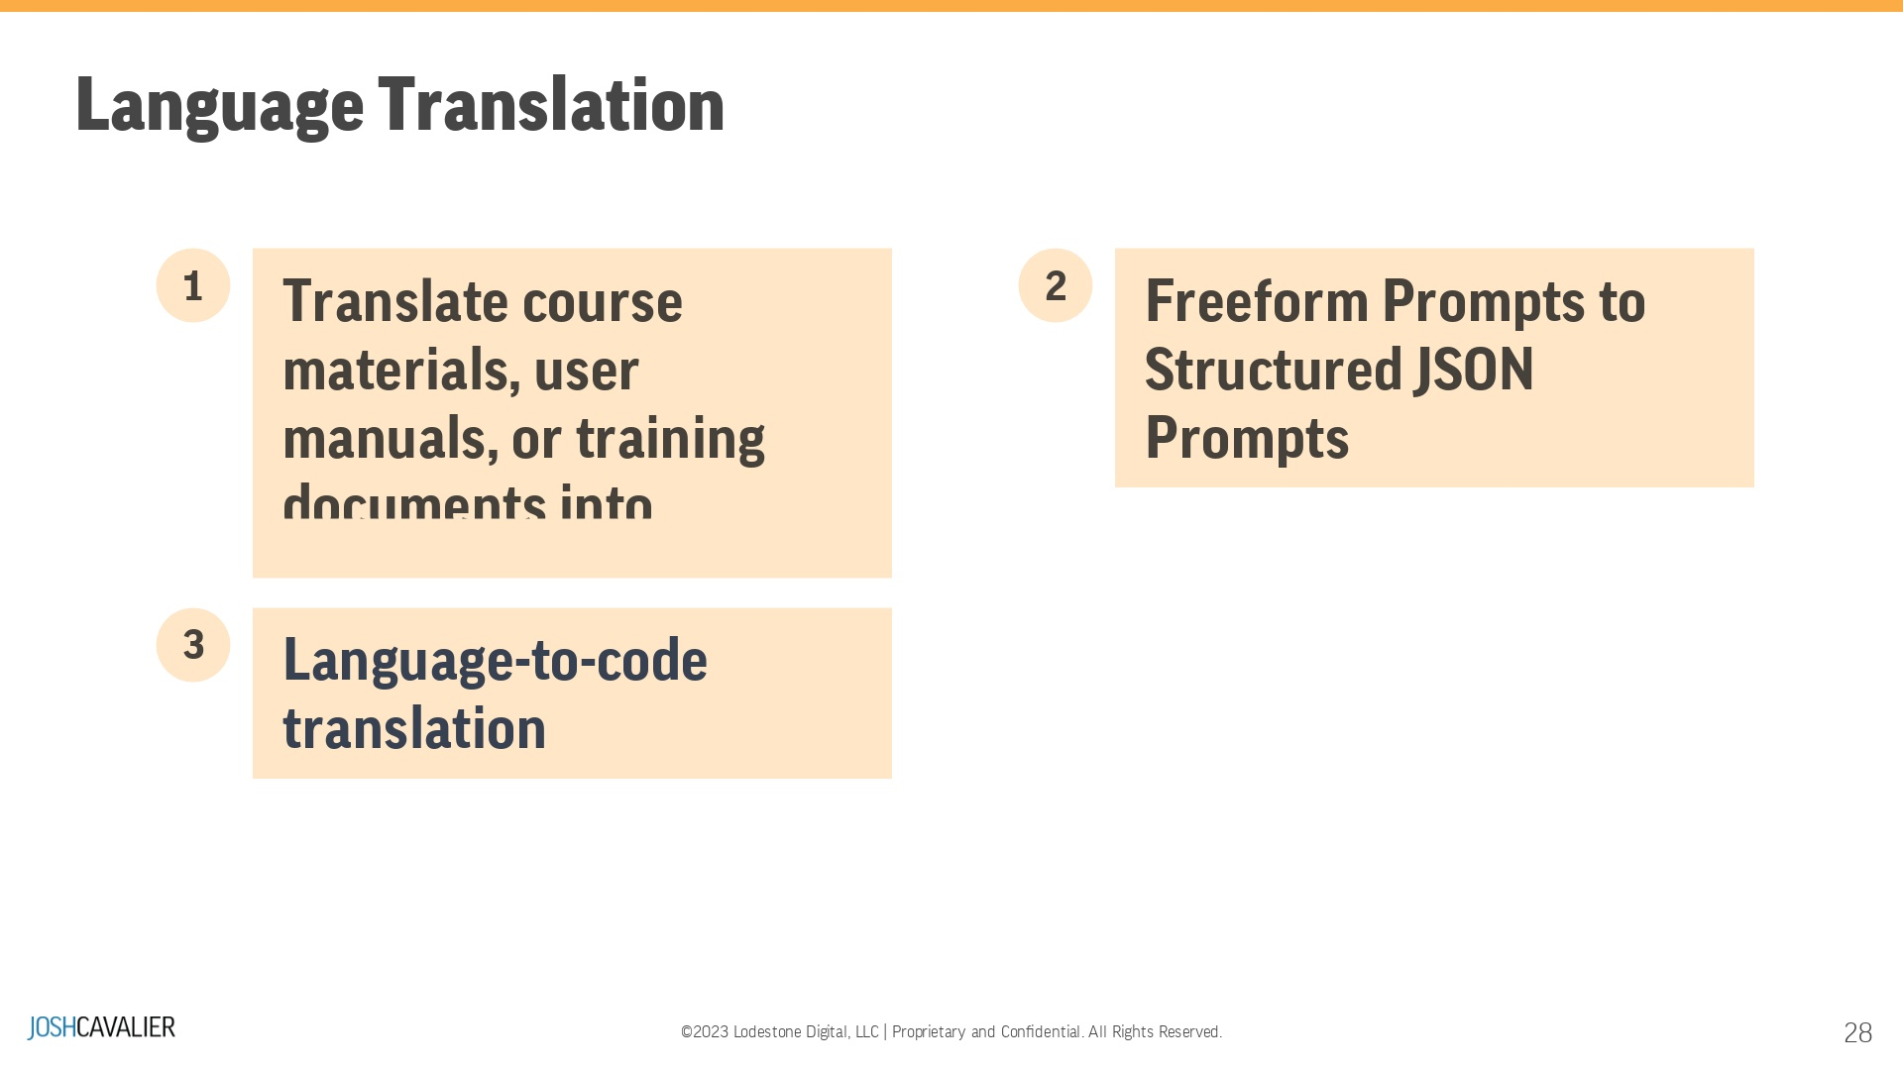
Notes:
Language Translation: ChatGPT can translate text from one language to another, enabling effective communication across languages. In L&D, this can help create multilingual learning materials, facilitate collaboration among global teams, or support learners whose first language is not the primary language of instruction.

Slide 29
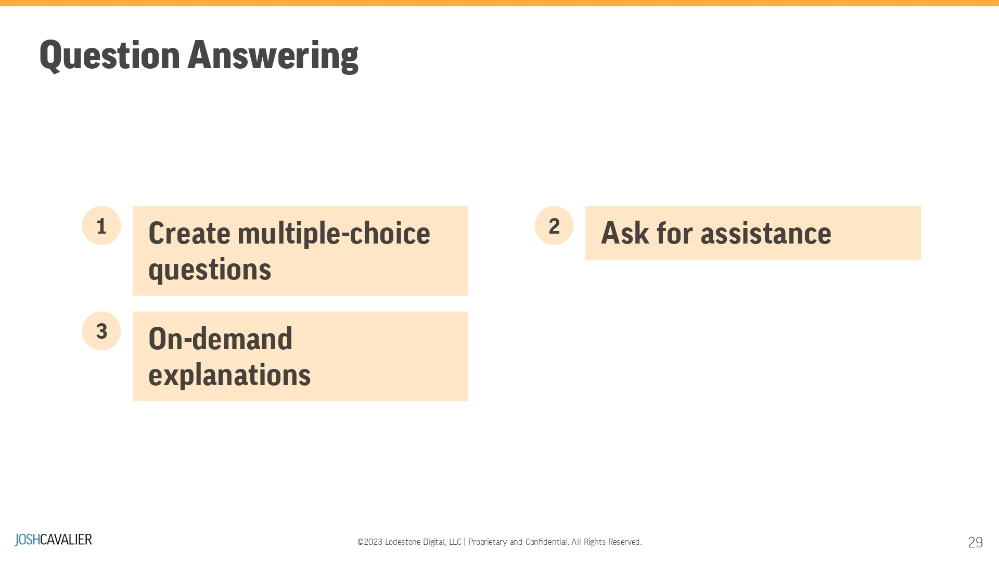
Notes:
Question Answering: ChatGPT can answer questions based on a given context or body of knowledge. In L&D, this can create interactive learning experiences, such as quizzes or assessments, provide on-demand support for learners, or enhance virtual assistants to guide users through complex topics.

Slide 30
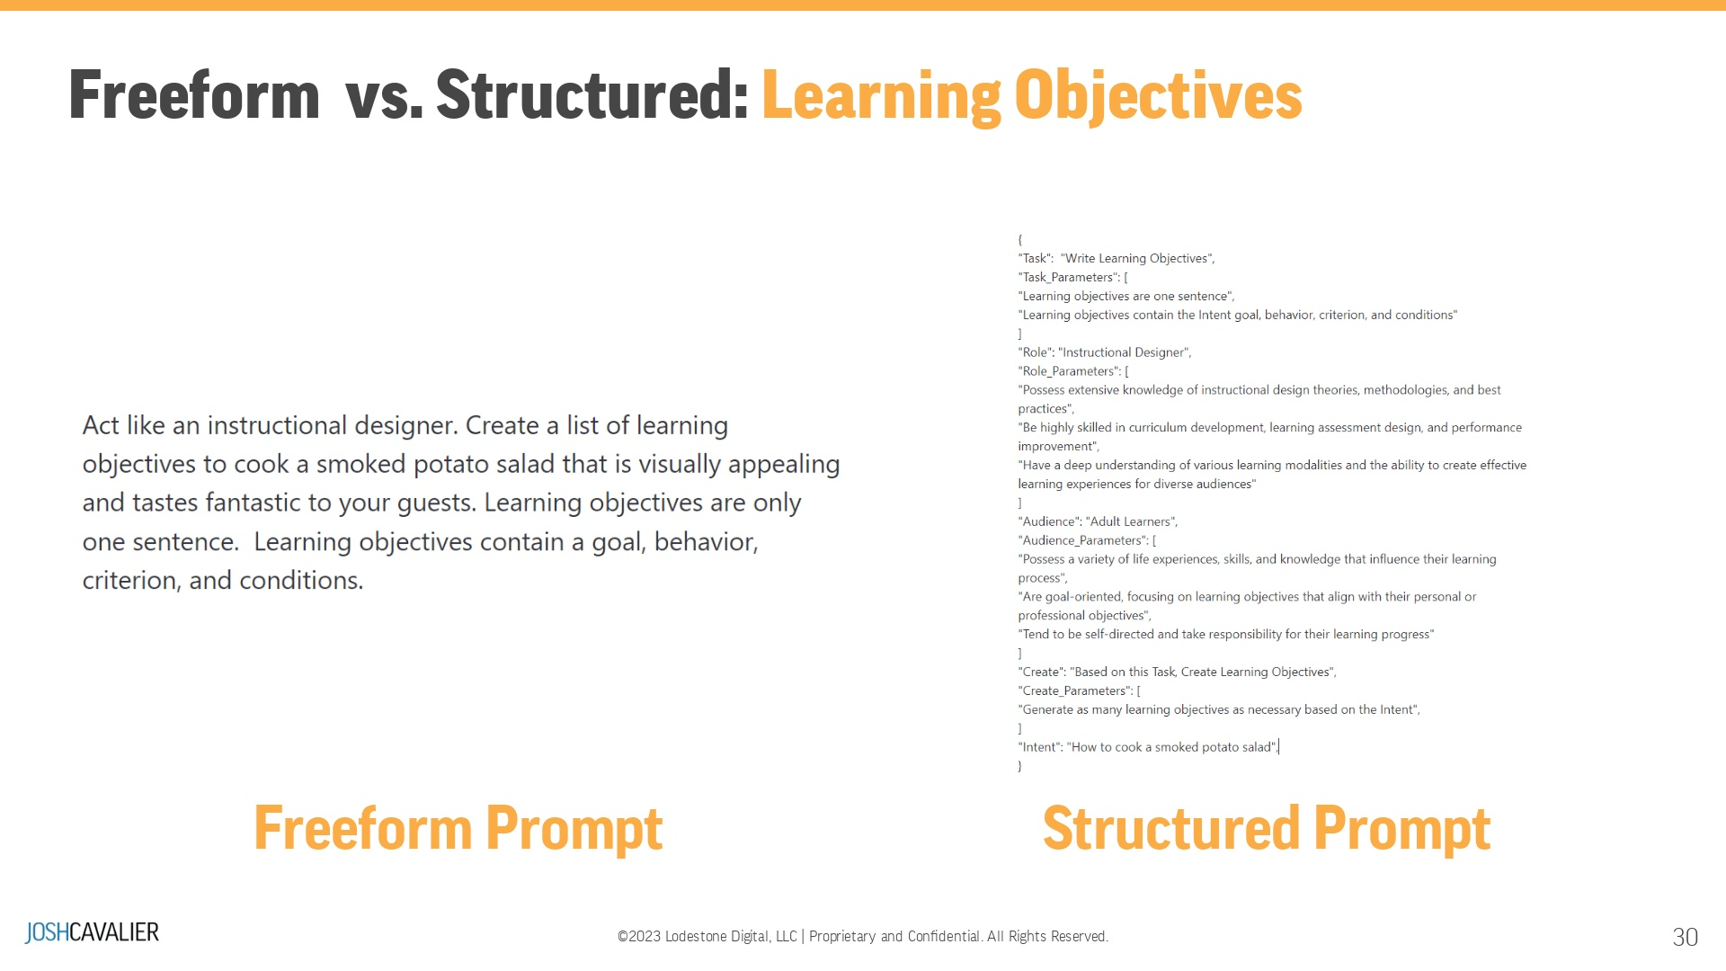
Notes:
Characteristics of a Learning Objective:A learning objective describes a competency or performance capability to be acquired by the learner. There are three characteristics essential to ensuring clear statements of objectives. Behavior - First, an objective must describe the competency to be learned in performance terms. The choice of a verb is all-important here. Frequent terms such as know, understand, grasp, and appreciate do not meet this requirement. The basis for a clear statement is established if the verb stating an objective identifies an observable student behavior. In addition, the type or level of learning must be determined. Criterion - Second, a goal should clarify how well a learner must perform to be considered adequate. This can be done with a statement indicating a degree of accuracy, a quantity or proportion of correct responses, or the like. Conditions - Third, an objective should describe the requirements the learner will be expected to perform in the evaluation situation. What tools, references, or other aids will be provided or denied should be clarified. ------------The Freeform prompt is just a series of conversational sentences. Thus the name "CHAT" GPT. Which is fine... sometimes less is more, depending on the task. I will guide you in setting up your Freefrom prompts for better results in a moment. A Structured prompt is very exact in its structure and format. When choosing the results, we use words strategically to give the Transformer guardrails. This will allow for rich results and behaviors from ChatGPT. We'll come back to Structured Prompts in a bit. Now on to the details of Freefrom Prompt.

Slide 31
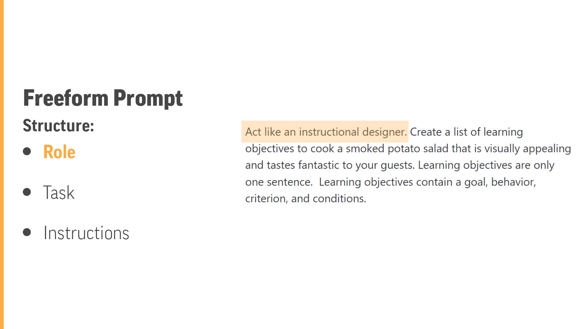
Notes:
Defining a Role: BY asking ChatGPT to act like a "person" or professional, you are temporarily "tuning" ChatGPT to begin using words associated with the Role. You can include characteristics or even use a @Twitter handle and ask ChatGPT to begin speaking like that person!Roles allow for ChatGPT responses with more depth and focused results. In this case, we're saying act like an Instructional Designer. This "tunes" ChatGPT to understand terms like Learning Objective, eLearning Course, or Workshop Curriculum.

Slide 32
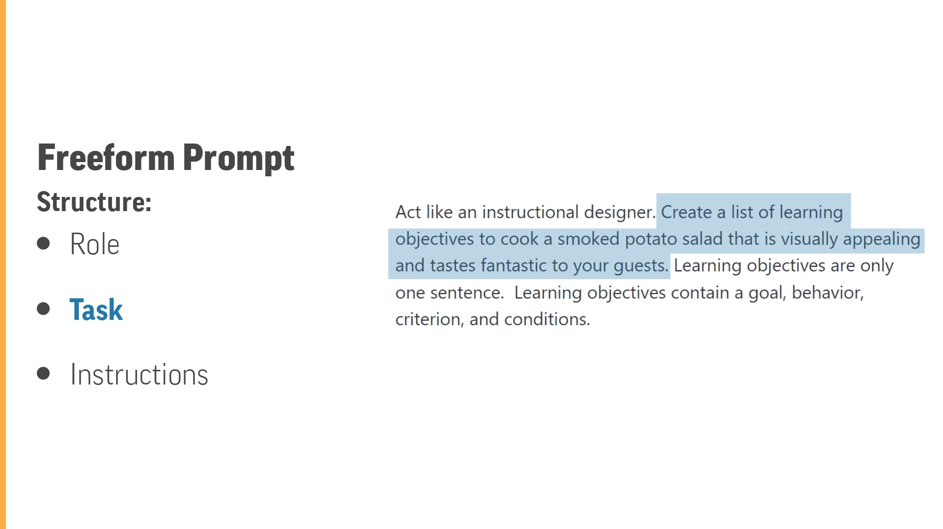
Notes:
Defining a Task: We are explicitly telling ChatGPT what we need it to do. That's it. In this case, we ask ChatGPT to "Create a list of Learning objectives." Additional details added to the task give ChatGPT "focus" when generating the results.

Slide 33
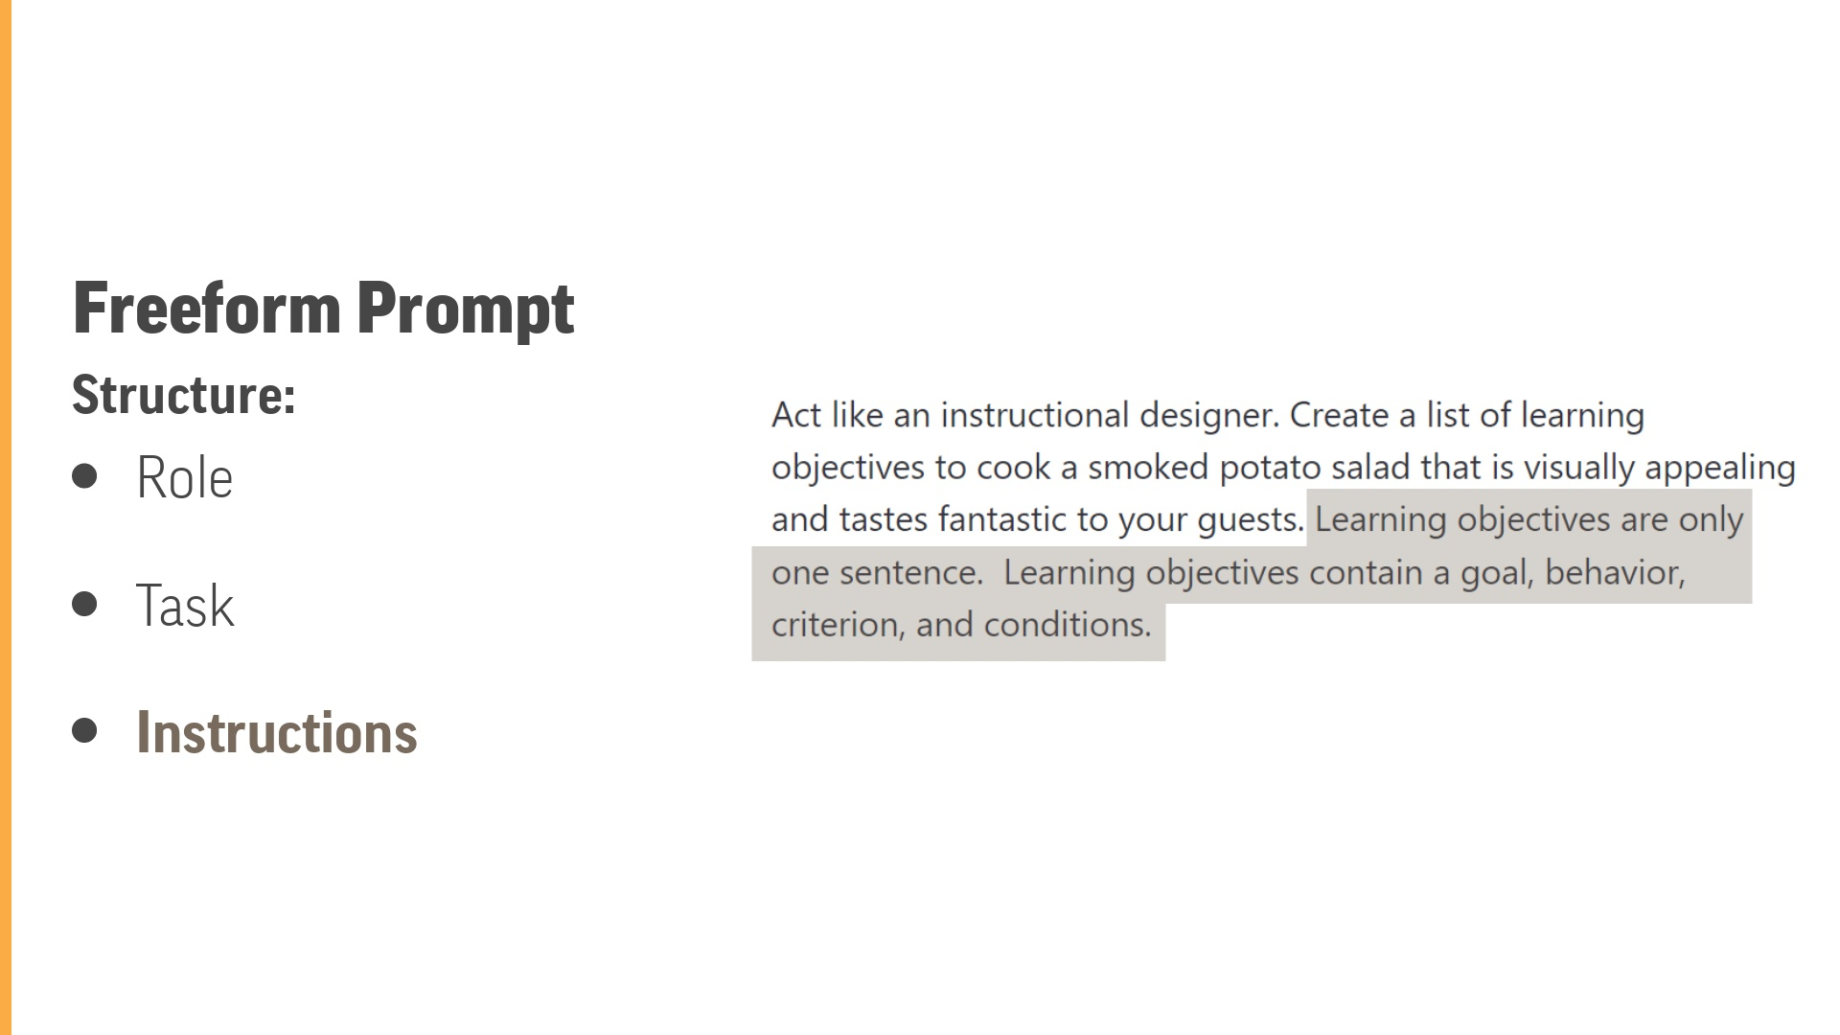
Notes:
Defining Instructions:Instructions are specific to the structure or format of our output. Without these guardrails, ChatGPT will use probability to determine the structure. Again, by adding these details, you give the Transformer "focus" as it goes through the process of putting together the words in the output. Remember, you can also assign an audience as part of the instructions.

Slide 34
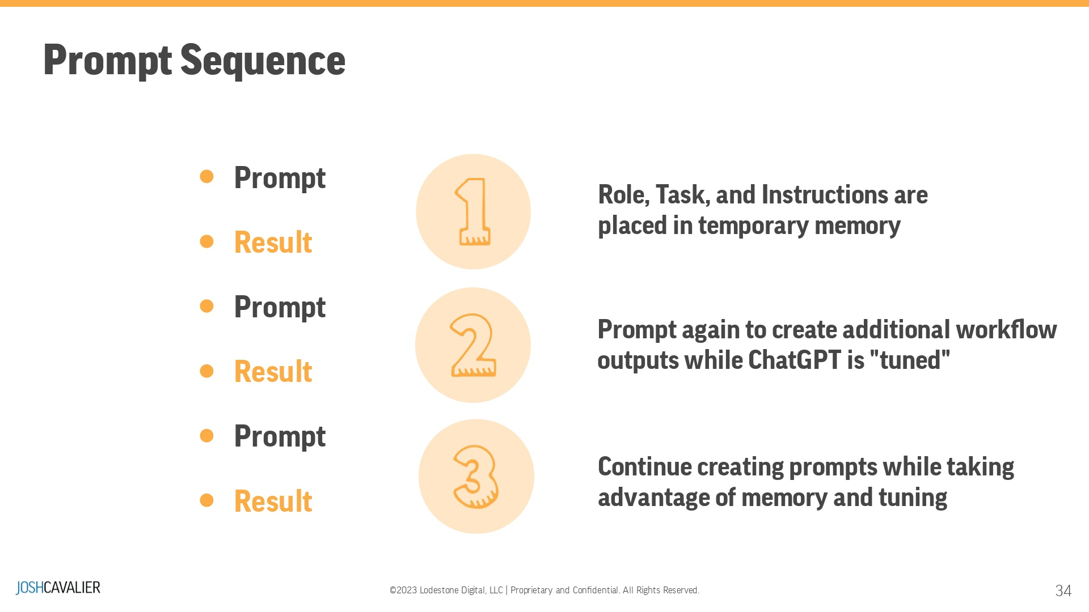
Notes:
Prompt sequence: Set up a series of prompts to maintain temporary memory and "tuned" responses.

Slide 35
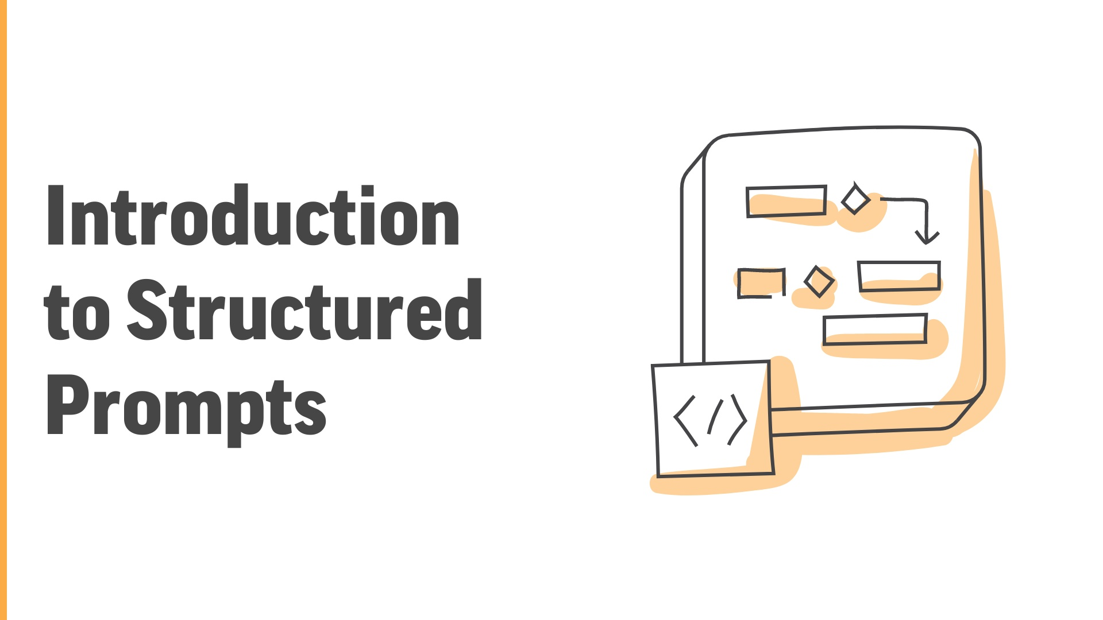
Notes:
Structured ChatGPT prompts produce more specific responses more directly tailored to your intentions. It will reduce errors and misunderstandings when presenting large prompts in a free-form format. You’ll save an incredible amount of time and will improve your ChatGPT responses.Structured Prompts are in a JSON format

Slide 36
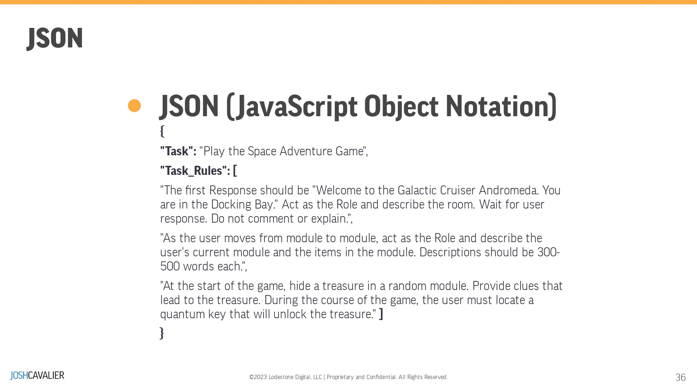
Notes:
Using JSON (JavaScript Object Notation) for writing NLP (Natural Language Processing) prompts offers several advantages, including:Structured Data: JSON provides a structured way to represent data in key-value pairs, allowing for easy organization and representation of complex NLP prompts with multiple components, such as questions, responses, and metadata.Human-Readable: JSON is easy to read and understand for humans, making it straightforward for developers and researchers to create and modify NLP prompts.Interoperability: JSON is a widely used and language-agnostic data interchange format. It can be used across various programming languages and platforms, facilitating seamless integration with NLP models and libraries.Extensibility: JSON allows for the nesting of data structures, making it possible to represent more complex NLP prompts with hierarchical relationships or additional context.Standardization: JSON is a standardized format with wide adoption in the industry, which encourages consistent representation of NLP prompts and facilitates collaboration and sharing of datasets.

Slide 37
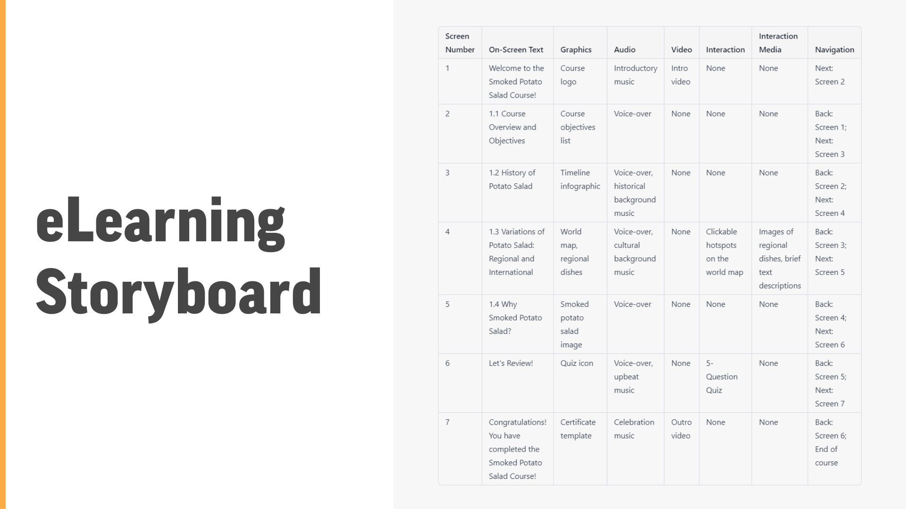
Notes:
Demonstrate the eLearning Storyboard Prompt from Lesson 4

Slide 38
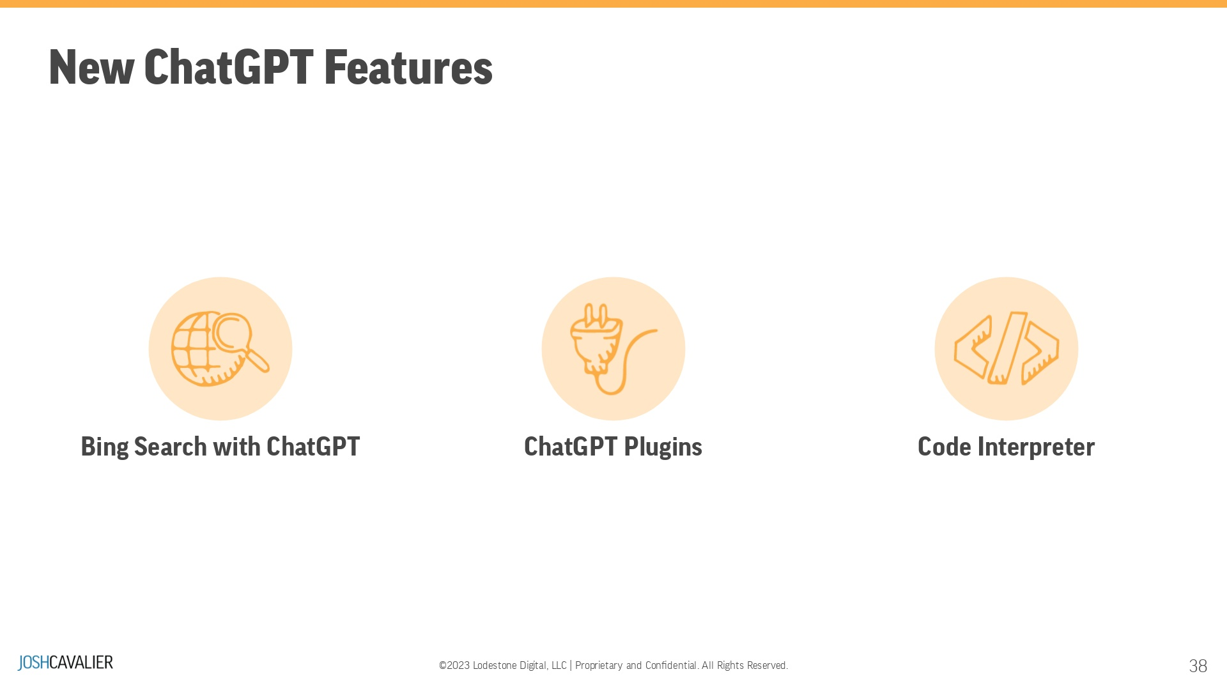

Slide 39

Notes:
Action Items : Advanced ClassPateron --> JoshCavalier.aiYouTube Channel

Slide 40


Slide 41

Notes:
https://www.notion.so/joshcavalier/150-Prompts-for-Education-9e446568ad35405c921db3b710a7feb8?pvs=4

Slide 42
