Slide 1
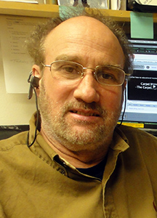
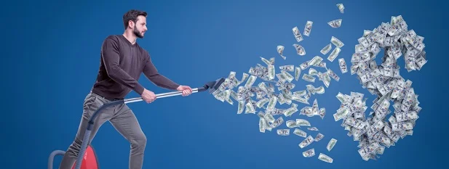

Profit Suckers in a Cleaning Business or Department
Cleaning Consultant Services. Inc.
Email: bg1@ccsmL.com
Phone: 206-849-0179
Web: www.cleaningconsultants.com
Wm R. Griffin, Consultant

Slide 2



https://www.cleanbuildingsconference.com/2024/

Slide 3

Questions and Discussion

Slide 4
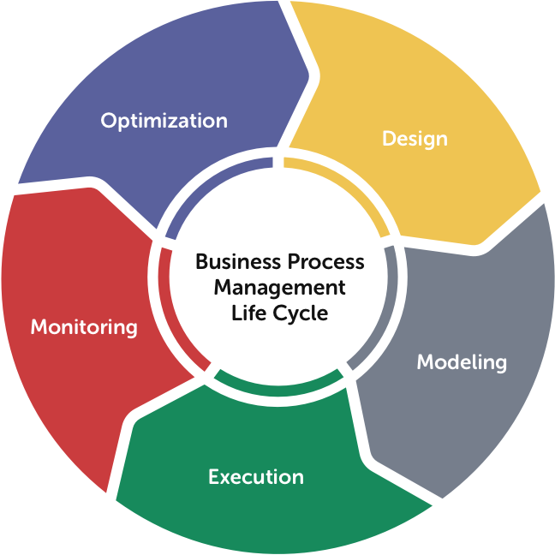
The Role of BPM
Role
To improve and manage a firm's end-to-end business processes to achieve outcomes crucial to a performance-based and customer-driven operation.
Outcome
Clarity on strategic direction,
Alignment of the firm's resources,
Increased discipline in daily operations.
Thank You For Coming
Thank You For Coming

Slide 5

The Five Stages of Business Process Management
Design.
Analyze the current state of the processes and devise an improvement plan accordingly.
1
Model.
Map out the entire process considering inputs/outputs and how the redesigned process operates in different scenarios.
2
Execute.
Implement improvements, by testing on a small scale to identify potential problems and allow for adjustments.
3
Monitor.
Establish a set of metrics to aid in identifying potential bottlenecks or areas of improvement.
4
Optimize.
Optimization is important because it helps achieve desired outcomes while reducing costs through continuous improvement.
5

Slide 6

Labor
Why – Majority of Cost – 55% – 85%
How – Inadequate Supervision and Management
Facts - Science and Engineered vs SWAG
Time Studies
Work Loading
Production Rates
Training for Supervision and Management

Slide 7

Taxes, Fees, Assessment
State, Federal, Municipal
Legal Accounting Principals
Do you Vote and Encourage Others to Vote?
Educate Yourself
Advisors and Consultants

Slide 8

Management and Supervision
Reactive vs Active
Lack of Ongoing Training
  When
  What
  How
Upward Mobility Opportunity – Ownership – Intrapreneurship/Entrepreneurship
Incentives and Environment
Reasonable Rewards
Transparency, Inclusivity and Engagement
Fun and Fair
Recognition
Challenging

Slide 9
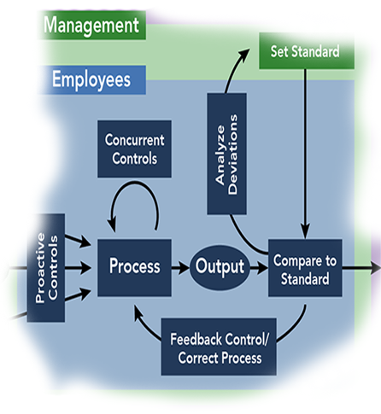
Lack of Management Controls
Policy
Procedures
Processes and Systems – Macro vs Micro
Engineer the Work – Who, What, When, and How long
Goals
Vision
Mission
Planning
Being in Business or Doing It for the Wrong Reasons

Slide 10

Management Tools for Success
Policies
Procedures
Quality Control Guidelines
Schedules
    Employee (Daily) Assignment Schedule
    Periodic tasks
    Inspections/Quality Control
    Training (initial and Ongoing, Mgt)
Blueprints/Floor Layout (11 x 17)
Short Staffing Plan
Budget Projection & Actual
Goals, Mission, Values

Slide 11
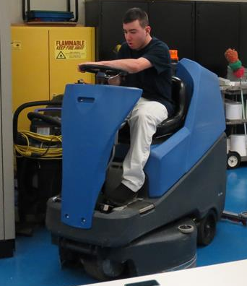
Inattention to Detail
Customers
Employees
Community – Internal and External
Trends
Costs
Profits
Marketing
Failing to Love What You Do
It’s Not About You
  Your Success Comes From What You Do for Others

Slide 12

Stopping the Blood Letting
Cleaning Industry Management Standard
(CIMS/GB Advanced by GBAC)
  Preventing Fires vs Fighting Fires
  Based on the Fundamentals' of Building and Operating a Successful
    Cleaning Business or Department
      Quality System
      Service Delivery
      Purchasing Procedures
      Human Resources
      Health, Safety and Environmental Stewardship
      Management Commitment
      Green Cleaning and Sustainability

Slide 13

Resources
Industry Associations
ISSA
IICRC
BSCAI
APPA
IFMA
BOMA
NWFA
Industry Standards
IICRC
ANSI
ASTM
Other
CMM
Google
YouTube
AI
Industry Publications, Blogs, Newsletters
Manufacturer’s and Distributor’s
Consultants
LinkedIn, Alignable, Others

Slide 14

Closing Comments
It’s Your Job/Opportunity and Responsibility
Do it or Someone Else Will – Fill the Vacuum
Continuous Process Improvement
Continuous Self Improvement – Strive to Learn and Improve Every Day
Technology
  Equipment
  Chemicals
  Processes
  Software
  AI

Slide 15
Questions and Discussion

Slide 16

Thank You
Wm R. Griffin, Consultant
Cleaning Consultant Services. Inc.
Email: bg1@ccsmL.com
Cell: 206-849-0179
Web: www.cleaningconsultants.com

